Slide 1
SIGNAL PROCESSING FOR
NEXT-GEN SEQUENCING DATA
Peaks
DNAse I-seq
CHIP-seq
Gene models
RNA-seq
RIP/CLIP-seq
Binding sites
FAIRE-seq
Transcripts

Slide 2
The Power of Next-Gen Sequencing
Chromosome Conformation Capture
+ More Experiments
DNA
Genome Sequencing
Exome Sequencing
DNAse I hypersensitivity
CHIP
CHART, CHirP, RAP
CLIP, RIP
CRAC
PAR-CLIP
iCLIP
Protein
RNA
RNA-seq
For more Seq technologies, see: http://liorpachter.wordpress.com/seq/

Slide 3
Next-Gen Sequencing as Signal Data
Map reads (red) to the genome. Whole pieces of DNA are black.
Count # of reads mapping to each DNA base → signal
Rozowsky et al. 2009 Nature Biotech
Notes:
Need better picture

Slide 4
Outline
Read mapping: Creating signal map
Finding enriched regions
  CHIP-seq: peaks of protein binding
RNA-seq: from enrichment to transcript quantification
Application: Predicting gene expression from transcription factor and histone modification binding
Isoform 1
Isoform 2

Slide 5
Read mapping
Problem: match up to a billion short sequence reads to the genome
Need sequence alignment algorithm faster than BLAST
Rozowsky et al. 2009 Nature Biotech

Slide 6
Read mapping (sequence alignment)
Dynamic programming
  Optimal, but SLOW
BLAST
  Searches primarily for close matches, still too slow for high throughput sequence read mapping
Read mapping
  Only want very close matches, must be super fast

Slide 7
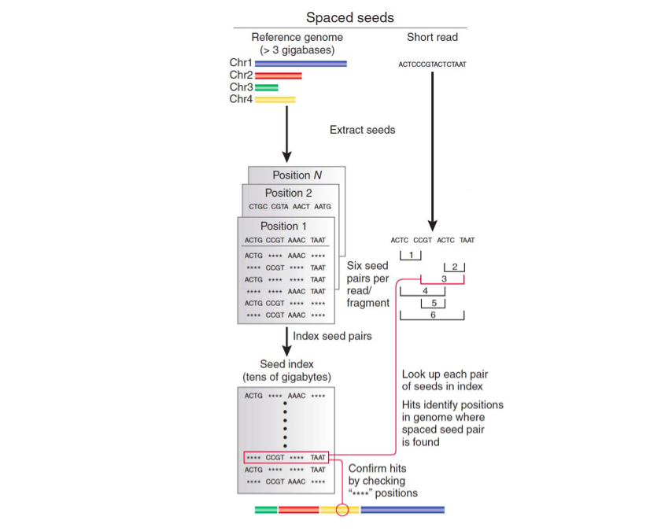
Index-based short read mappers
Similar to BLAST
Map all genomic locations of all possible short sequences in a hash table
Check if read subsequences map to adjacent locations in the genome, allowing for up to 1 or 2 mismatches.
Very memory intensive!
Trapnell and Salzberg 2009, Slide adapted from Ray Auerbach
Notes:
So memory intensive that you have to use regions of the genome as queries and index strings in groups of reads.

Slide 8
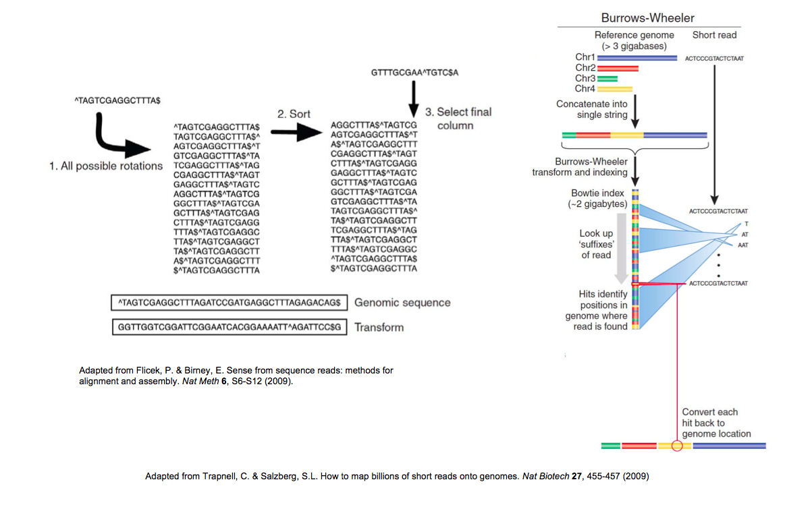
Read Alignment using Burrows-Wheeler Transform
Used in Bowtie, the current most widely used read aligner
Described in Coursera course: Bioinformatics Algorithms (part 1, week 10)
Trapnell and Salzberg 2009, Slide adapted from Ray Auerbach

Slide 9
Read mapping issues
Multiple mapping
Unmapped reads due to sequencing errors
VERY computationally expensive
  Remapping data from The Cancer Genome Atlas consortium would take 6 CPU years¹
Current methods use heuristics, and are not 100% accurate
These are open problems
¹https://twitter.com/markgerstein/status/396658032169742336

Slide 10
FINDing enriched regions: CHIP-seq data analysis
transcription factor
histone modification
Park 2009 Nature Reviews Genetics

Slide 11
CHIP-seq Intro
Determine locations of transcription factors and histone modifications.
The binding of these factors is what regulates whether genes get transcribed.
Park 2009 Nature Reviews Genetics

Slide 12
CHIP-seq protocol
DNA bound by histones and transcription factors
Target protein of interest with Antibody
Sequence DNA bound by protein of interest
Park 2009 Nature Reviews Genetics

Slide 13
CHIP-seq Data
# of sequence reads
Chromosomal region
Basic interpretation: Signal map to represents binding profile of protein to DNA
How do we identify binding sites from CHIP-seq signal “peaks”?
Park 2009 Nature Reviews Genetics
Notes:
Highlight that there are many different methods being used for CHIP-seq data analysis

Slide 14
“Naïve” CHIP-seq analysis
Background assumption: all sequence reads map to random locations within the genome
Divide genome into bins, distribution of expected frequencies of reads/bin is described by the Poisson distribution.
Assign p-value based on Poisson distribution for each bin based on # of reads
# of sequence reads
Chromosomal region
Rozowsky et al. 2009 Nature Biotech, Park 2009 Nature Reviews Genetics
Notes:
Would be nice to have a histogram of the reads/bin for a CHIP-seq data set, compared to the Poisson distribution

Slide 15
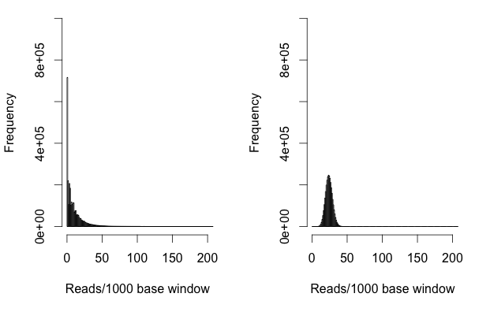
Is a Poisson background reasonable for CHIP-seq data?
Input
Poisson Distribution
“Input” is from a CHIP-seq experiment using an antibody for a non-DNA binding protein
ENCODE NF-Kb CHIP-seq data

Slide 16
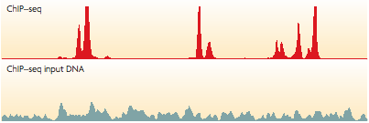
Is a Poisson background reasonable for CHIP-seq data?
“Input” experiment: Do CHIP-seq using an antibody for a protein that doesn’t bind DNA
There are also “peaks” in the input!
Park 2009 Nature Reviews Genetics

Slide 17
Peakseq
Rozowsky et al. 2009 Nature Biotech
Gerstein Lab

Slide 18
Determining protein binding sites by comparing CHIP-seq data with input
Candidate binding site
identification
Input normalization/
bias correction
Comparison of sample vs. input

Slide 19
Candidate binding site identification
Use Poisson distribution as background, as in the “naïve” analysis discussed earlier
Normalize read counts for mappability (uniqueness) of genomic regions
Use large bin size, finer resolution analysis later
Rozowsky et al. 2009 Nature Biotech

Slide 20
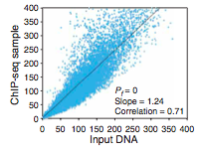
Input normalization
Normalize based on slope of least squares regression line.
Normalized reads = CHIP-seq reads/(slope*input reads)
Rozowsky et al. 2009 Nature Biotech
Notes:
Low quality image

Slide 21
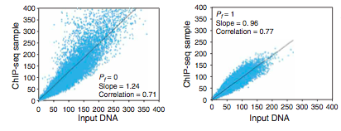
Input normalization
All data points
Candidate peaks removed
Using regression based on all data points (including candidate peaks) is overly conservative.
Rozowsky et al. 2009 Nature Biotech

Slide 22
Calling peaks vs. input
Binomial distribution
  Each genomic region is like a coin
  The combined number of reads is the # of times that the coin is flipped
  Look for regions that are “weighted” toward sample, not input
ENCODE NF-Kb CHIP-seq data
Notes:
Maybe expand this into two slides

Slide 23
Multiple Hypothesis Correction
Millions of genomic bins → expect many bins with p-value < 0.05!
How do we correct for this?

Slide 24
Multiple Hypothesis Correction
Bonferroni Correction
  Multiply p-value by number of observations
  Adjusts p-values → expect up to 1 false positive
  Very conservative

Slide 25
Multiple Hypothesis Correction
False discovery rate (FDR)
  Expected number of false positives as a percentage of the total rejected null hypotheses
  Expectation[false positives/(false positives+true postives)]
q-value: maximum FDR at which null hypothesis is rejected.
Benjamini-Hochberg Correction
  q-value = p-value*# of tests/rank

Slide 26
Is PeakSeq an optimal algorithm?

Slide 27
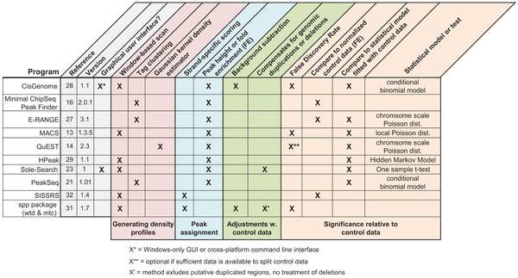

Many other CHIP-seq “peak”-callers
Wilbanks EG, Facciotti MT (2010) Evaluation of Algorithm Performance in ChIP-Seq Peak Detection. PLoS ONE 5(7): e11471. doi:10.1371/journal.pone.0011471
http://www.plosone.org/article/info:doi/10.1371/journal.pone.0011471
Notes:
Even more now!

Slide 28
CHIP-seq summary
Method to determine DNA binding sites of transcription factors or locations of histone modifications
Must normalize sequence reads to experimental input
Search for signal enrichment to find peaks
  Peakseq: binomial test + Benjamini-Hochberg correction
  Many other methods

Slide 29
RNA-SEQ: GOING BEYond enrichment

Slide 30
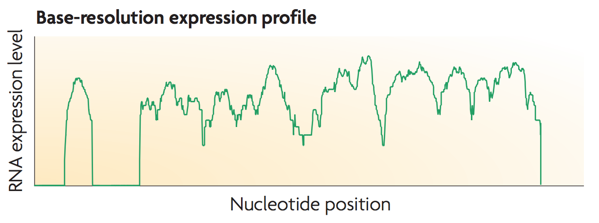
RNA-seq
Searching for “peaks” not enough:
Are these “peaks” part of the same RNA molecule?
How much of the RNA is really there?
Wang et al Nature Reviews Genetics 2009

Slide 31
Background: RNA splicing
intron
exon
pre-mRNA must have introns spliced out before being translated into protein.
The components that are retained in the mature mRNA are called exons

Slide 32
Background: alternative splicing
intron
exon
Alternative splicing leads to creation of multiple RNA isoforms, with different component exons.
Sometimes, exons can be retained, or introns can be skipped.
Isoform 1
Isoform 2

Slide 33
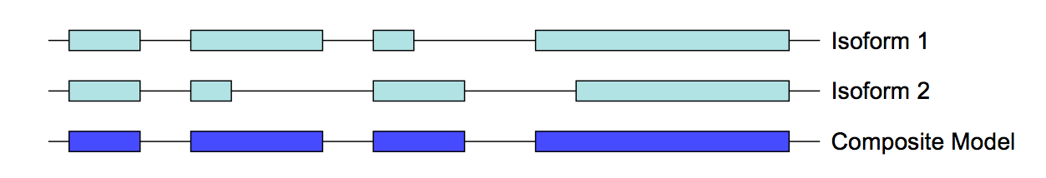
Simple quantification
Count reads overlapping annotations of known genes
Simplest method: Make composite model of all isoforms of gene
Quantification: Reads per kilobase per million reads (RPKM)

Slide 34
Isoform Quantification
Map reads to genome
How do we assign reads to overlapping transcripts?

Slide 35
Isoform Quantification
Simple method: only consider unique reads

Slide 36
Isoform Quantification
Simple method: only consider unique reads
Problem: what about the rest of the data?

Slide 37
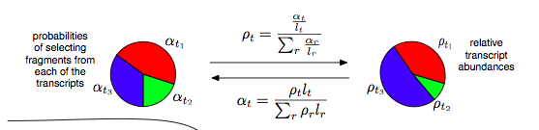
Expectation Maximization Algorithm
Assign reads to isoforms to maximize likelihood of generating total pattern of observed reads.
0. Initialize (expectation): Assign reads randomly to isoforms based on naïve (length normalized) probability of the read coming from that isoform (as opposed to other overlapping isoforms)
Lior Pachter 2011 ArXiv

Slide 38
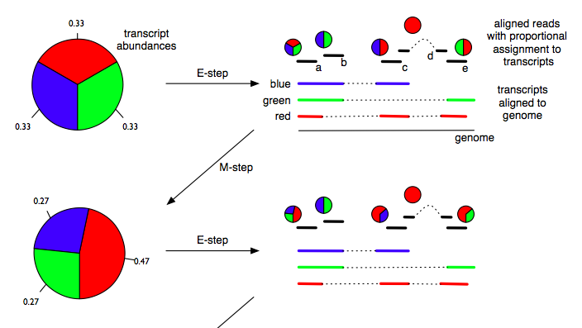
Expectation Maximization Algorithm
1. Maximization: Choose transcript abundances that maximize likelihood of the read distribution (Maximization).
Lior Pachter 2011 ArXiv

Slide 39
Expectation Maximization Algorithm
2. Expectation: Reassign reads based on the new values for the relative quantities of the isoforms.
Lior Pachter 2011 ArXiv

Slide 40
Expectation Maximization Algorithm
3. Continue expectation and maximization steps until isoform quantifications converge (it is a mathematical fact that this will happen).
Lior Pachter 2011 ArXiv

Slide 41
Detecting new transcripts
Search for “peaks”:
Reads that overlap splice junctions→peaks part of same transcript
Special sequencing techniques to find ends of transcripts
Still a major open area of research
Wang et al Nature Reviews Genetics 2009

Slide 42
RNA-Seq conclusions
RNA-Seq is a powerful tool to identify new transcribed regions of the genome and compare the RNA complements of different tissues.
Quantification harder than CHIP-seq because of RNA splicing
Expectation maximization algorithm can be useful for quantifying overlapping transcripts

Slide 43
Comparing Genome-wide signals

Slide 44
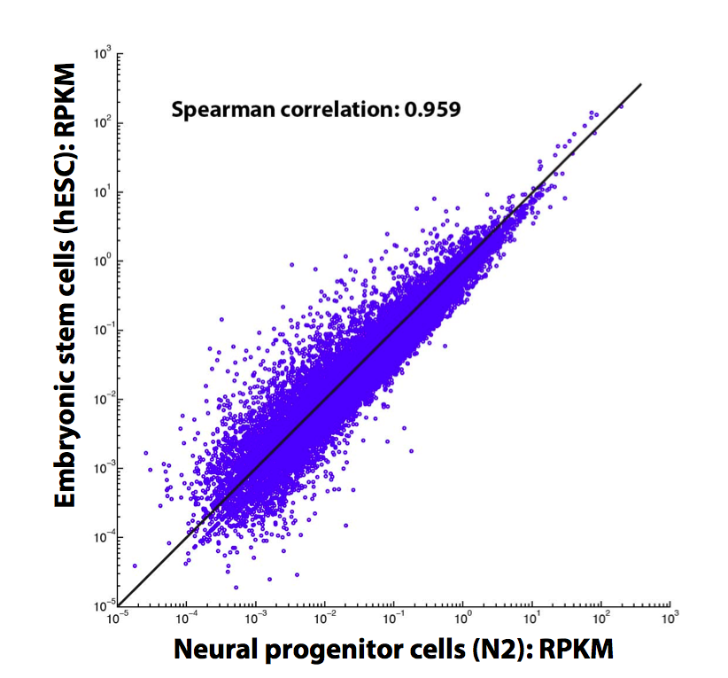
RNA-seq Expression Correlation
Correlate expression between tissues
Slide adapted from L Habegger

Slide 45
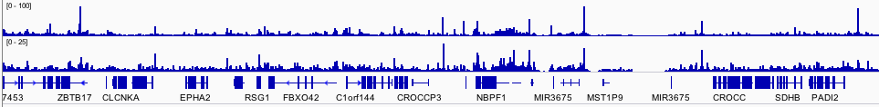
CHIP-seq signals of interacting proteins
Fos and Jun, which interact physically, have similar binding profiles at many genomic loci.
Fos
Jun
Data from ENCODE Consortium, figure by me

Slide 46
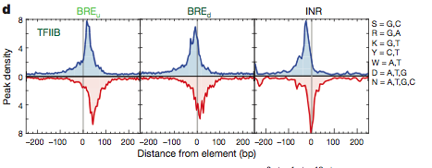
Signal aggregation
Sum signals from all genomic locations of a certain type
  Here: CHIP seq signal at fixed distances from protein binding motif
Venters and Pugh Nature 2013
Notes:
Use different example

Slide 47
Predicting gene expression with chip-seq data

Slide 48

Relating gene expression with histone modification and TF binding signals
“Input”
To what extent the gene expression levels are determined by TF binding/ HM modification?
Histone modification
TF Binding signal
Predictive models
Gene expression levels
“Output”
Slide by Chao Cheng

Slide 49
Setting up the model
1. Divide area around gene into bins according to distance to trascription start and end sites
TSS (transcription start site)
TTS (transcription terminal site)
Gene k
40
1
80
120
81
4 …
41 ….44
121
160
Bin 40-1
(TSS-4kb to TSS)
Bin 41-80
(TSS to TSS+4kb)
Bin 120-81
(TTS-4kb to TTS)
Bin 121-160
(TTS to TTS+4kb)
Slide by Chao Cheng

Slide 50
Setting up the model
2. Collect histone modification data for each bin, and for each gene
TSS (transcription start site)
TTS (transcription terminal site)
Gene k
40
1
80
120
81
4 …
41 ….44
121
160
Bin 40-1
(TSS-4kb to TSS)
Bin 41-80
(TSS to TSS+4kb)
Bin 120-81
(TTS-4kb to TTS)
Bin 121-160
(TTS to TTS+4kb)
Chromatin features:
Histone modifications
Predictors
~10000 refseq genes
HM1, 2, 3, ……
Bin 1
Bin 2
……
Bin160
Slide by Chao Cheng

Slide 51
Setting up the model
3. Train model to “learn” relationship between CHIP-seq and RNA-seq data.
TSS (transcription start site)
TTS (transcription terminal site)
Gene k
40
1
80
120
81
4 …
41 ….44
121
160
RNA-Seq data
Bin 40-1
(TSS-4kb to TSS)
Bin 41-80
(TSS to TSS+4kb)
Bin 120-81
(TTS-4kb to TTS)
Bin 121-160
(TTS to TTS+4kb)
Prediction target:
Gene expression level
Chromatin features:
Histone modifications
Predictors
~10000 refseq genes
HM1, 2, 3, ……
Bin 1
Bin 2
……
Bin160
Slide by Chao Cheng

Slide 52
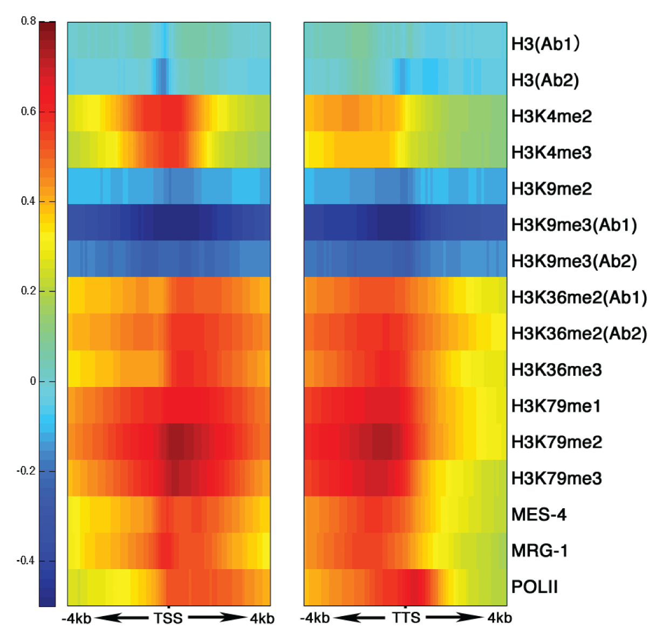
His. mods around TSS & TTS are clearly related to level of gene expression, in a position-dependent fashion
START
STOP
TTS
Slide by Chao Cheng
Gerstein*,…, Cheng* et al. 2010, Science
Correlation between Signal and expression

Slide 53
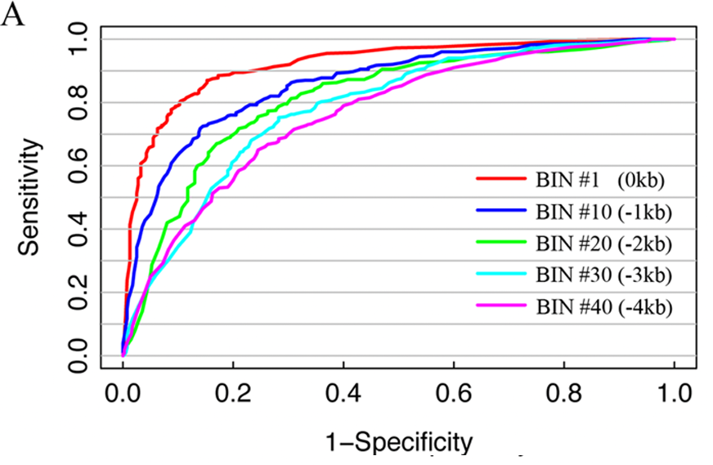
Support vector machine to classify genes with high, medium and low expression
Areas close to gene predict expression better
Slide by Chao Cheng

Slide 54
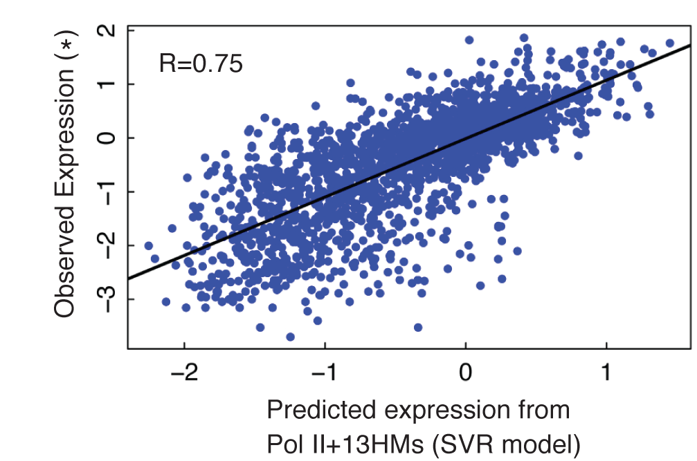
Support vector regression to predict gene expression levels
Slide by Chao Cheng
Notes:
Cite Cheng et al. Genome Research 2013

Slide 55
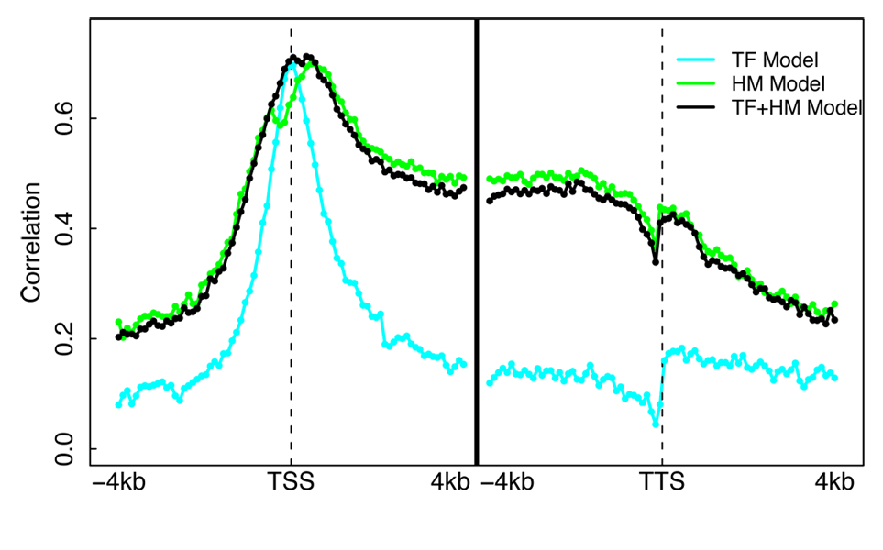
Mouse ESC Models Illuminates Different Regions of Influence for TFs vs HMs
Datasets
  ChIP-Seq for 12 TFs
  (Chen et al. 2008)
  ChIP-Seq for 7 HMs
  (Meissner et al.’08; Mikkelsen et al. ’07)
  RNA-Seq (Cloonan et al. 2008)
A TF+HM model that combine TF and HM features does NOT improve accuracy!
Cheng et al. 2011, Nucleic Acids Res.
Slide by Chao Cheng

Slide 56
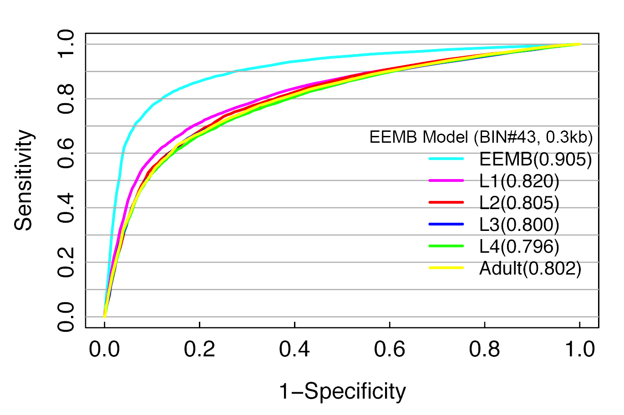
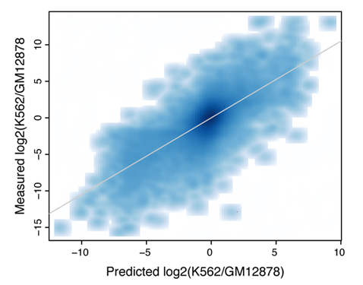
TF and HM models are tissue specific
PCC=0.73
HM model-- Best prediction is achieved by using histone modification and expression data from the same developmental stage
TF model– differential TF binding signals are predictive of differential expression levels between two human cell lines
Slide by Chao Cheng
Cheng et al. 2011, Genome Biology (a)

Slide 57
Summary: relate TF/HM signals with expression
TF/HM signals are highly predictive to gene expression
TF and HM signals are redundant for ‘predict’ gene expression
TF and HM models are tissue/cell line specific
microRNA expression can also be predicted
Slide by Chao Cheng
Gerstein et al. 2010, Science
Cheng et al. 2011, Nucleic Acids Res.
Cheng et al. 2011, Genome Biology (a)

Slide 58
Conclusions
Diverse sequencing experiments have common analysis elements, based on signal processing.
Proper statistics key to making claims about NGS data.
Integrating many genome-wide experiments through machine learning can yield useful inferences about biology.

