Slide 1

Genomics II:
Applications of high-throughput sequencing
Jim Noonan
Department of Genetics

Slide 2
Outline
Functional analysis of biological systems using sequencing
Regulatory element discovery: ChIP-seq, etc.
Chromatin state profiling and the ‘histone code’
Transcriptome analysis: RNA-seq
Genetic basis of common human diseases
Variant discovery and interpretation
Genome reduction strategies (exome sequencing)

Slide 3
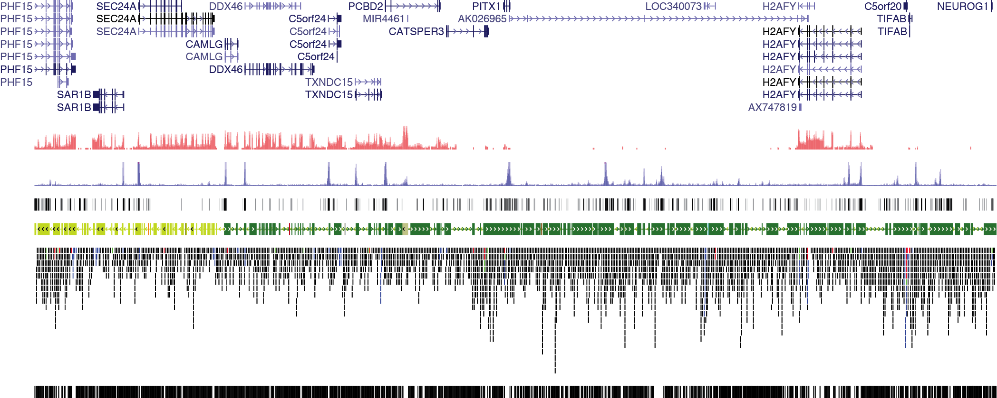
Identifying regulatory functions in genomes
Chr5: 133,876,119 – 134,876,119
Genes
Transcription
Regulatory elements are not easily detected by sequence analysis
Examine biochemical correlates of RE activity in cells/tissues:
  Chromatin Immunoprecipitation (ChIP-seq)
  DNase-seq and FAIRE
  Methylated DNA immunoprecipitation (MeDIP)

Slide 4
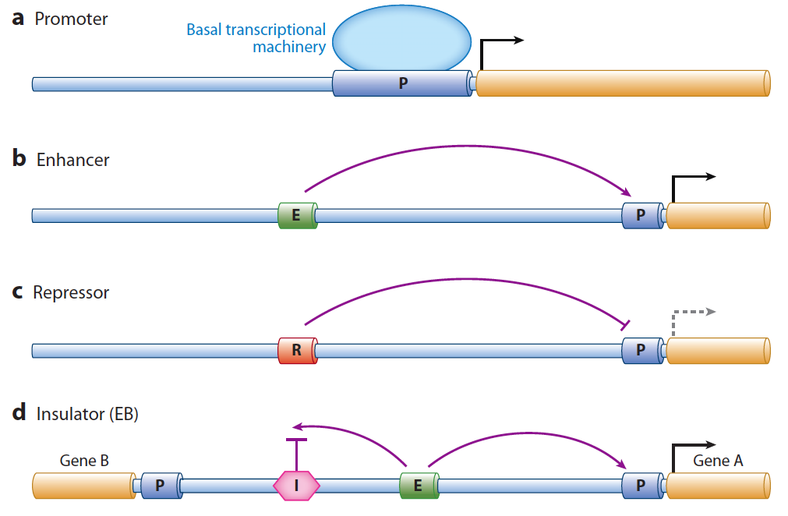
Identifying regulatory functions in genomes
Noonan and McCallion, Ann Rev Genomics Hum Genet 11:1 (2010)
Notes:
Merge into general discussion of regulatory space - regulomics

Slide 5
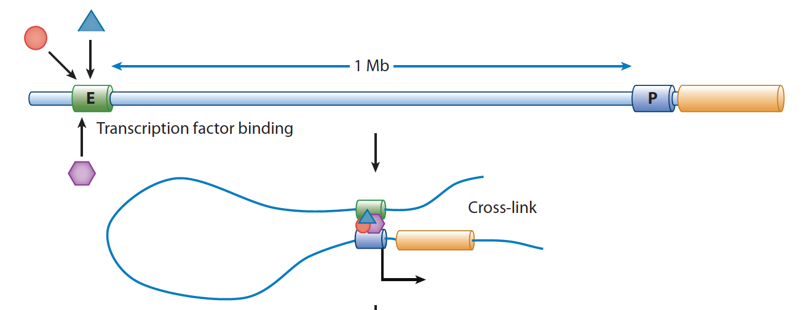

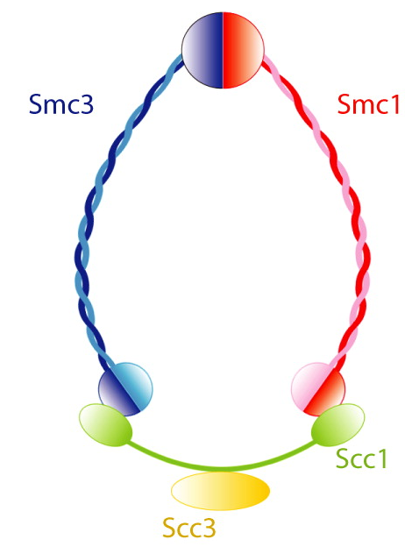
Biochemical indicators of regulatory function
1. TF binding
2. Histone
modification
H3K27ac
H3K4me3
3. Chromatin
modifiers &
coactivators
p300
MLL
4. DNA looping
factors
cohesin

Slide 6
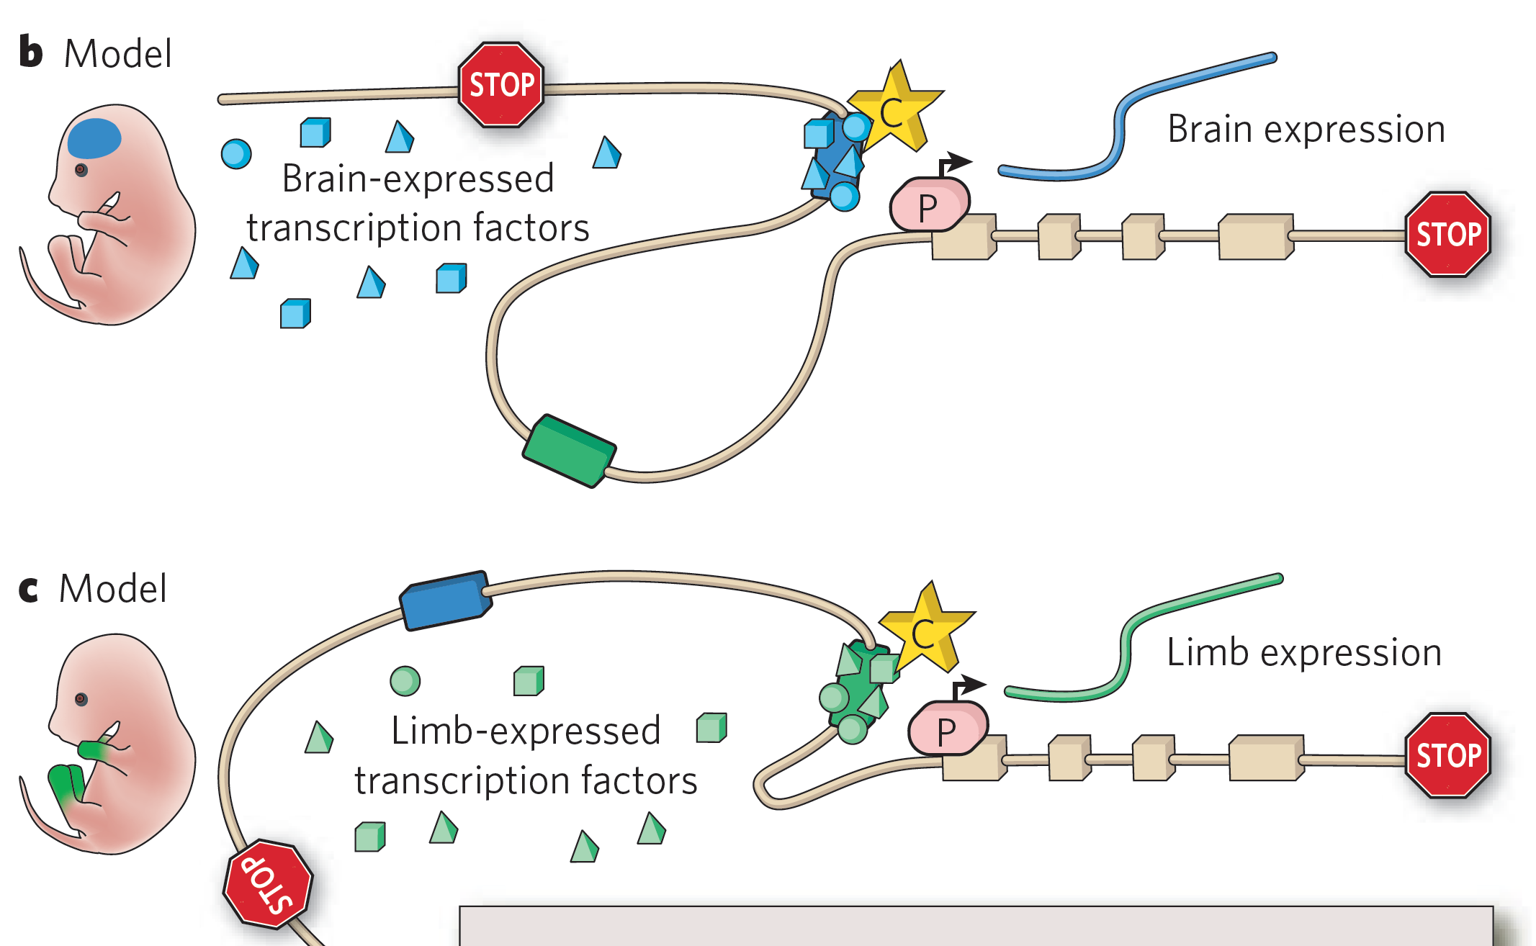
Regulatory functions are tissue/cell type/time point-specific
From Visel et al. (2009) Nature 461:199

Slide 7
Identifying regulatory functions in genomes
Chr5: 133,876,119 – 134,876,119
Genes
Transcription
Histone mods
TF binding

Slide 8
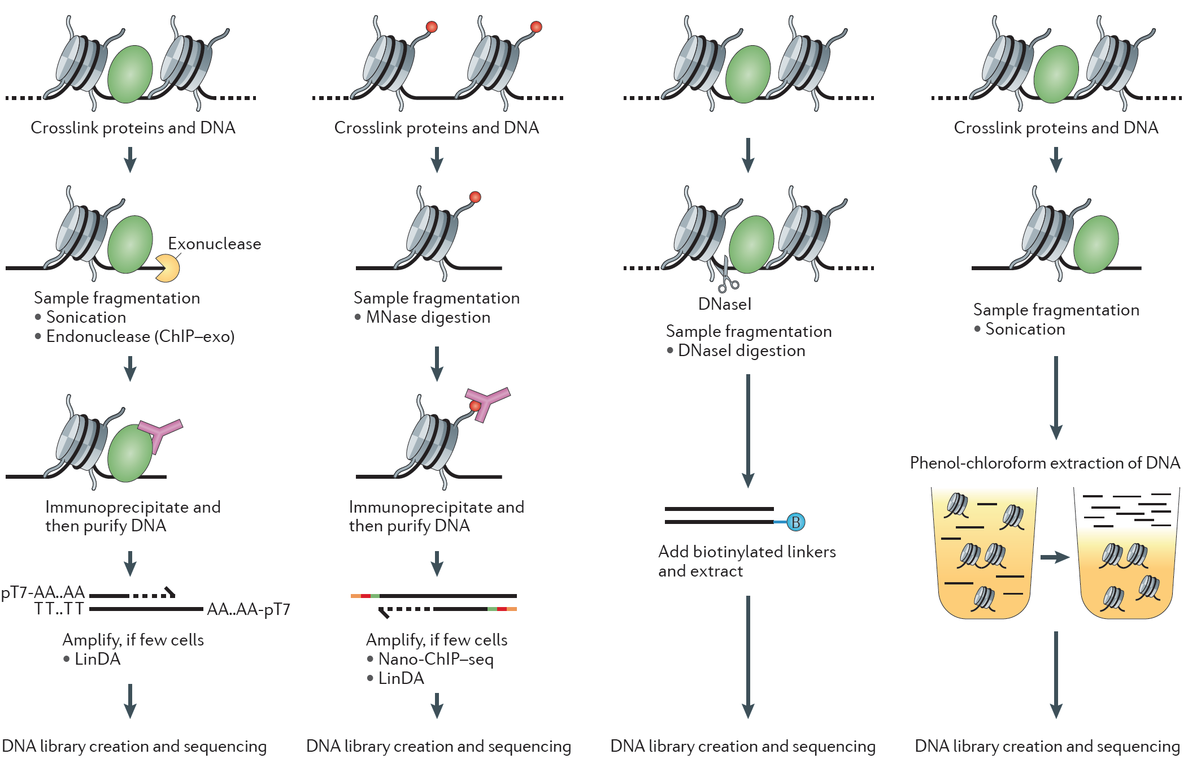
Methods
ChIP-seq
Chromatin accessibility
TFs
Histone mods
DNase
FAIRE
From Furey (2012) Nat Rev Genet 13:840

Slide 9
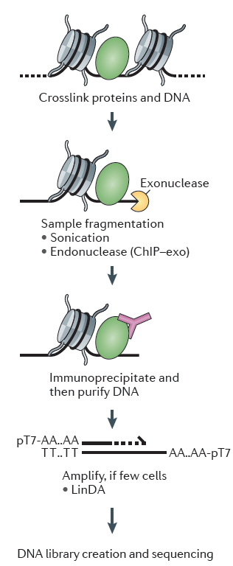
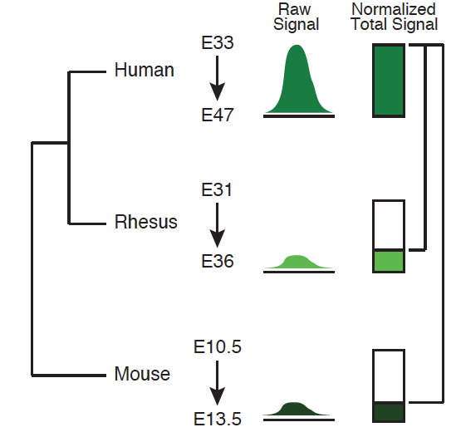
ChIP-seq
ChIP
Peak call
Signal
Input
Align reads to reference
Use peaks of mapped reads to
identify binding events
PCR

Slide 10
Calling peaks in ChIP-seq data
ChIP
Peak call
Enrichment
relative to control
Input
ChIP-seq is an enrichment method
Requires a statistical framework for determining the significance of enrichment
ChIP-seq ‘peaks’ are regions of enriched read density relative to an input control
Input = sonicated chromatin collected prior to immunoprecipitation
Notes:
Highlight the challenges for both ChIP and RNA-seq in both protocols

Slide 11
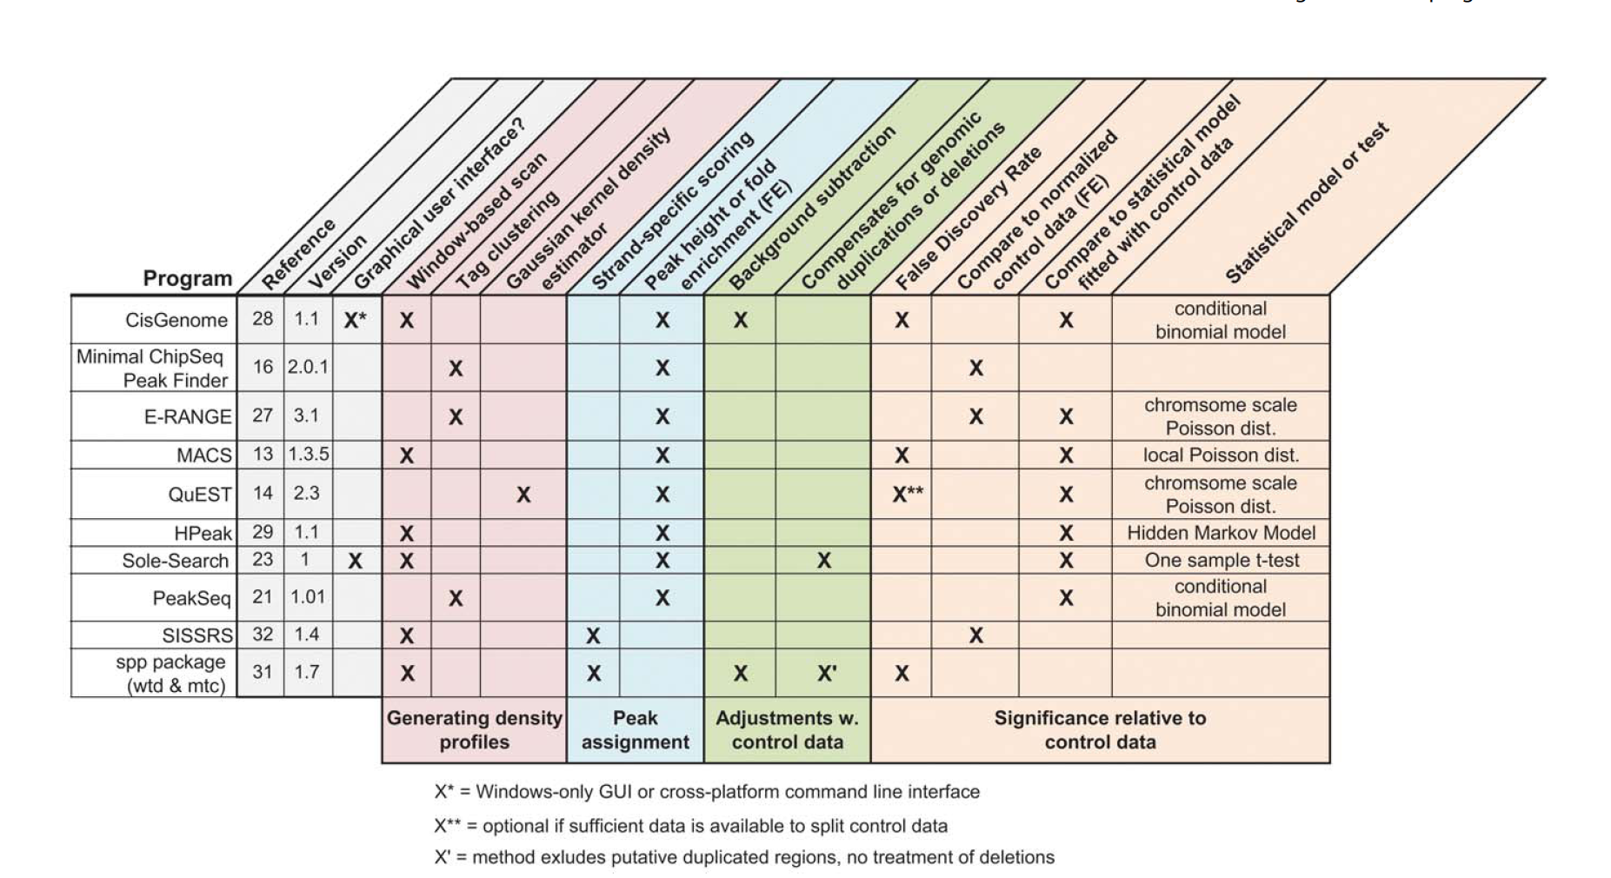
There are many ChIP-seq peak callers available
Wilbanks and Facciotti PLoS ONE 5:e11471 (2010)

Slide 12
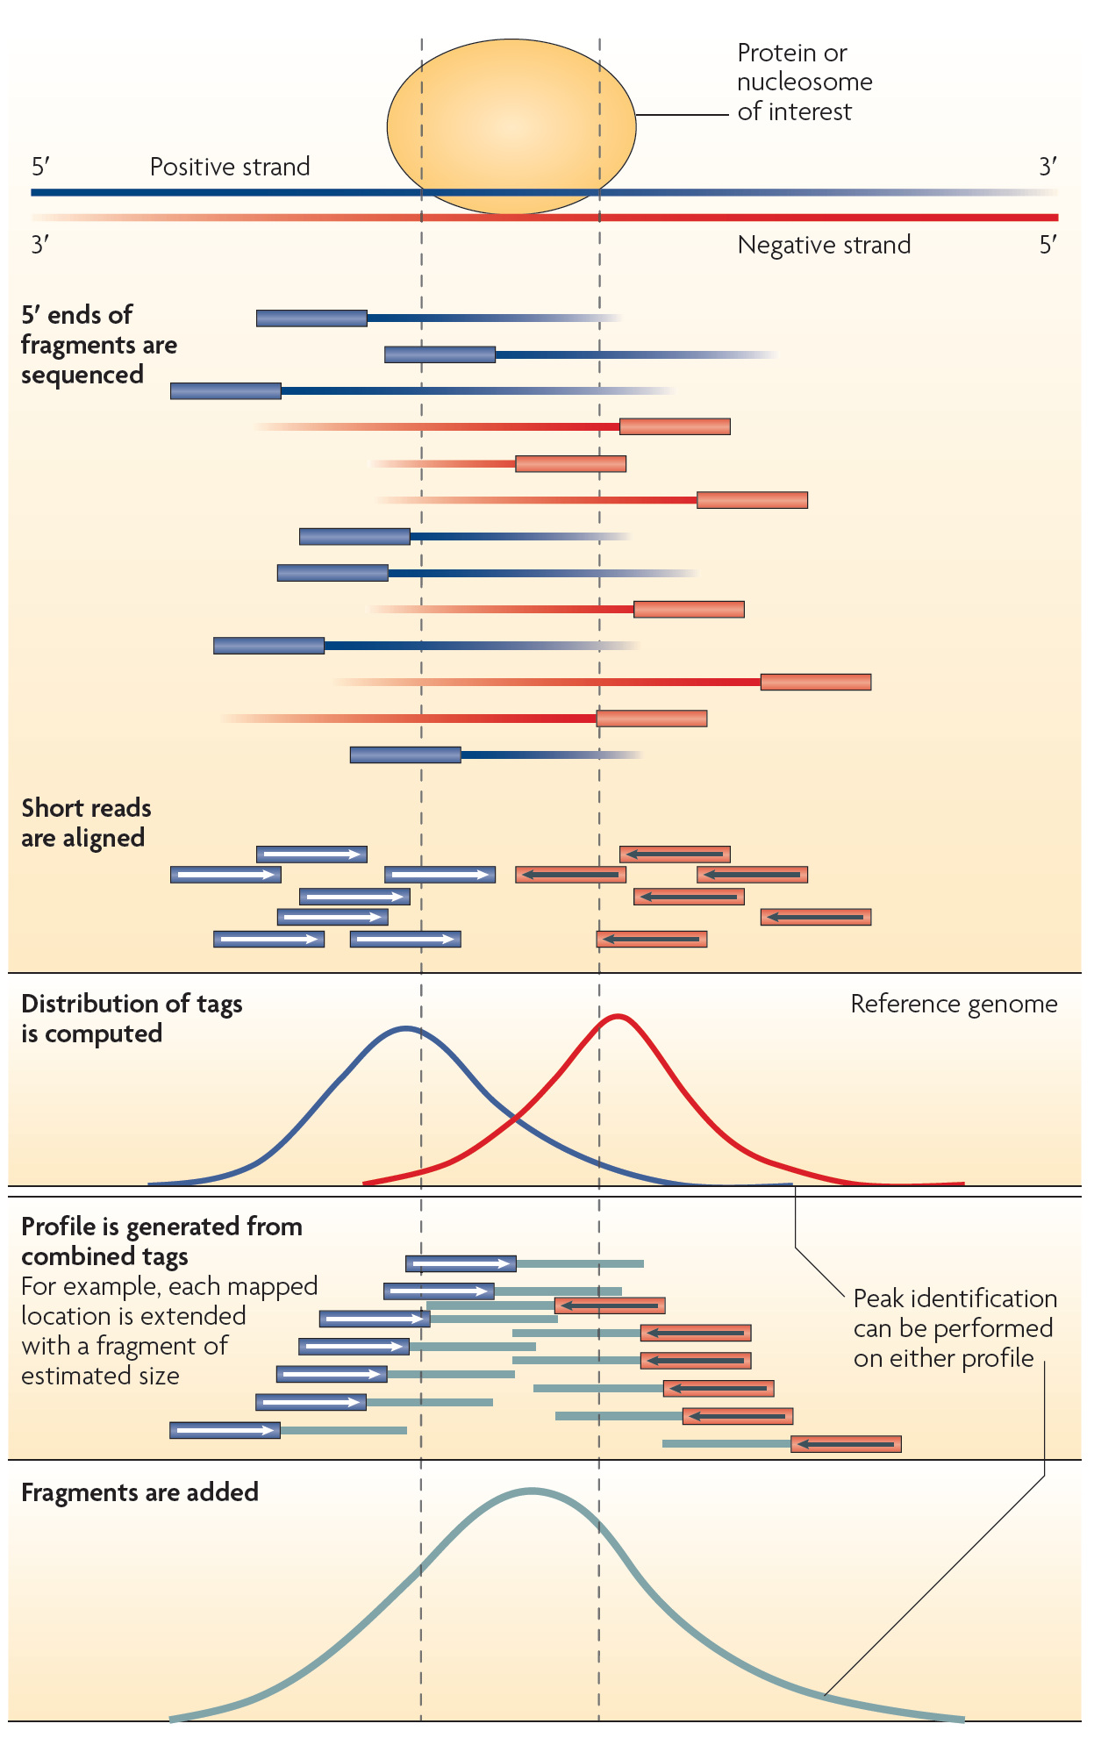
Generating ChIP-seq peak profiles
Artifacts:
Repeats
PCR duplicates
From Park (2009) Nat Rev Genet 10:669

Slide 13
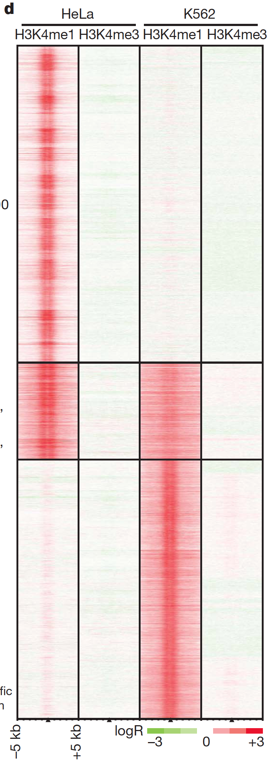
Quantitative analysis of ChIP-seq signal profiles
HeLa
K562
HeLa
Sites strongly
marked in HeLa
Sites
strongly marked
in both
Signal at 20,000 bound sites
Clustering
ChIP-seq
signal
Sites
strongly
marked
in K562
Notes:
signal

Slide 14
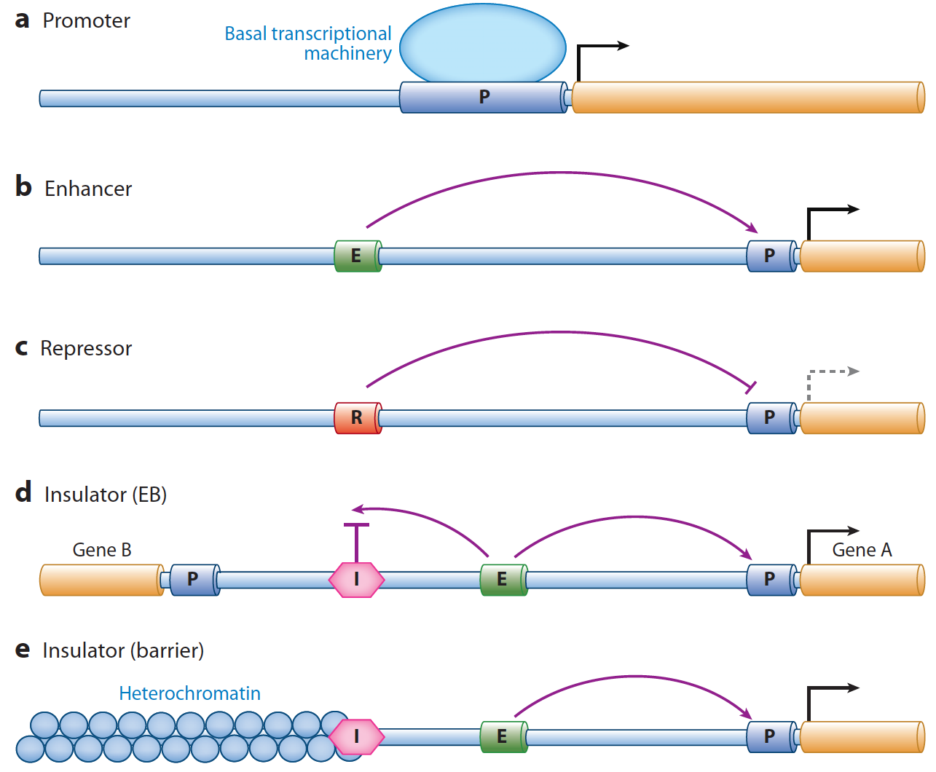
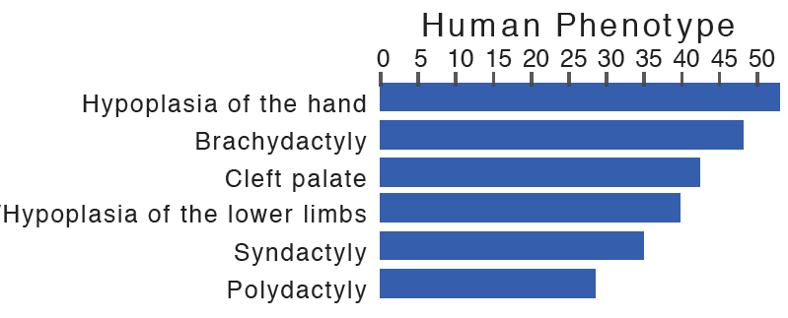
Discovering regulatory functions specific to a biological state
Limb
Brain
Function?
Assign enhancers to genes based on proximity (not ideal)
GREAT: bejerano.stanford.edu/great/
Gene ontology annotation assigned to regulatory sequences

Slide 15
Single TF binding events may not indicate regulatory function
Many TFs are present at high concentrations
in the nucleus
TF motifs are abundant in the genome
Single TF binding events may be incidental
Enhancer-associated
histone modification
Notes:
Combinations of marks/TF binding events

Slide 16
Biochemical indicators of regulatory function
1. TF binding
2. Histone
modification
H3K27ac
H3K4me3
3. Chromatin
modifiers &
coactivators
p300
MLL
4. DNA looping
factors
cohesin

Slide 17
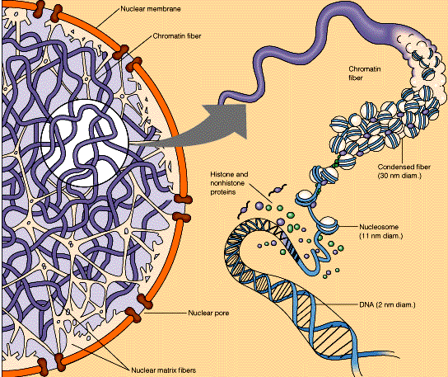
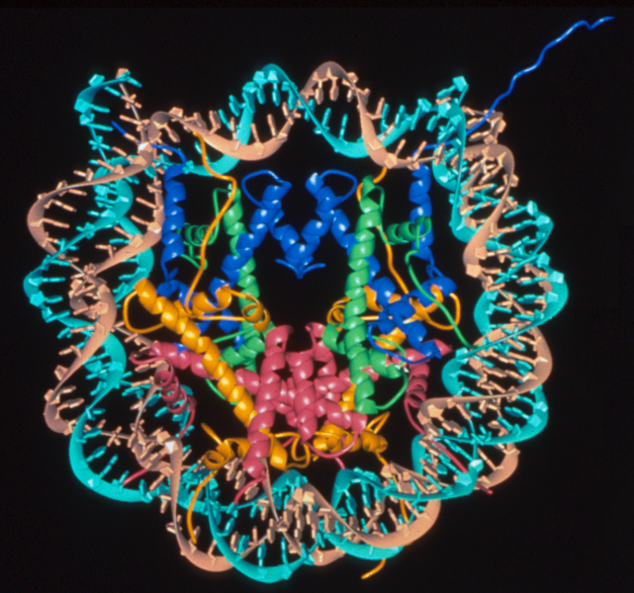
Chromatin structure
nucleosome
H2A
H3
H2B
H4
H3 tail
Luger, Richmond & colleagues 1997

Slide 18
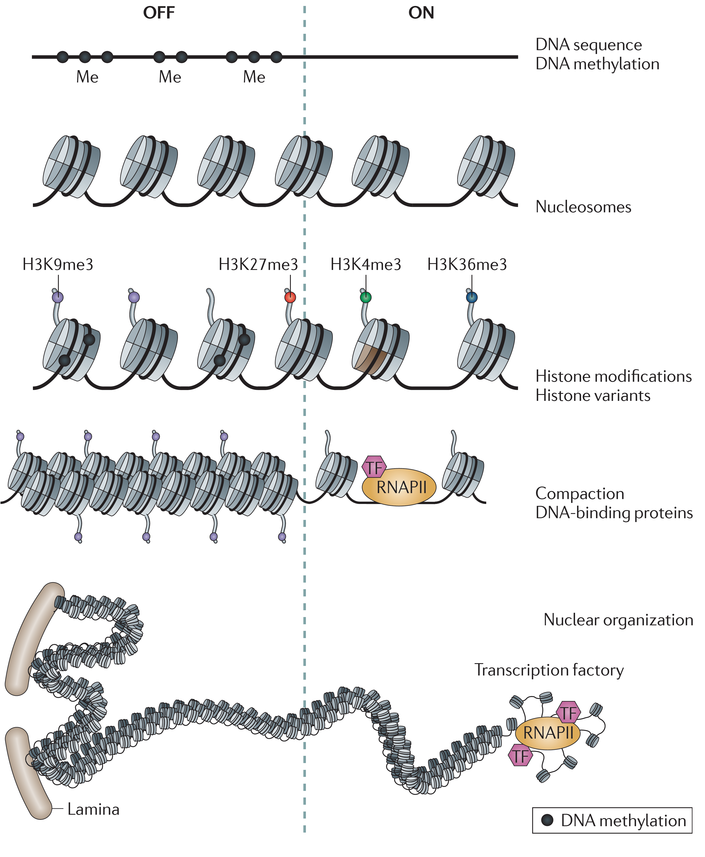
Chromatin structure
Zhou et al. Nat Rev Genet
12:7 (2011)

Slide 19
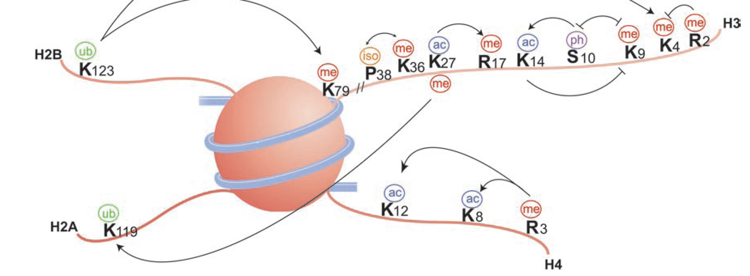
Covalent modifications on histones
me = methylation
ac = acetylation
ph = phosphorylation
ub = ubiquitination
H3 K27 ac
Histone
Residue
Modification
From Bannister and Kouzarides (2011) Cell Res 21:381

Slide 20
Covalent modifications on histones
me = methylation
ac = acetylation
ph = phosphorylation
ub = ubiquitination
H3 K27 me3
Histone
Residue
Modification
From Bannister and Kouzarides (2011) Cell Res 21:381
Notes:
Writers and erasers

Slide 21
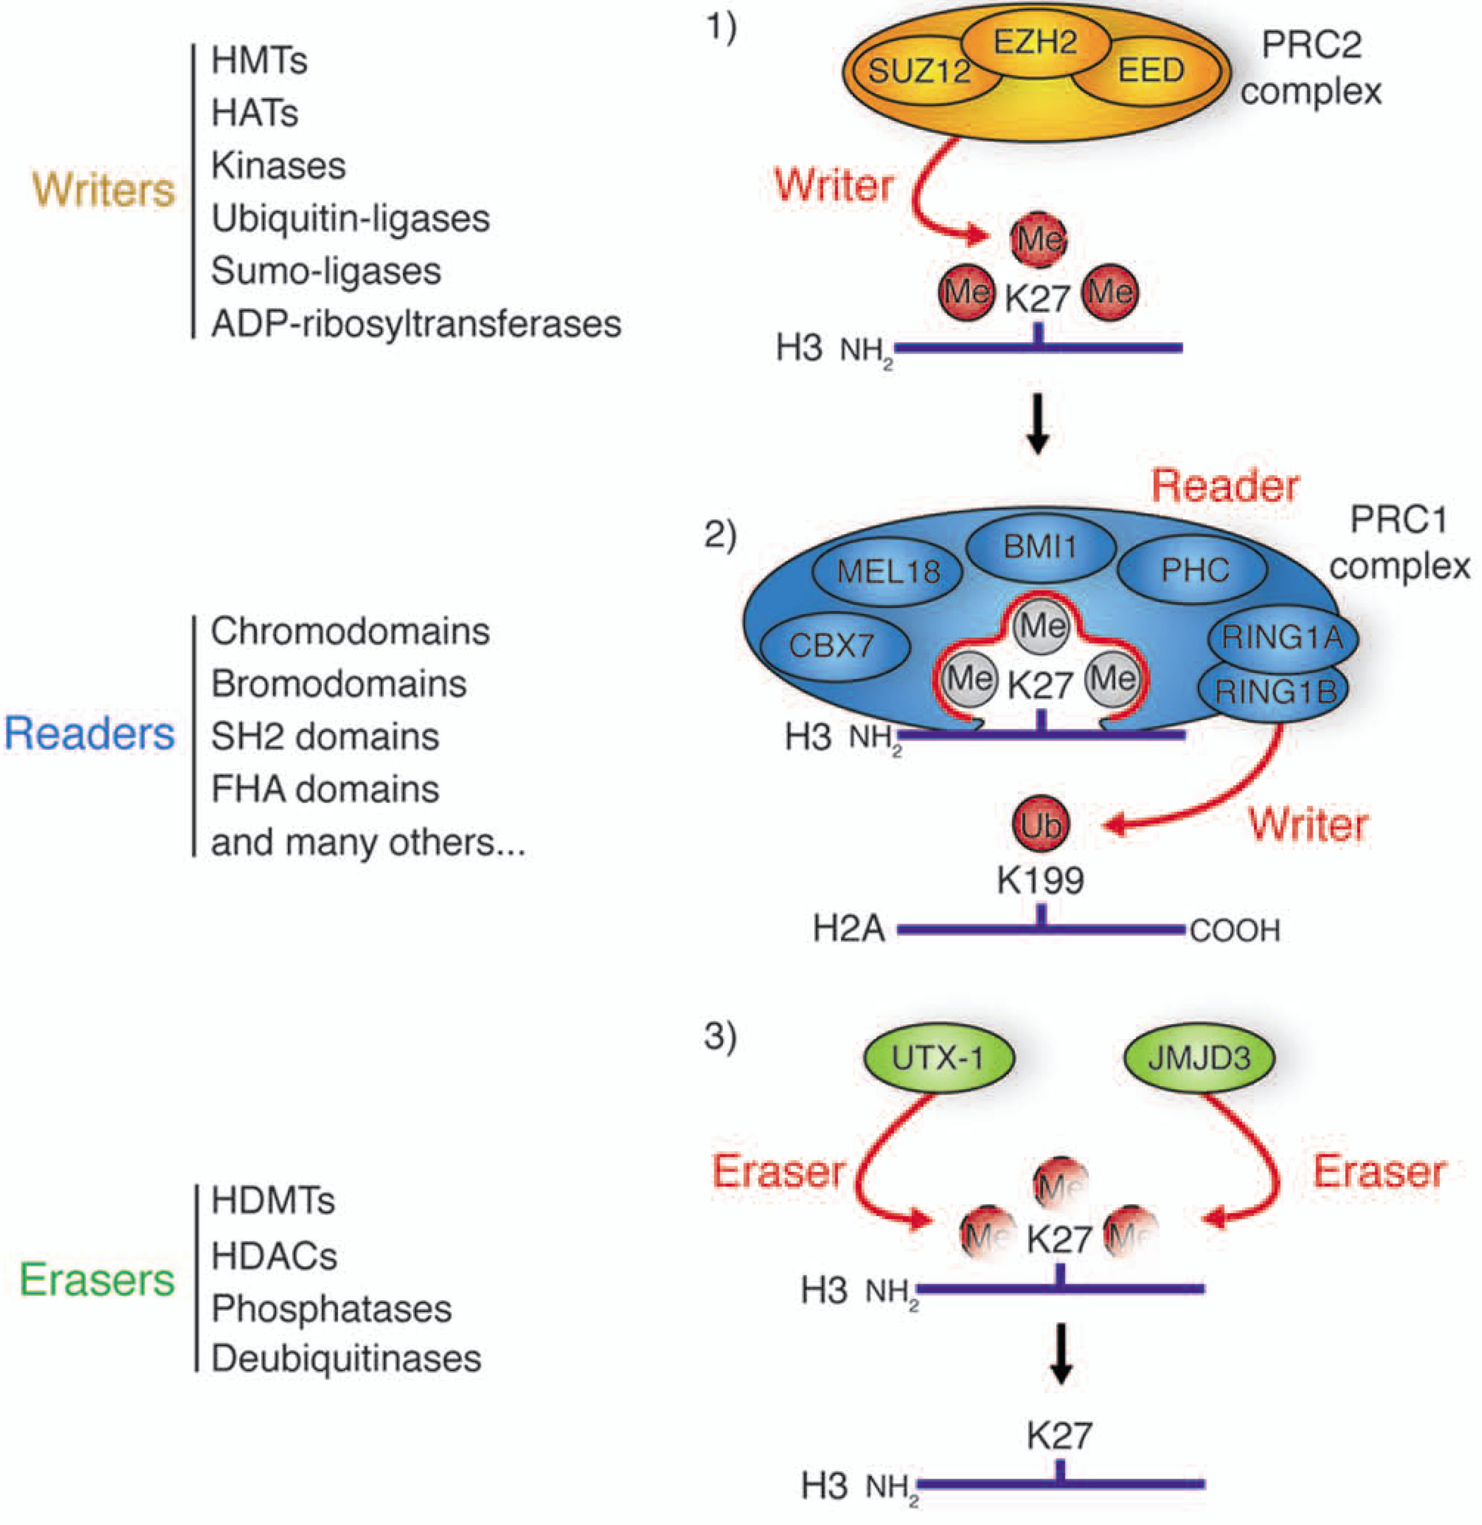
Writers, readers and erasers of histone modifications
Tollervey and Lunyak (2012) Epigenetics 7:823
Ram et al., Cell 147:1628 (2011)

Slide 22
Writers, readers and erasers of histone modifications
MLL
p300
PRC2
KDM6B
From Bannister and Kouzarides (2011) Cell Res 21:381

Slide 23
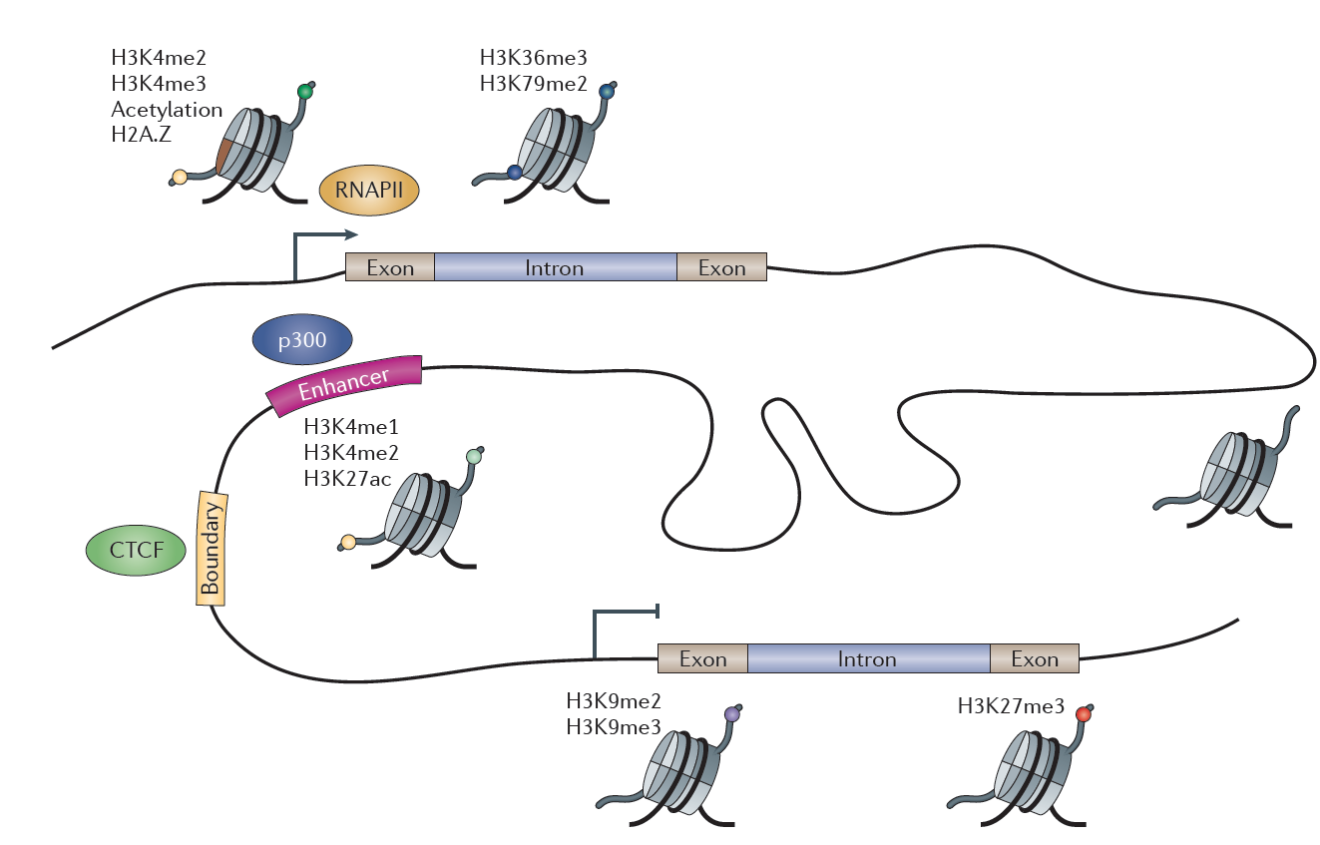
Histone modifications correspond to functions in the genome
Zhou et al. Nat Rev Genet 12:7 (2011)

Slide 24
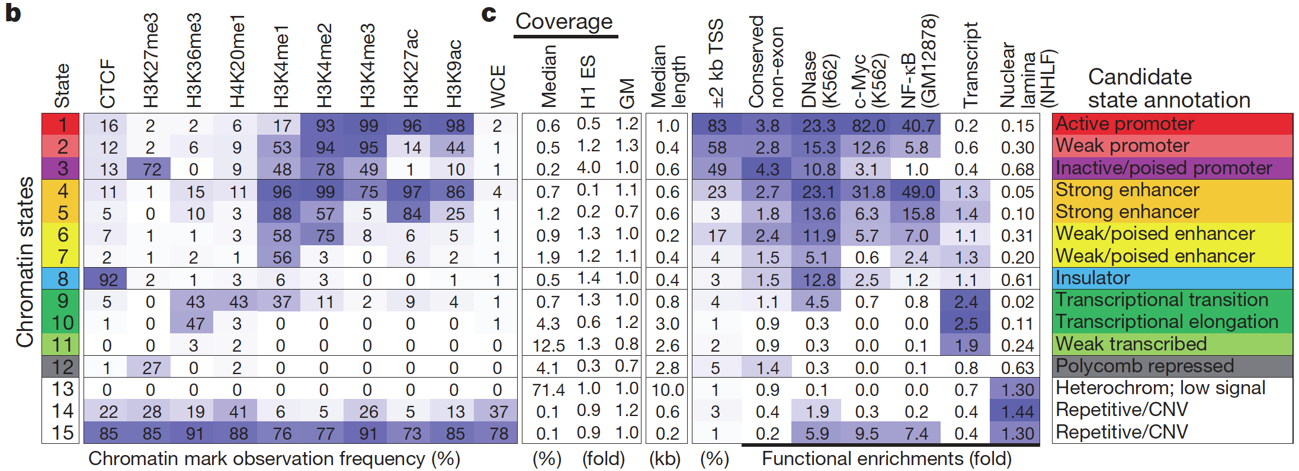
Mapping and analysis of chromatin state dynamics in nine human
cell types
Multivariate HMM to infer chromatin states from combinations of histone marks
‘emission’ probabilities associated with each chromatin state
‘transition’ probabilities – frequency in which chromatin states occur in
spatial relationships with each other along genome
Functional inferences
Genomic features – promoters, genes, etc.
Associations of histone modifications with regulatory activities
Ernst et al., Nature 473:43 (2011)

Slide 25
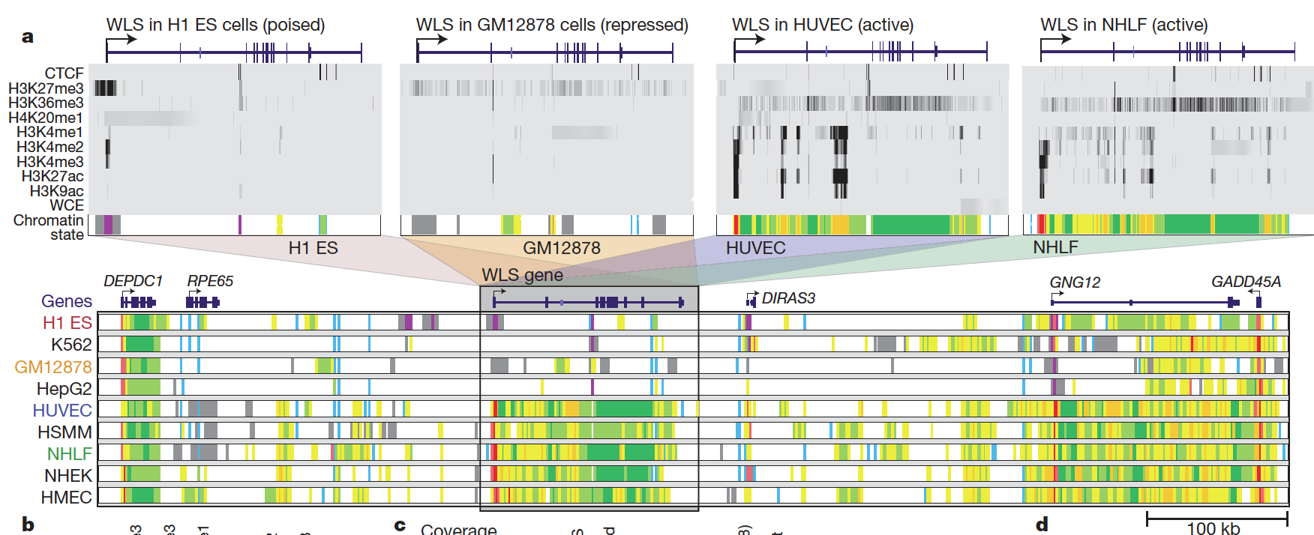
Chromatin states vary across cell types
Chromatin states at WLS:
Ernst et al., Nature 473:43 (2011)

Slide 26
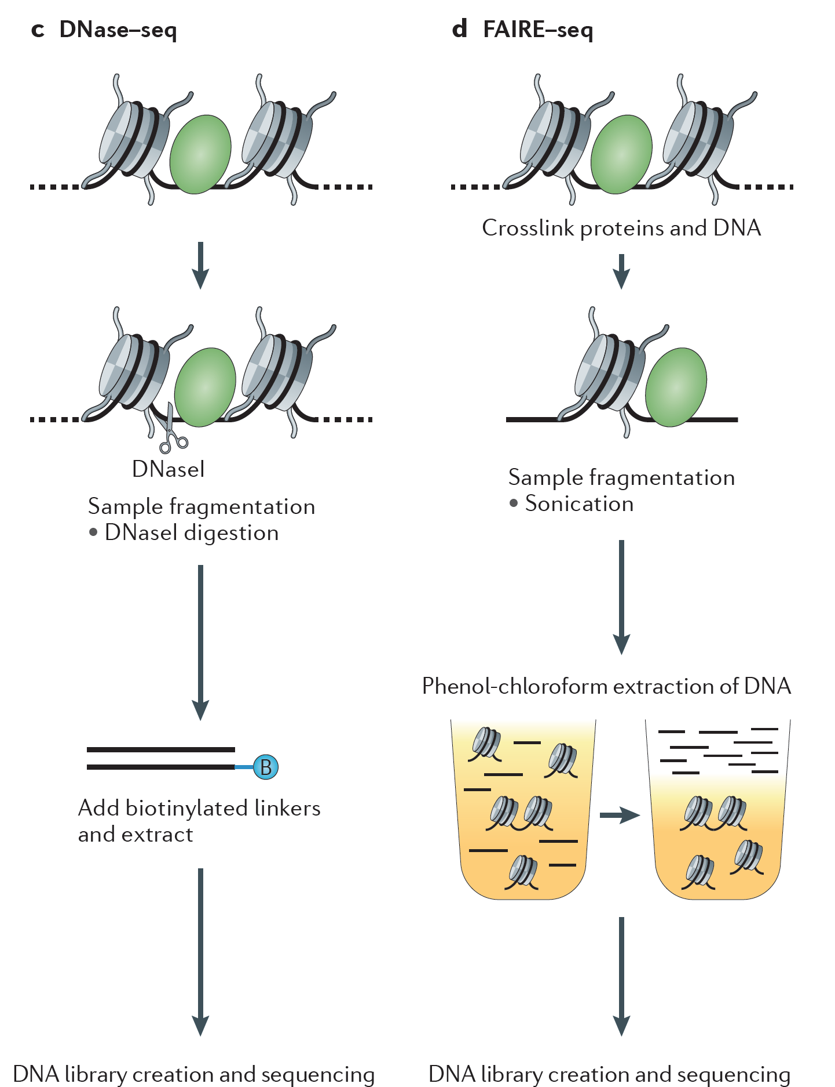
Mapping chromatin accessibility (no specific factor or mod)
DNase I
FAIRE
From Furey (2012)
Nat Rev Genet
13:840

Slide 27
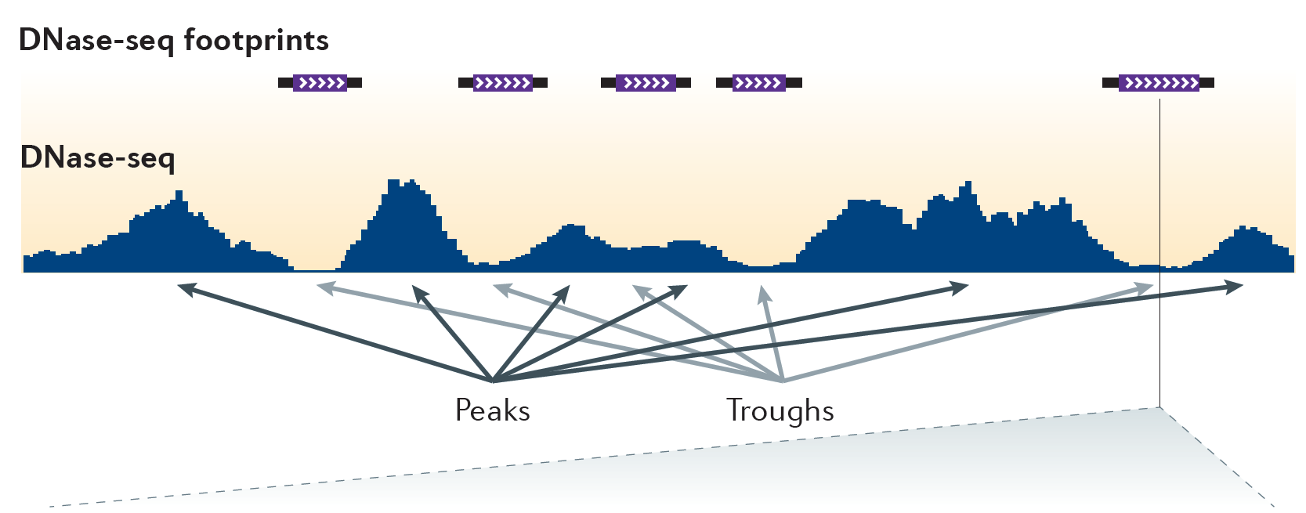
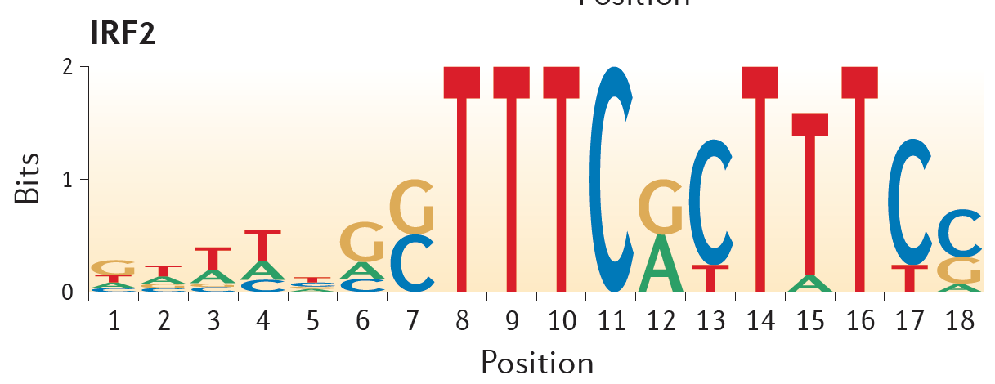
DNase I hypersensitivity identifies TF binding events
From Furey (2012) Nat Rev Genet 13:840

Slide 28
mRNA-seq
  Technical methodology
  Read mapping and normalization
  Estimating isoform-level gene expression
  De novo transcript reconstruction
  Sensitivity and sequencing depth
  Differential expression analysis

Slide 29
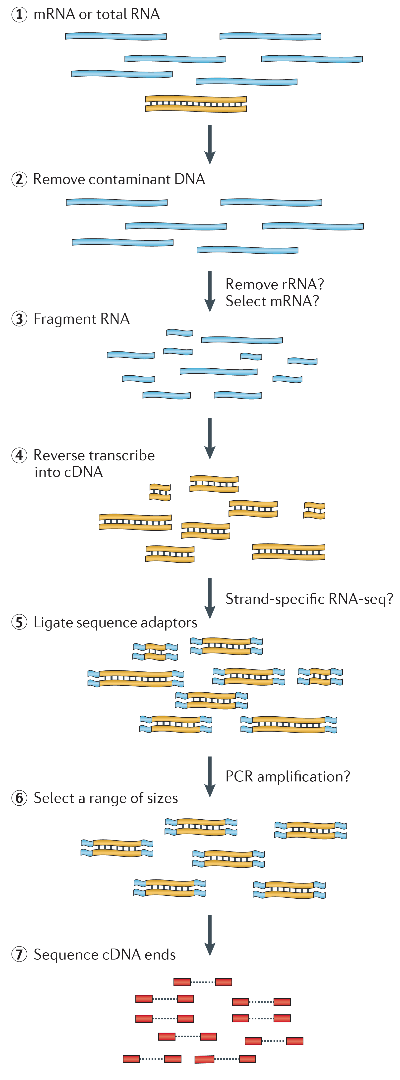
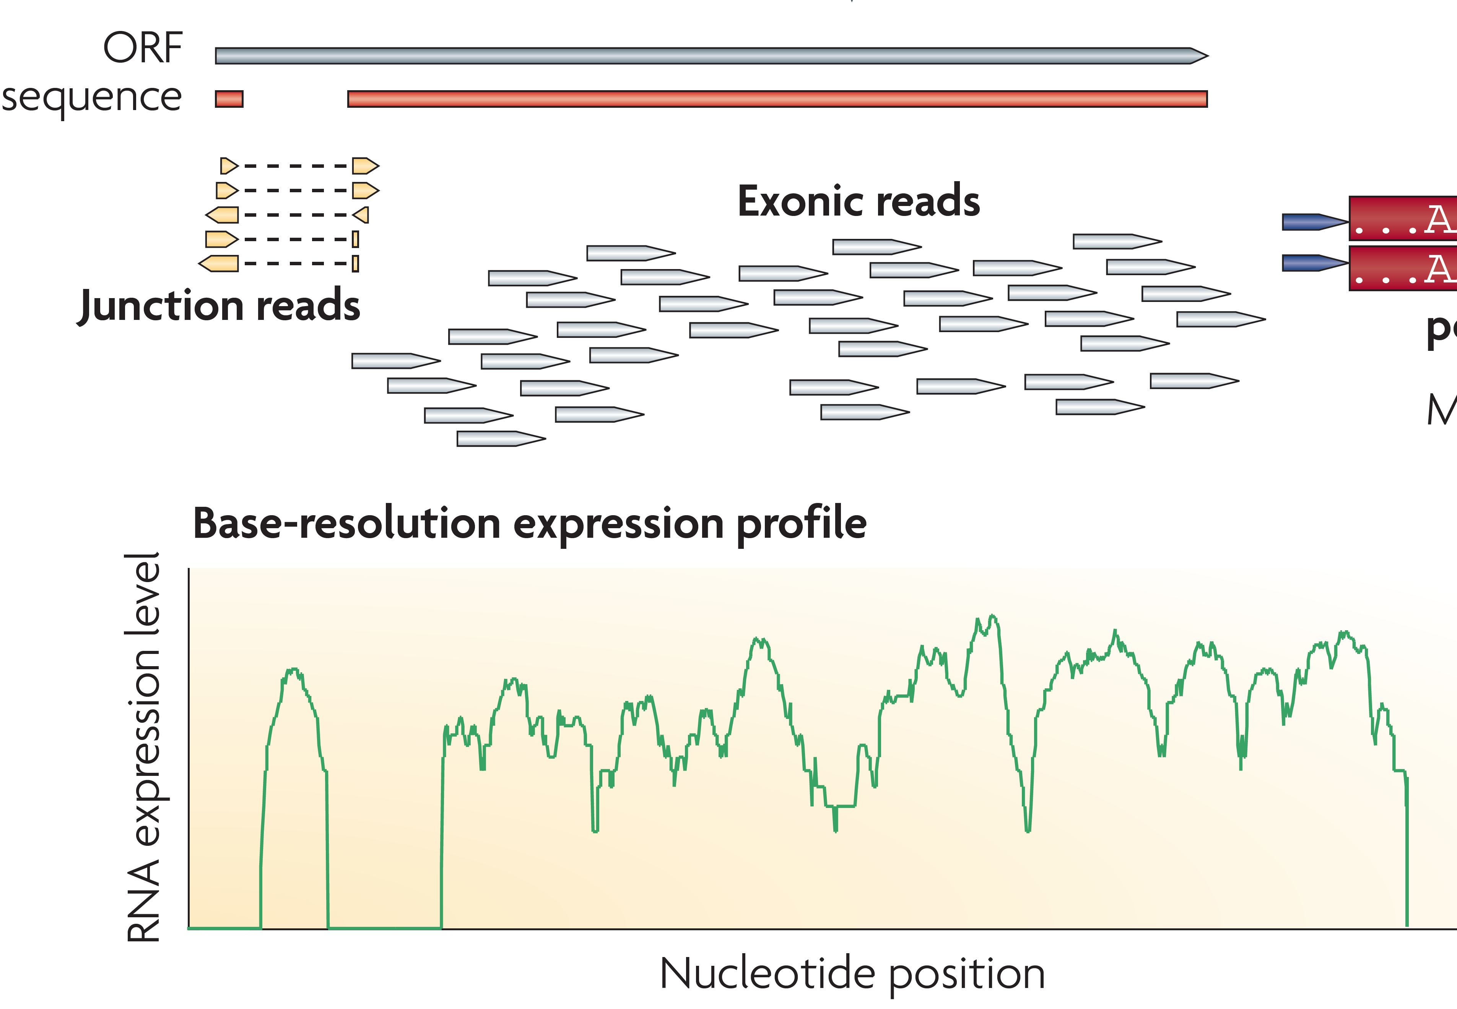
mRNA-seq
workflow
Martin and Wang Nat Rev Genet 12:671 (2011)
Wang et al. Nat Rev Genet 10:57 (2009)

Slide 30

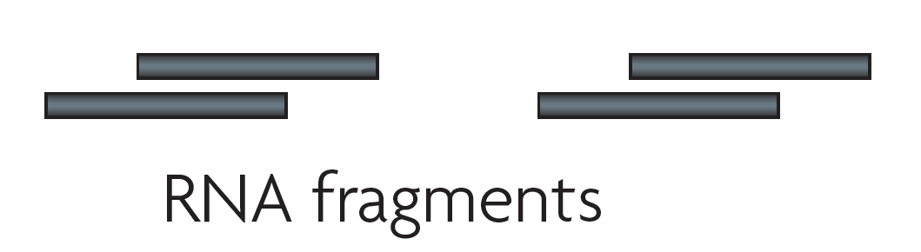
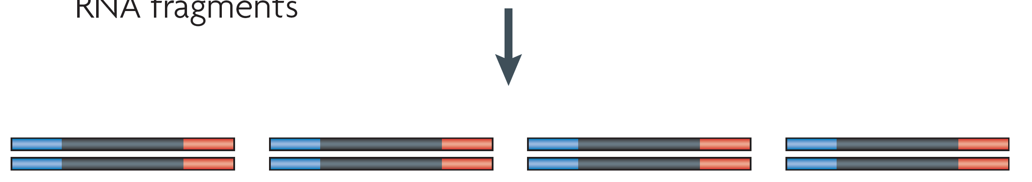
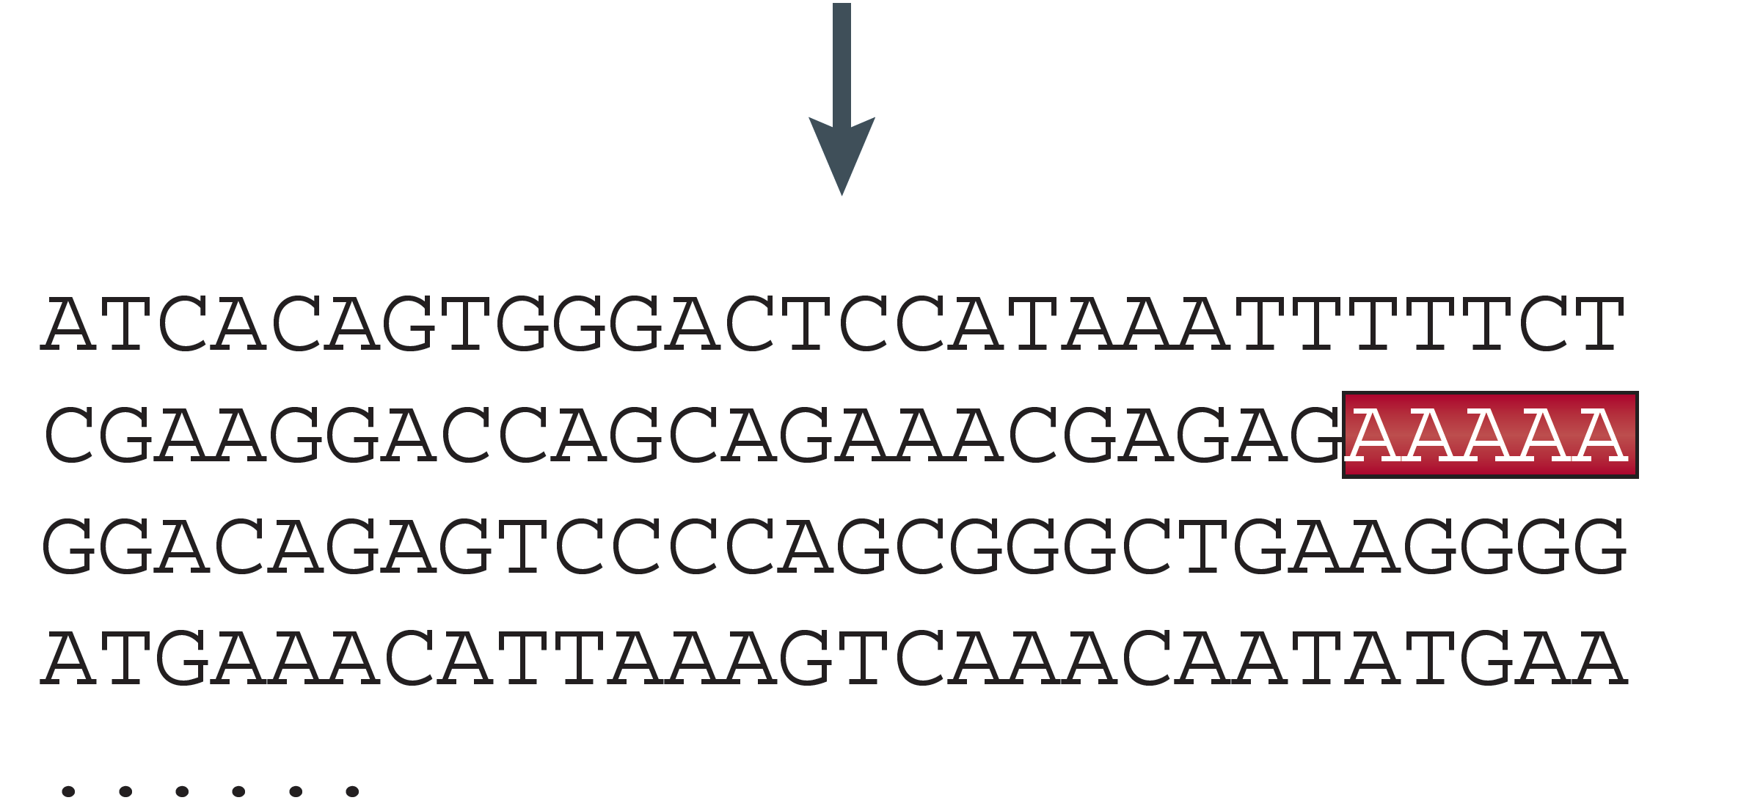
Illumina RNA-seq library preparation
Capture poly-A RNA with poly-T oligo attached beads (100 ng total) (2x)
RNA quality must be high – degradation produces 3’ bias
Non-poly-A RNAs are not recovered
Fragment mRNA
Synthesize ds cDNA
Ligate adapters
Amplify
Generate clusters and
sequence

Slide 31
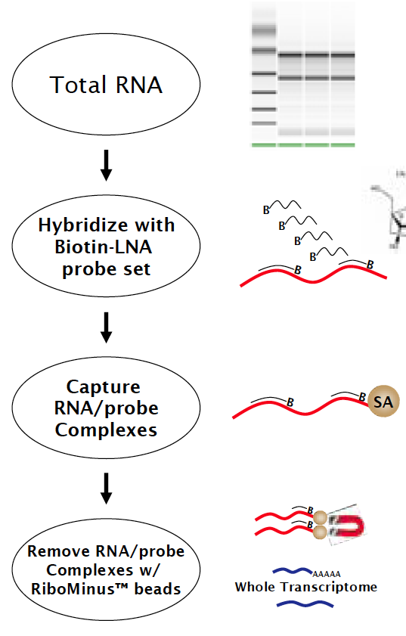
Ribosomal RNA subtraction
RiboMinus

Slide 32
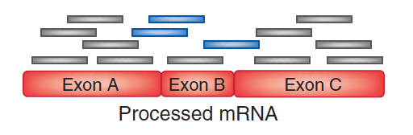
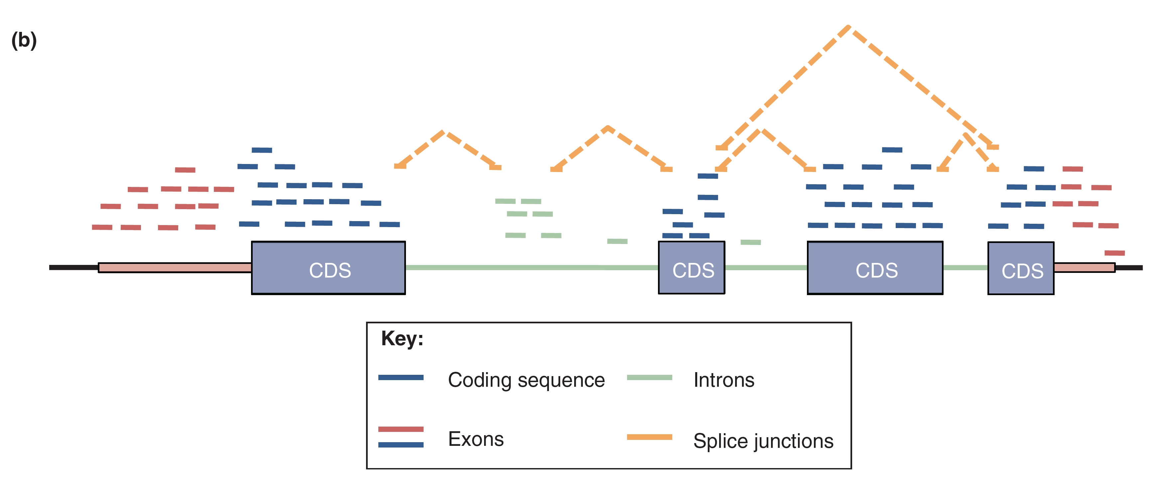
Mapping RNA-seq reads and quantifying transcripts

Slide 33
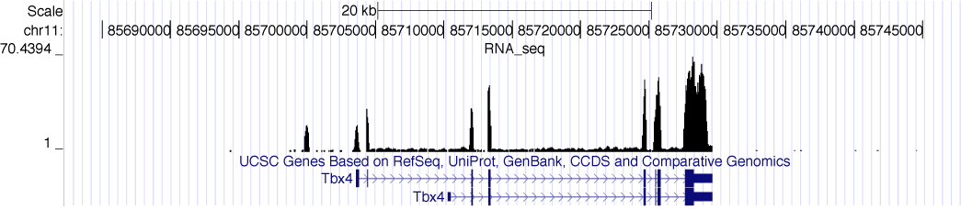
RNA-seq reads mapped to a reference genome
Normalization :
Reads per kilobase of feature length per million mapped reads (RPKM)
What is a “feature?”
What about genomes with poor genome annotation?
What about species with no sequenced genome?
For a detailed comparison of normalization methods, see:
Bullard et al. BMC Bioinformatics 11:94 (2010).
Robinson and Oshlack, Genome Biol 11:R25 (2010)
Notes:
Quantify expression of known genes (counting)
Gene model level → composite of the whole gene vs constitutive
Differences that we are seeing could be due to splicing → methods for isoform level expression values
Transcriptome reconstruction → combination of Tophat,paired end tags

Slide 34
Quantifying gene expression by RNA-seq
  Use existing gene annotation:
    Align to genome plus annotated splices
    Depends on high-quality gene annotation
    Which annotation to use: RefSeq, GENCODE, UCSC?
    Isoform quantification?
    Identifying novel transcripts?
  Reference-guided alignments:
    Align to genome sequence
    Infer splice events from reads
    Allows transcriptome analyses of genomes with poor gene annotation
  De novo transcript assembly:
    Assemble transcripts directly from reads
    Allows transcriptome analyses of species without reference genomes

Slide 35
Applications of mRNA-seq
Characterizing transcriptome complexity
  Alternative splicing
Differential expression analysis
  Gene- and isoform-level expression comparisons
Novel RNA species
  lincRNAs and eRNAs
  Pervasive transcription
Translation
  Ribosome profiling
Allele-specific expression
  Effect of genetic variation on gene expression
  Imprinting
RNA editing
  Novel events

Slide 36
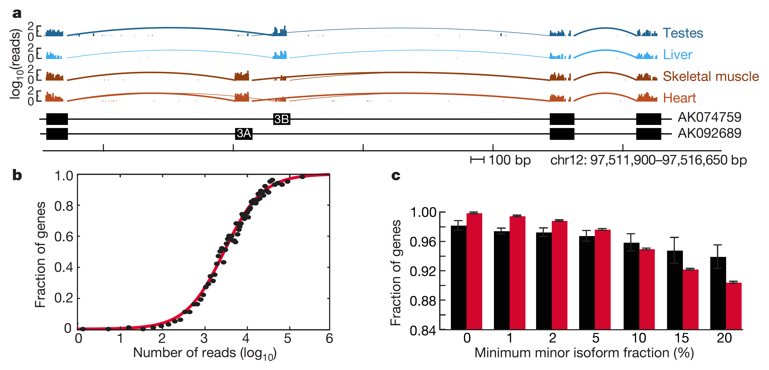
Alternative isoform regulation in human tissue transcriptomes
Wang et al Nature 456:470 (2008)

Slide 37
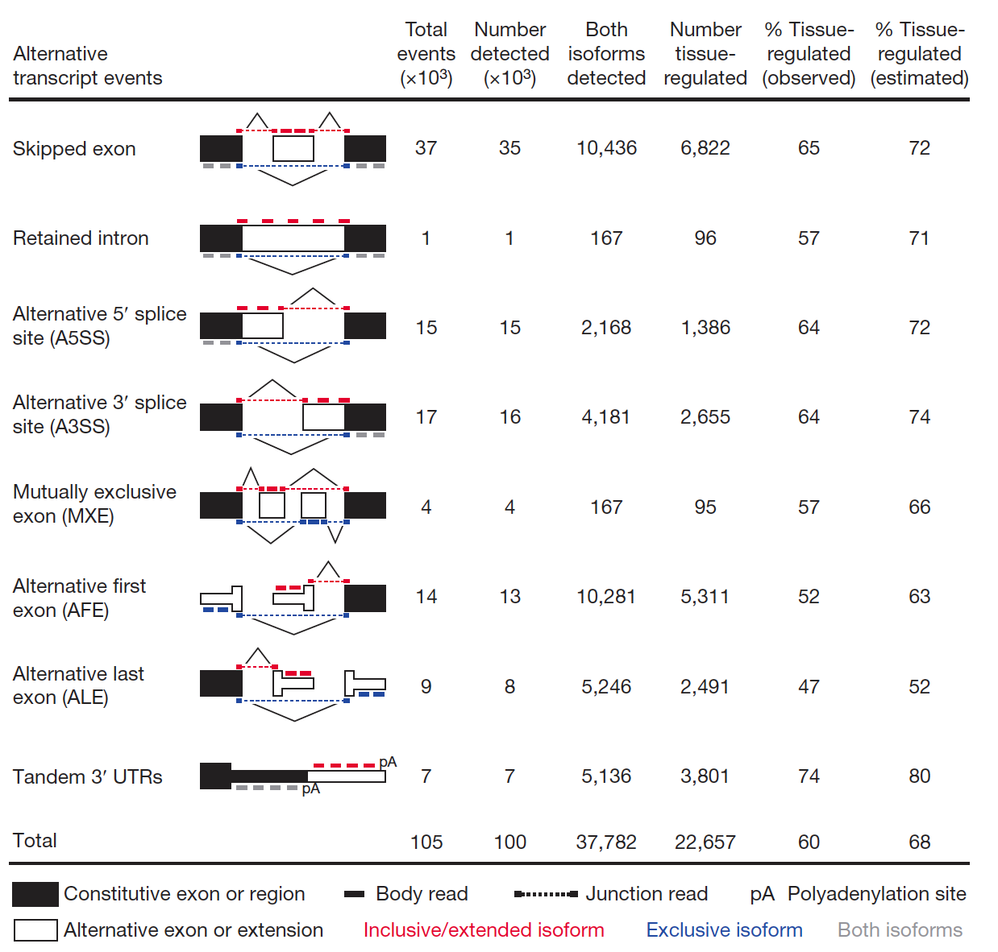
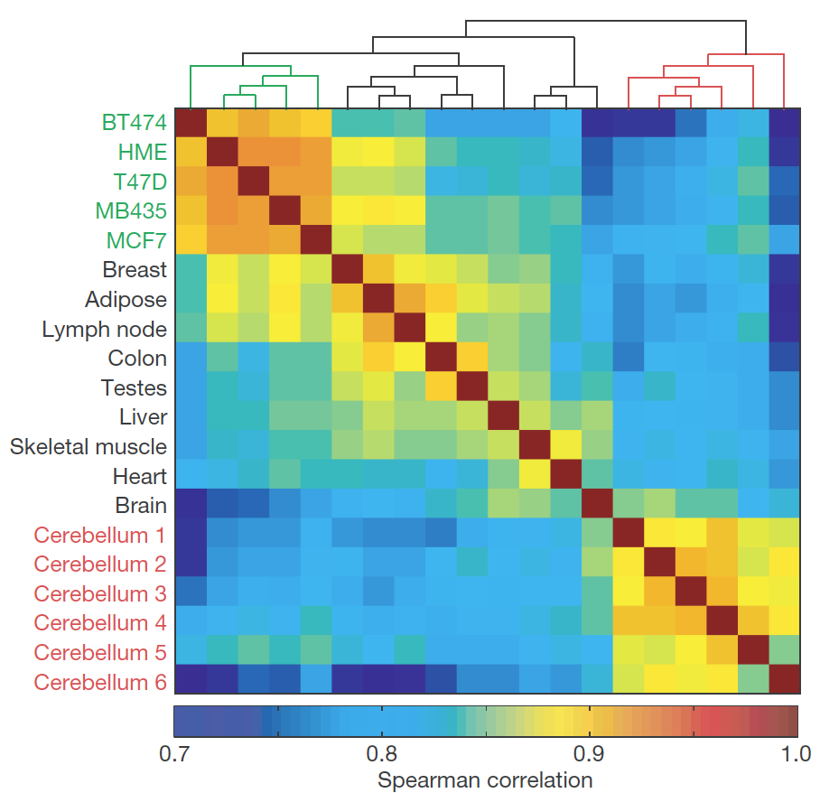
Diversity of alternative splicing events in human tissues
Wang et al. Nature 456:470 (2008)

Slide 38
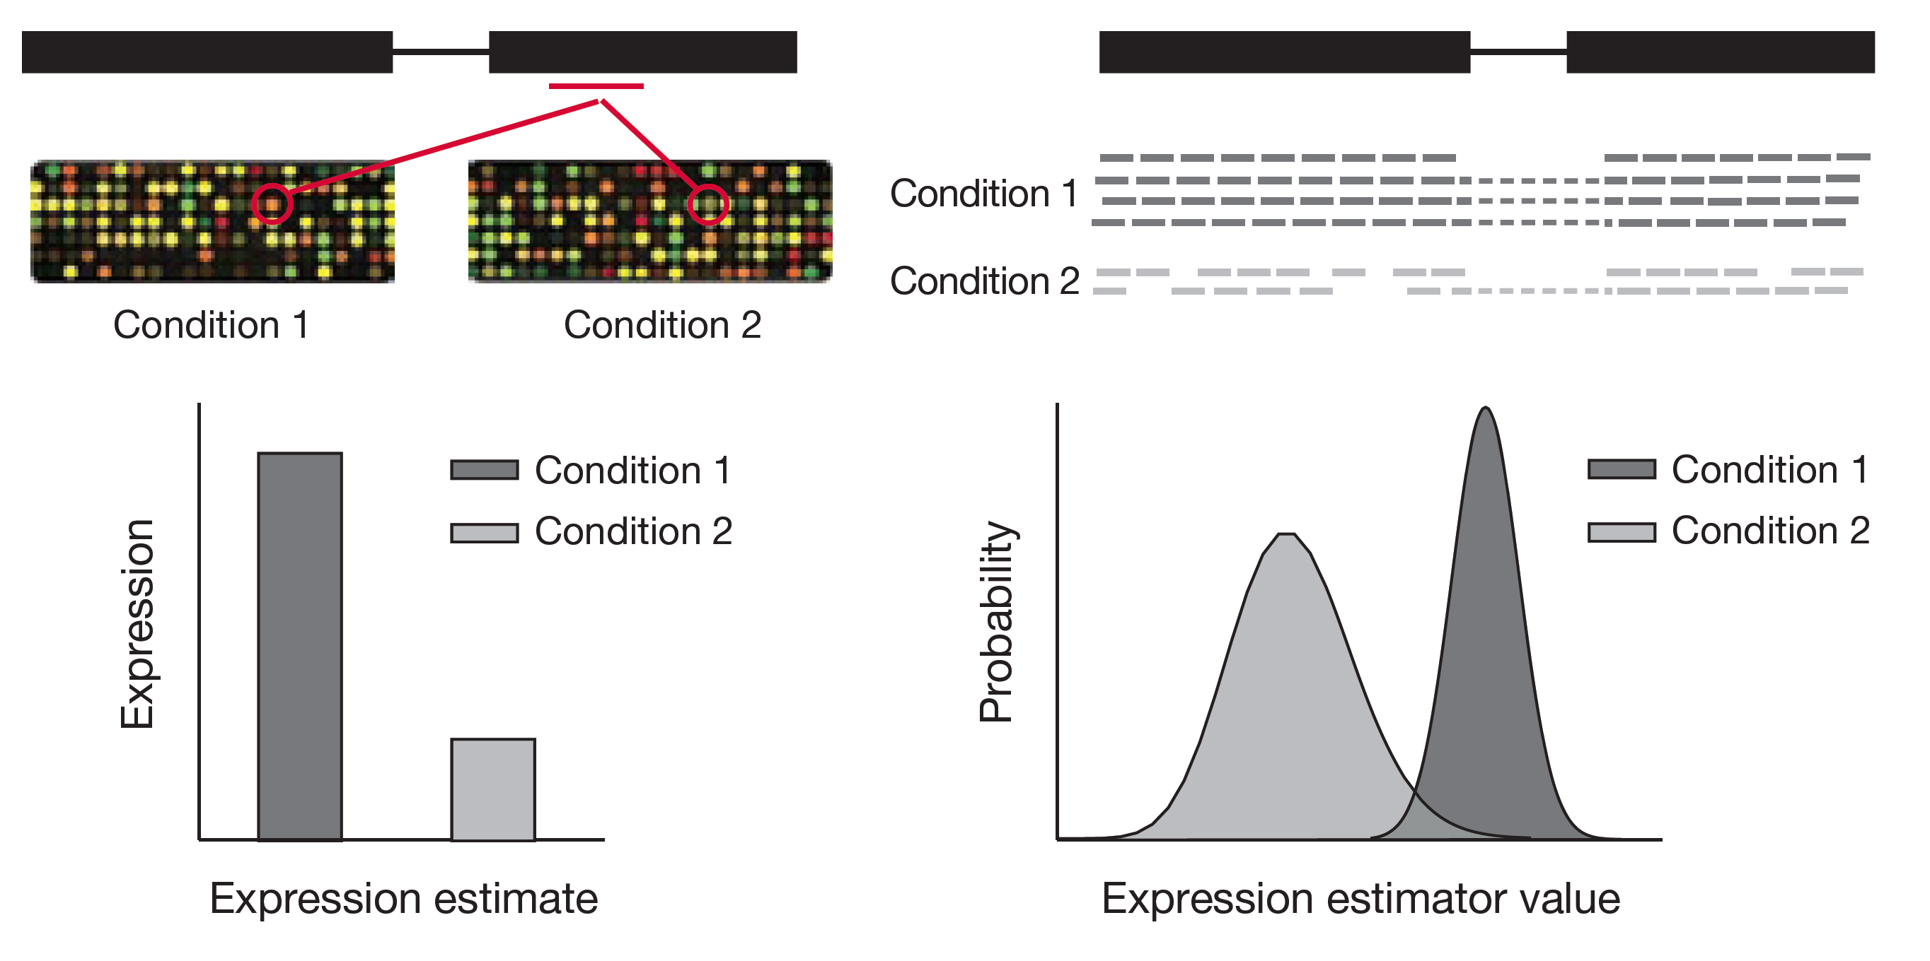
Differential expression
Garber et al. Nat Methods 8:469 (2011)

Slide 39
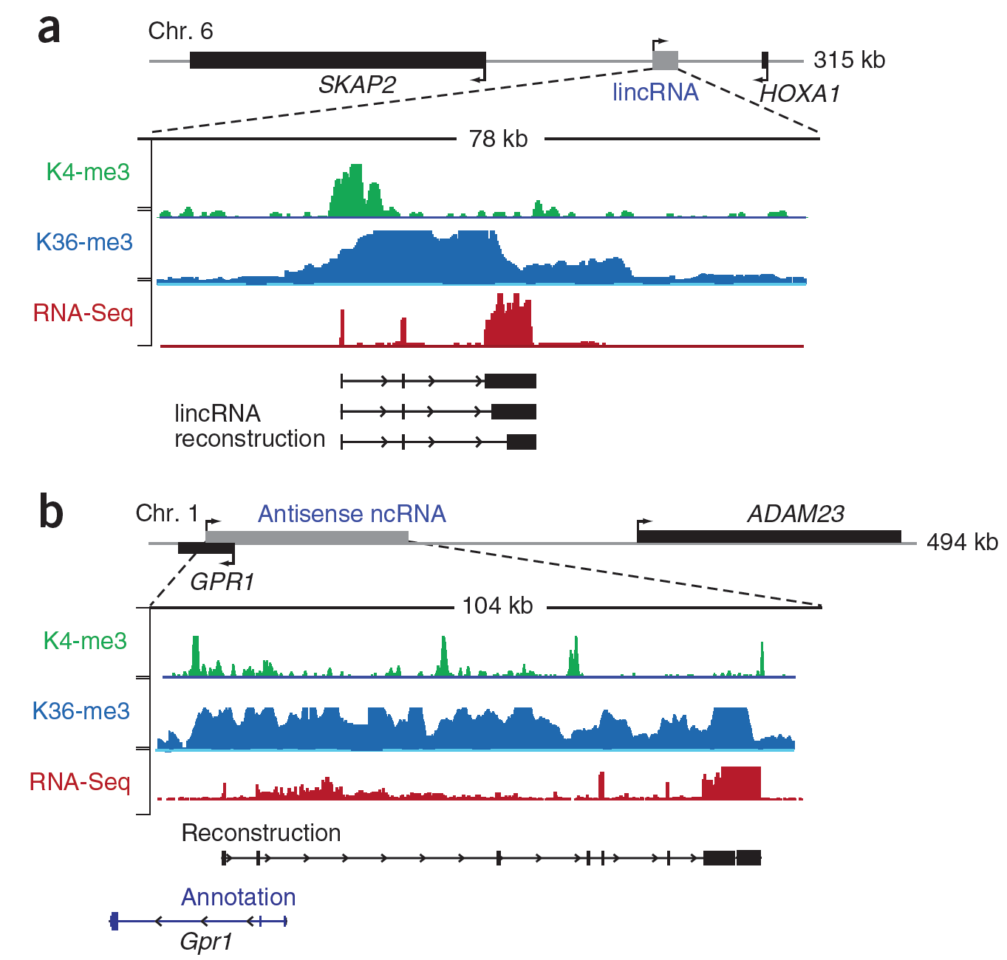
Novel RNA species: annotating lincRNAs
Guttman et al Nat Biotechnol 28:503 (2010)

Slide 40
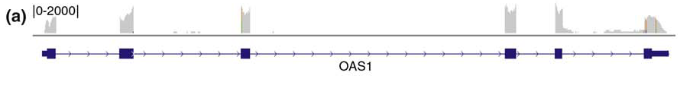
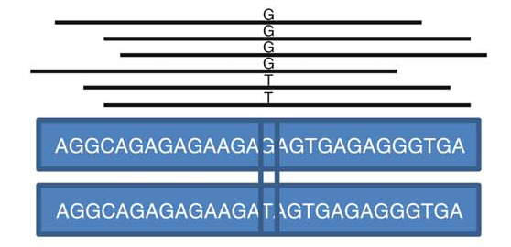
Exploiting sequence information in RNA-seq reads
Majewski and Pastinen. Trends Genet 27:72 (2011)

Slide 41
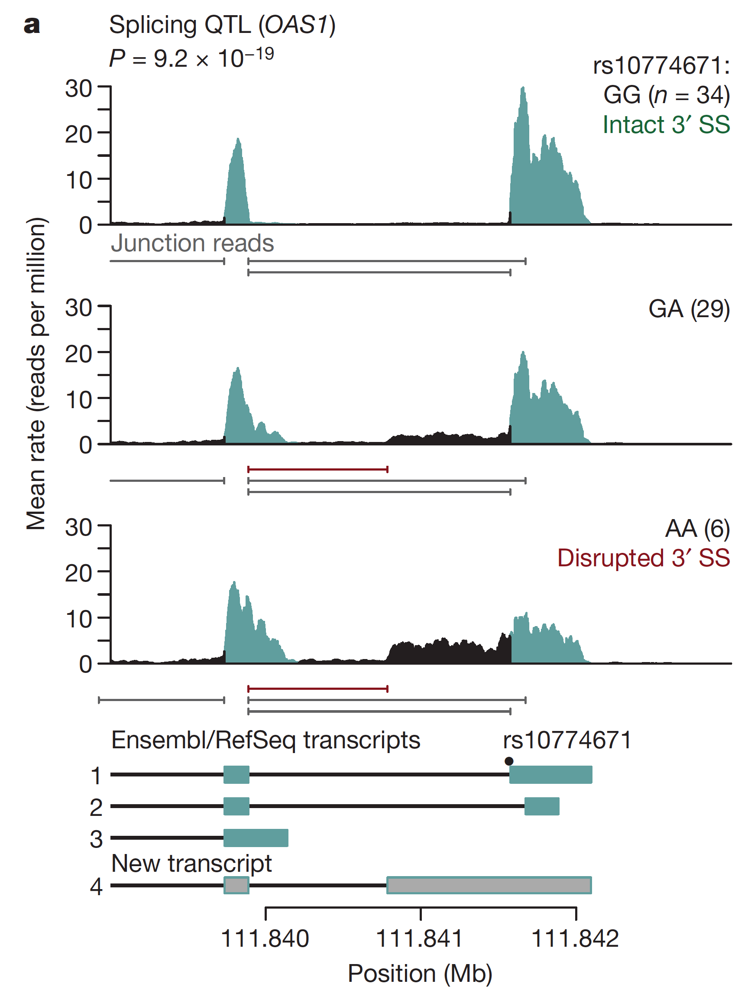
Detecting variants that affect splicing
Pickrell et al . Nature 464:768 (2010)

Slide 42
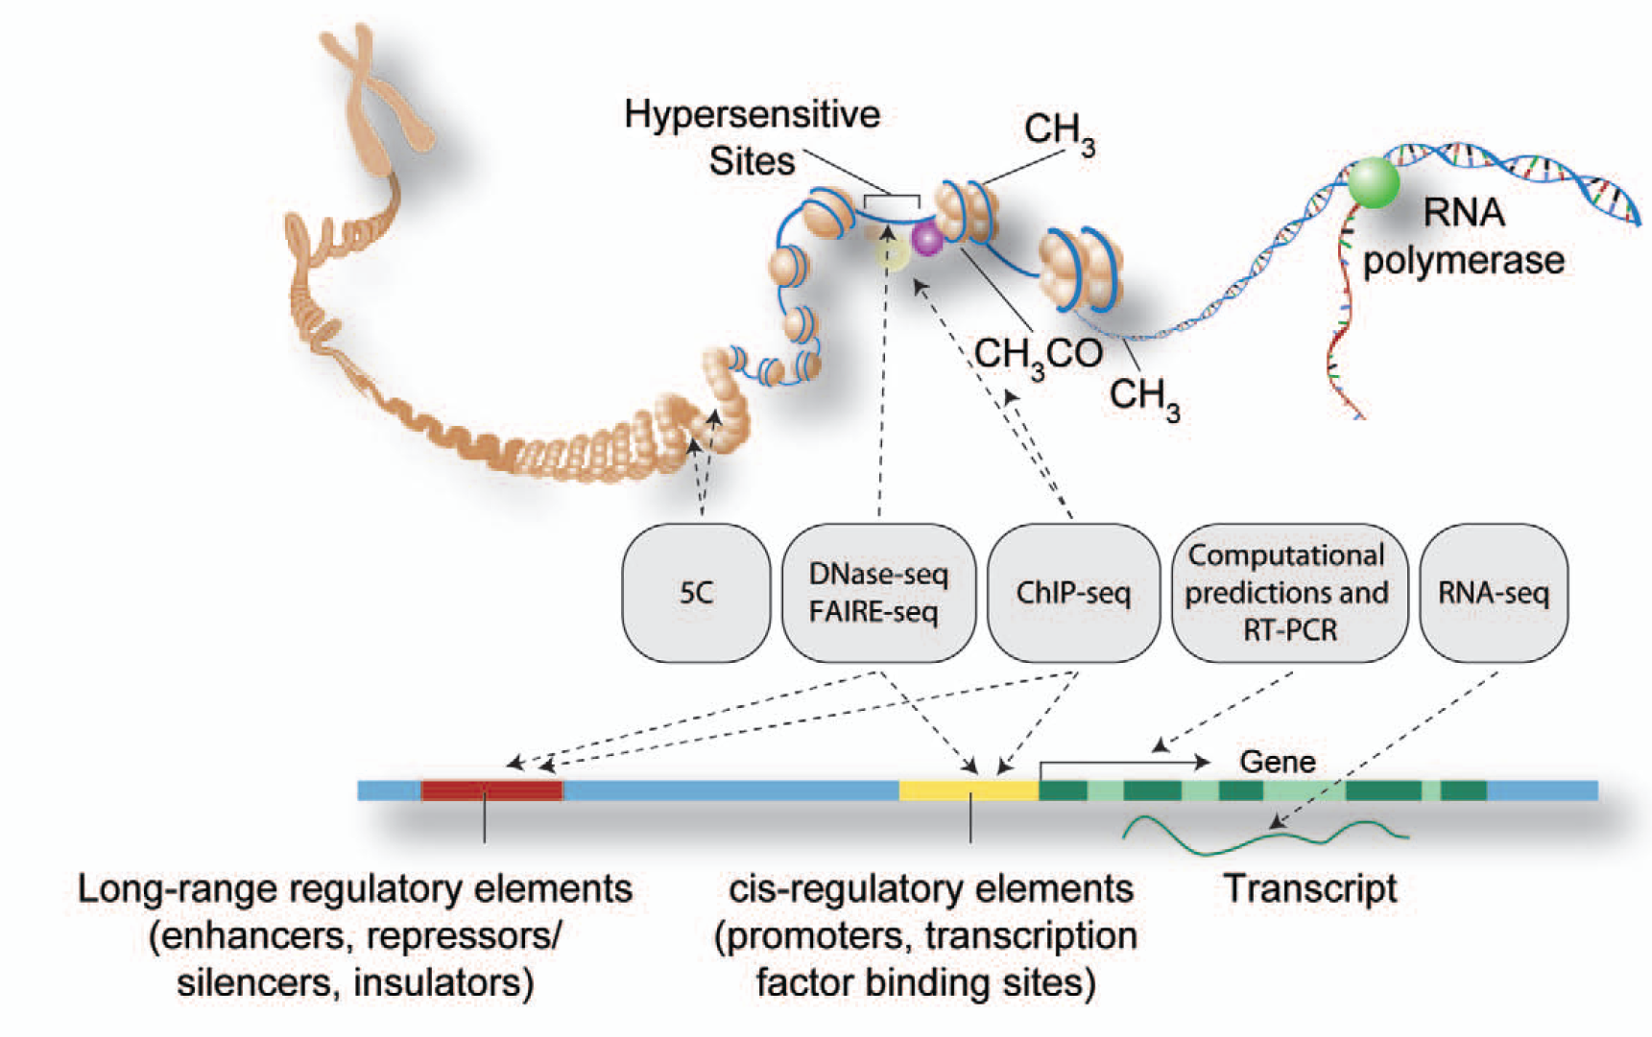
Big functional genomics data:
ENCODE, Roadmap Epigenome, etc.

Slide 43
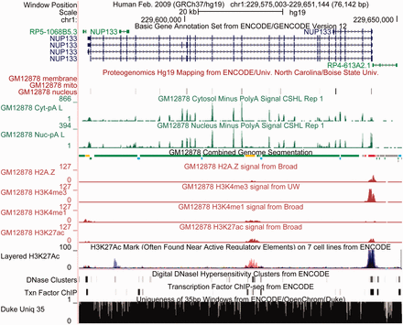
ENCODE data at the UCSC genome browser
novel independent transcript in the first intron of TP53

Slide 44
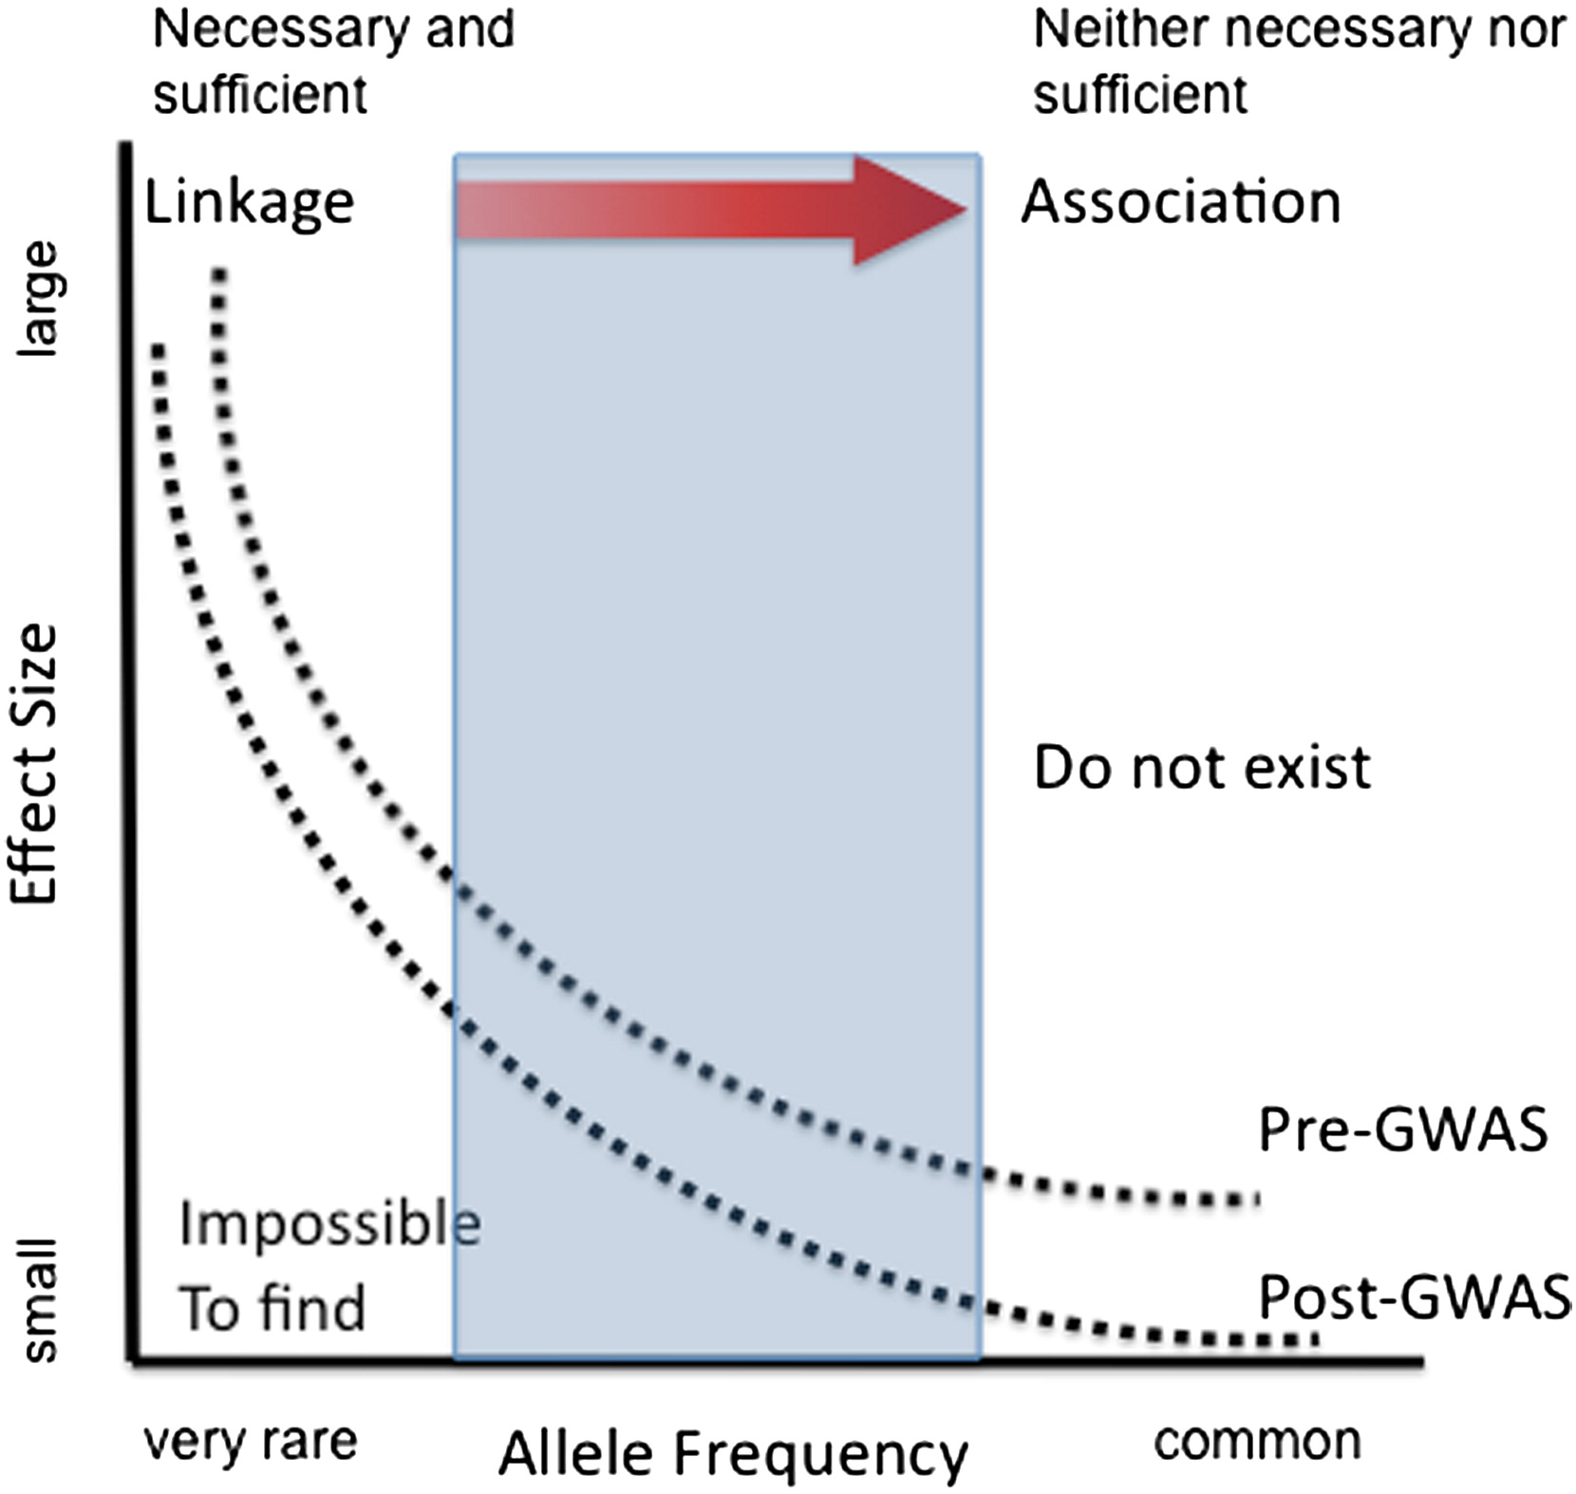
The genetic architecture of human disease
State, MW. Neuron 68:254 (2010)

Slide 45
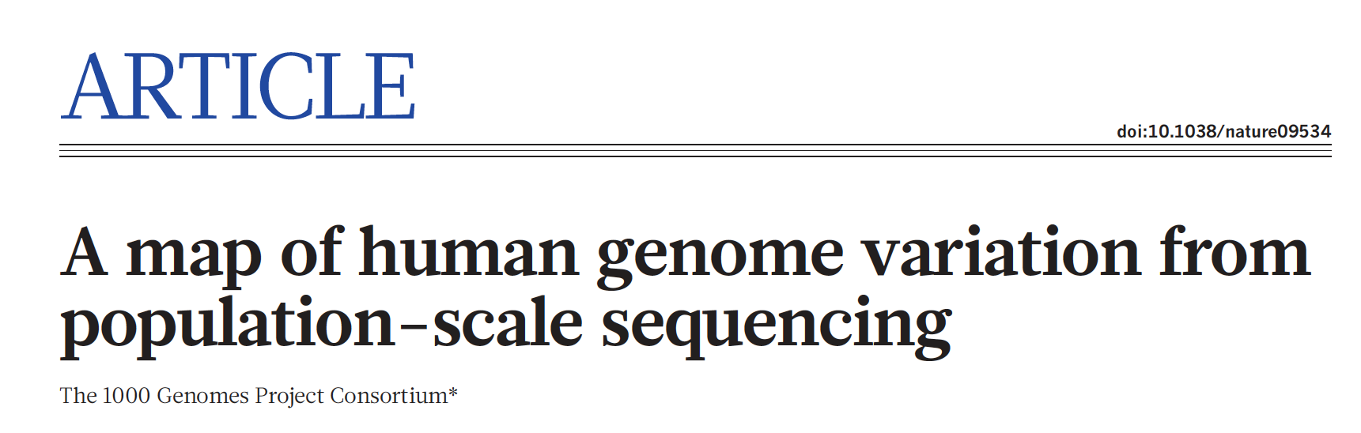
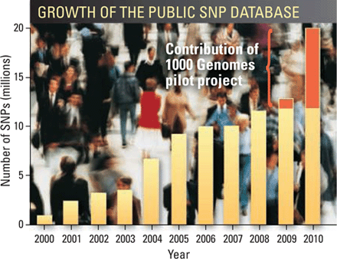

Whole genome sequencing: 1000 Genomes

Slide 46
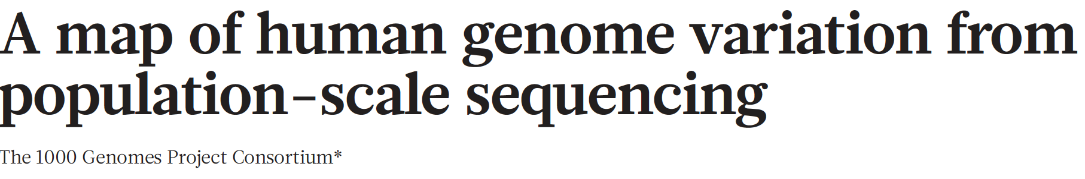
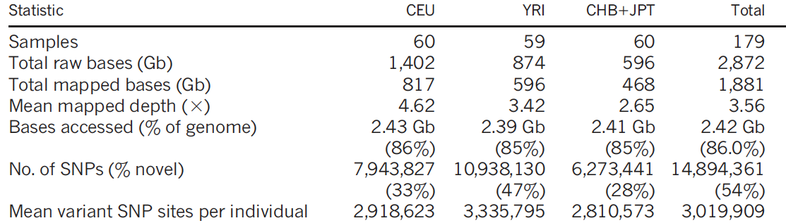
Nature 467:1061 (2010)

Slide 47
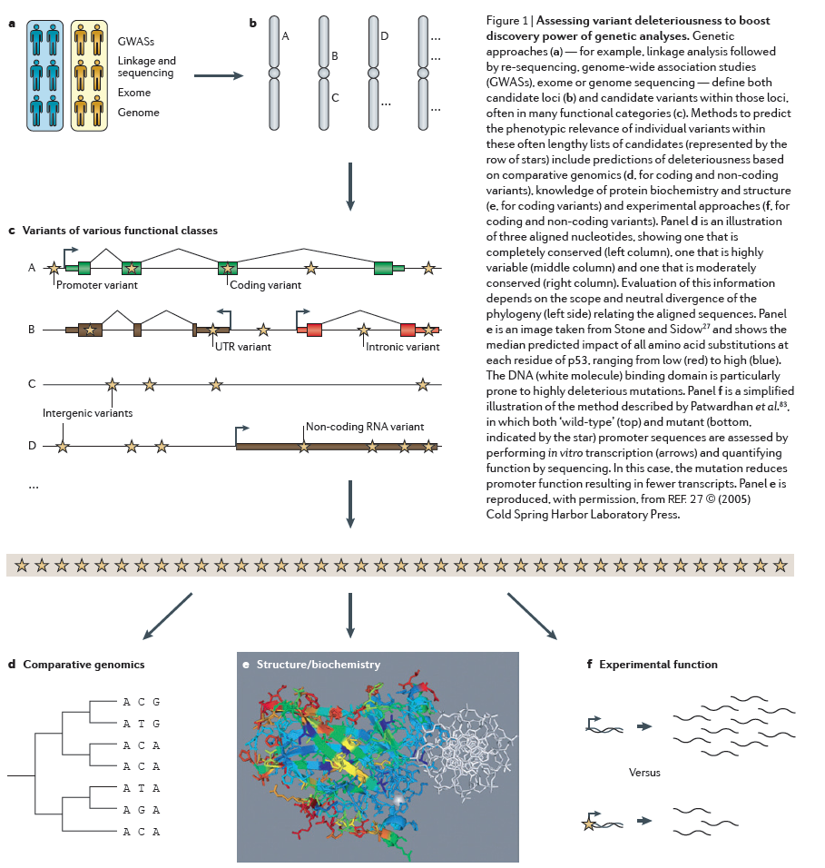
Challenge:
Interpreting genetic variation
Cooper and Shendure, Nat Rev Genet 12:628 (2011)

Slide 48
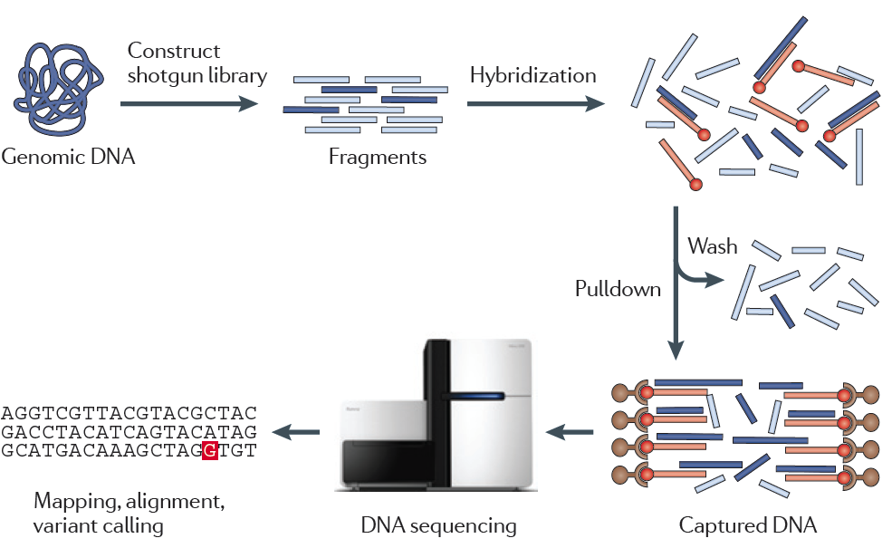
Genome reduction: Exome sequencing
Bamshad et al. Nat Rev Genet 12:745 (2011)

Slide 49

Finding disease-causing rare variants by exome sequencing
De novo mutation
Screen unrelated trios for recurrence
Likely to have functional effect
Recurrence in independent affected individuals
Absence in controls
Reveal critical pathways in disease – allow interpretation of
transmitted variants in common cases

Slide 50


Excess of damaging mutations in affected siblings:
Genes with multiple independent
loss of function mutations:
CHD8
SCN2A
DYRK1A
ANK2
GRIN2B
TBR1
Sanders et al. Nature 485:237 (2012)

Slide 51

ASD-related genes are co-expressed during midfetal
cortical development
Willsey et al. Cell 155:997 (2013)

