Slide 1
SIGNAL PROCESSING FOR
NEXT-GEN SEQUENCING DATA
Peaks
DNAse I-seq
CHIP-seq
Gene models
RNA-seq
RIP/CLIP-seq
Binding sites
FAIRE-seq
Transcripts

Slide 2
The Power of Next-Gen Sequencing
Chromosome Conformation Capture
+ More Experiments
DNA
Genome Sequencing
Exome Sequencing
DNAse I hypersensitivity
CHIP
CHART, CHirP, RAP
CLIP, RIP
CRAC
PAR-CLIP
iCLIP
Protein
RNA
RNA-seq

Slide 3
Next-Gen Sequencing as Signal Data
Map reads (red) to the genome. Whole pieces of DNA are black.
Count # of reads mapping to each DNA base → signal
Rozowsky et al. 2009 Nature Biotech
Notes:
Need better picture

Slide 4
Read mapping
Problem: match up to a billion short sequence reads to the genome
Need sequence alignment algorithm faster than BLAST
Rozowsky et al. 2009 Nature Biotech

Slide 5
Read mapping (sequence alignment)
Dynamic programming
  Optimal, but SLOW
BLAST
  Searches primarily for close matches, still too slow for high throughput sequence read mapping
Read mapping
  Only want very close matches, must be super fast

Slide 6
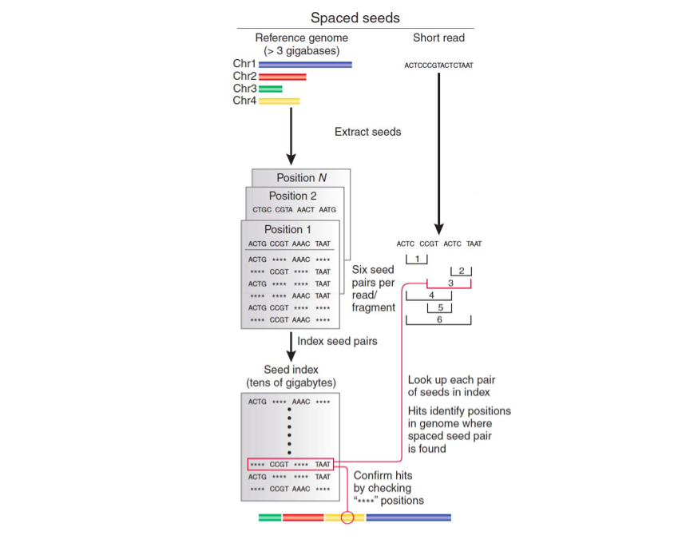
Index-based short read mappers
Similar to BLAST
Map all genomic locations of all possible short sequences in a hash table
Check if read subsequences map to adjacent locations in the genome, allowing for up to 1 or 2 mismatches.
Very memory intensive!
Trapnell and Salzberg 2010, Slide adapted from Ray Auerbach

Slide 7
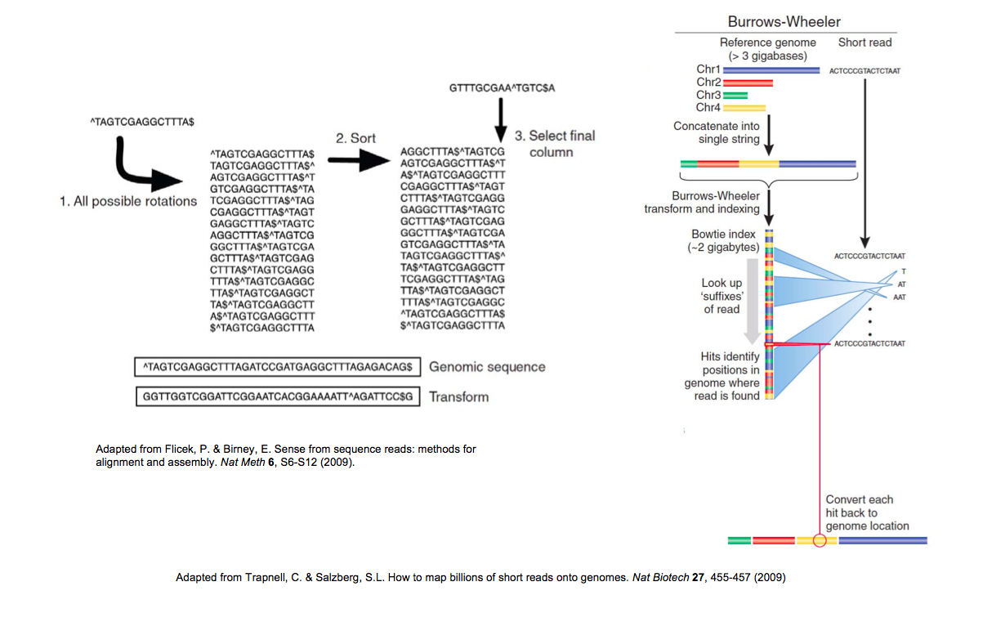
Read Alignment using Burrows-Wheeler Transform
Used in Bowtie, the current most widely used read aligner
Described in Coursera course: Bioinformatics Algorithms (part 1, week 10)
Trapnell and Salzberg 2010, Slide adapted from Ray Auerbach

Slide 8
Read mapping issues
Multiple mapping
Unmapped reads due to sequencing errors
VERY computationally expensive
  Remapping data from The Cancer Genome Atlas consortium would take 6 CPU years¹
Current methods use heuristics, and are not 100% accurate
These are open problems
¹https://twitter.com/markgerstein/status/396658032169742336

Slide 9
Outline
Finding enriched regions
  CHIP-seq: peaks of protein binding
RNA-seq: going beyond enrichment
Comparing genome-wide signal information
Application: Predicting gene expression from transcription factor and histone modification binding

