Slide 1

Model Selection in Machine Learning
+
Predicting Gene Expression from ChIP-Seq signals
https://twitter.com/nature

Slide 2
Review and warm-up questions
Andrew Ng
Notes:
What makes a good feature?

Slide 3
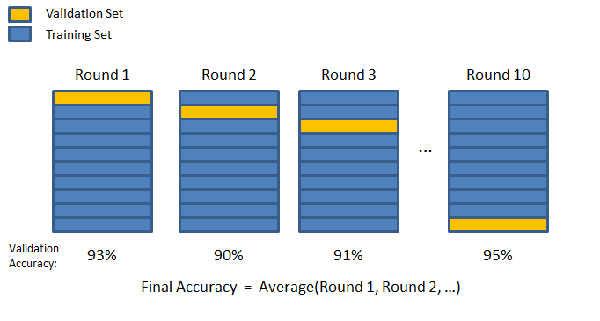
Training vs. Cross-Validation
Fit model to example data points
Evaluate model on separate set of data points
https://chrisjmccormick.wordpress.com/2013/07/31/k-fold-cross-validation-with-matlab-code/

Slide 4
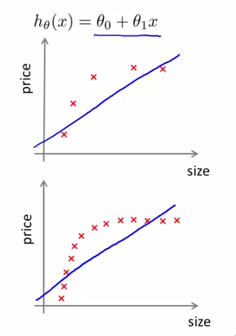
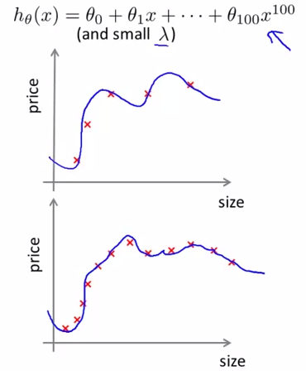
Bias vs. Variance
Model too simple
Model too complex
What’s the problem?
Adapted from Andrew Ng – https://www.youtube.com/watch?v=DYCv5e0Isow, http://see.stanford.edu/materials/aimlcs229/ML-advice.pdf
Notes:
Model = multinomial regression
Bias is defined by underfitting of data
High bias → More training data won’t help.
High variance is defined by overfitting of data
High variance → More training data WILL help

Slide 5
What’s the problem? – Bias
Adapted from Andrew Ng – https://www.youtube.com/watch?v=DYCv5e0Isow, http://see.stanford.edu/materials/aimlcs229/ML-advice.pdf
Notes:
Ask students for feedback. Are we overfitting or underfitting?

Slide 6
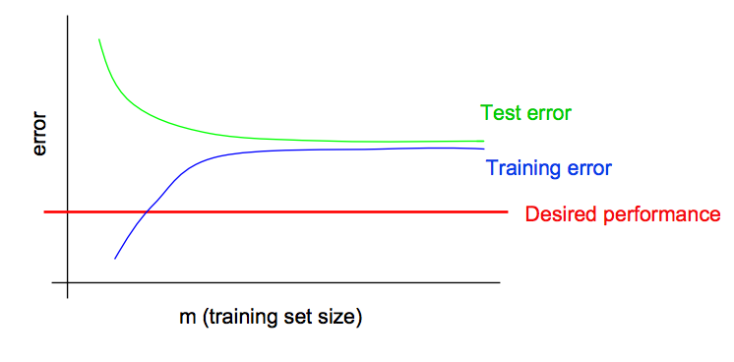
Learning curve – Bias
Bias
Model too simple
Adapted from Andrew Ng – https://www.youtube.com/watch?v=DYCv5e0Isow, http://see.stanford.edu/materials/aimlcs229/ML-advice.pdf

Slide 7
What’s the problem? – Variance
Adapted from Andrew Ng – https://www.youtube.com/watch?v=DYCv5e0Isow, http://see.stanford.edu/materials/aimlcs229/ML-advice.pdf
Notes:
Ask students for feedback

Slide 8
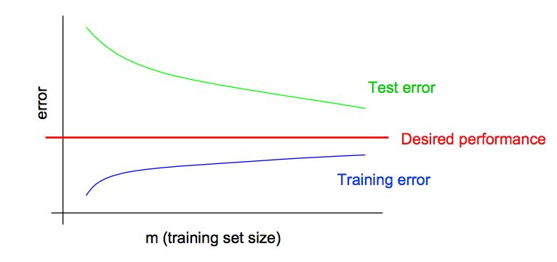
Learning curve – Variance
Variance
Model too complex
Adapted from Andrew Ng – https://www.youtube.com/watch?v=DYCv5e0Isow, http://see.stanford.edu/materials/aimlcs229/ML-advice.pdf
Notes:
Ask students: Will more data help?

Slide 9
What is the next step?
Bias
Variance
Adapted from Andrew Ng – https://www.youtube.com/watch?v=DYCv5e0Isow, http://see.stanford.edu/materials/aimlcs229/ML-advice.pdf

Slide 10
What is the next step?
Bias
Variance
More training features
Train more complicated model
More training examples
Try fewer features → Dimension Reduction
Simplify model
Adapted from Andrew Ng – https://www.youtube.com/watch?v=DYCv5e0Isow, http://see.stanford.edu/materials/aimlcs229/ML-advice.pdf

Slide 11
Practical Application:
Predicting gene expression from ChIP-Seq signals

Slide 12
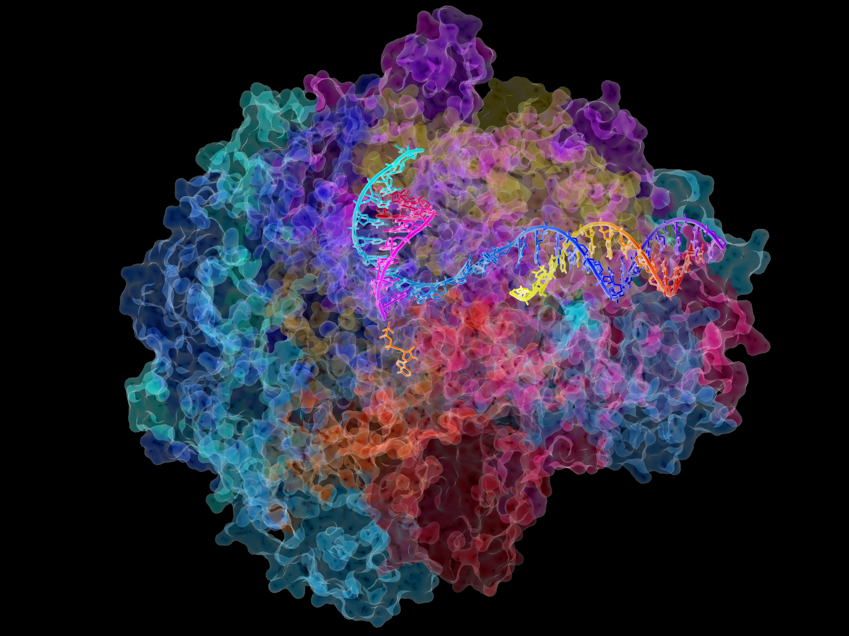
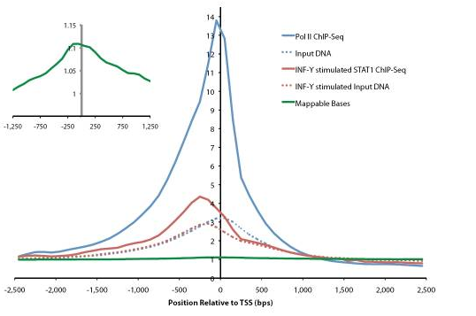
Where should we start?
TSS (transcription start site)
TTS (transcription terminal site)
Gene k
40
1
80
120
81
4 …
41 ….44
121
160
Bin 40-1
(TSS-4kb to TSS)
Bin 41-80
(TSS to TSS+4kb)
Bin 120-81
(TTS-4kb to TTS)
Bin 121-160
(TTS to TTS+4kb)
Park et al Nature Reviews Genetics 2009, Rozowsky et al Nature Biotech 2009, http://images.nigms.nih.gov/imageRepository/2484/RNA_pol_II_medium.jpg, Cheng et al Genome Biology 2011

Slide 13
RNA is transcribed by RNA polymerase
RNA pol II ChIP at
Transcription Start Sites
RNA polymerase II – Crystal structure
Roger Kornberg Nobel Prize
Rozowsky et al. Nature Biotech 2009
http://images.nigms.nih.gov/imageRepository/2484/RNA_pol_II_medium.jpg

Slide 14
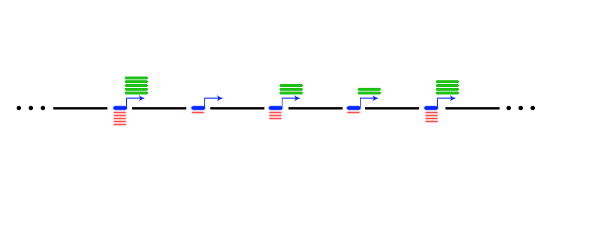
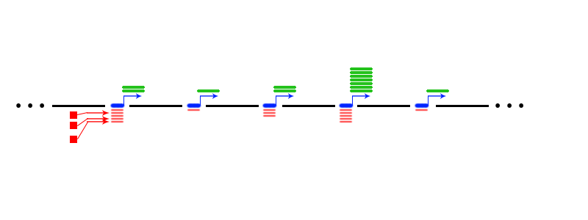
Relating Genomic Inputs to Outputs
Cell Type 1
Cell Type 2
Mark Gerstein/Mengting Gu

Slide 15
Initial model
-4000
TSS
+4000
data from K562 cell line, ENCODE consortium
Sum pol II ChIP signal across 8000 bp centered around transcription start site.
log₂(RNA-Seq RPKM) = a + b*log₂(RNA Pol II ChIP)
Why log scale??

Slide 16
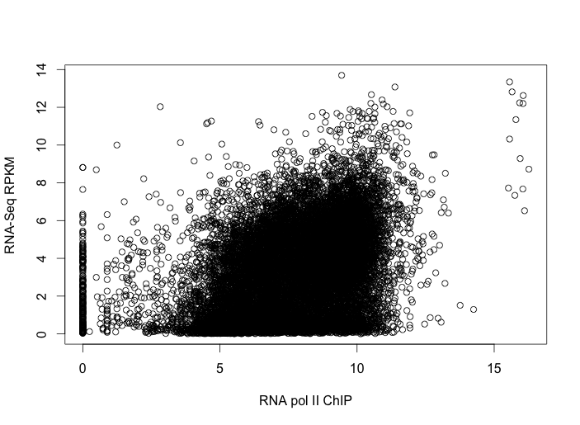
Can we do better than this?
Pearson’s R = 0.39
log2 scale
K562 Cell Line, ENCODE data
Notes:
Can we add more genes? Would that help?
Can we use a more complex model?
What about other ChIP data?

Slide 17
Can we do better than this?
Pearson’s R = 0.39
HOW?
log2 scale
K562 Cell Line, ENCODE data
Notes:
Can we add more genes? Would that help?
Can we use a more complex model?
What about other ChIP data?

Slide 18
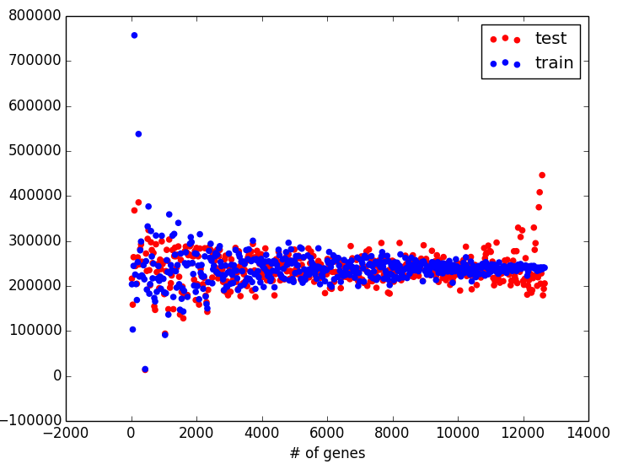
Learning curve: What’s our problem?
Mean squared error
of
Linear Regression
for
pol II ChIP vs. RNA-Seq
Notes:
What does the a single point on this graph mean?
This is BIAS, so we need more training features! How can we get more features?
Can we add more genes? Would that help?
Can we use a more complex model?
What about other ChIP data?

Slide 19
Learning curve: What’s our problem?
Mean squared error
of
Linear Regression
for
pol II ChIP vs. RNA-Seq
This is BIAS
More training features and/or
More complicated model
Notes:
This is BIAS, so we need more training features! How can we get more features?
Can we add more genes? Would that help?
Can we use a more complex model?
What about other ChIP data?

Slide 20
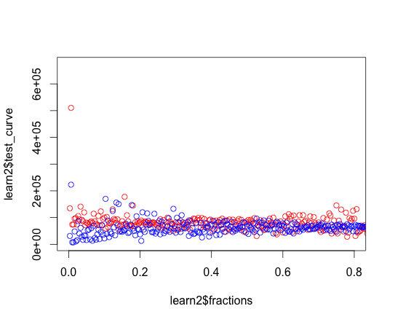
Polynomial regression: polII ChIP vs. RNA-Seq
log₂(RNA-Seq RPKM) = a + b*log₂(RNA Pol II ChIP)
+ c*log₂(RNA Pol II ChIP)^2
+ d*log₂(RNA Pol II ChIP)^3
+ …
+j*log₂(RNA Pol II ChIP)^10
Mean squared error
Proportion of training data (15,000 genes)

Slide 21
Polynomial regression: polII ChIP vs. RNA-Seq
Still BIASED!
More training features and/or
More complicated model
Mean squared error
Proportion of training data (15,000 genes)

Slide 22
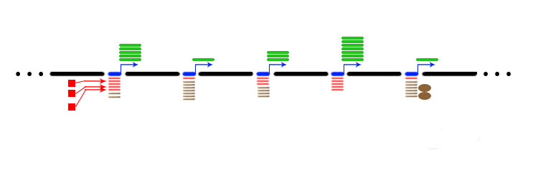
Y = aX₁ + bX₂ + c
Mark Gerstein/Mengting Gu

Slide 23
Adding more signals
Total signal from Promoter
RNA-Seq
Gene 1
Gene 2
…
…
Gene N
10
12
624
592
125
224
900
29
340
99
22
94
29
3
100
135
135
272
H3K27me3
H3K9me3
H3K36me3
H3K27Ac
RNA polII
H3K4me1
H3K4me1
H3K4me3
Take log₂ of each element

Slide 24
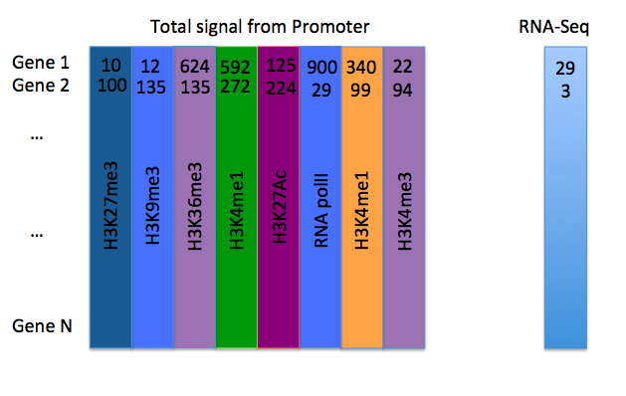
Multiple Linear Regression
Mean squared error
Proportion of training data (15,000 genes)
Y = aX₁ + bX₂ + c + …

Slide 25
Multiple Linear Regression
Still BIASED!
More training features and/or
More complicated model
Mean squared error
Proportion of training data (15,000 genes)

Slide 26
Random Forest Regression
Training correlation: 0.93
Test correlation: 0.52
Log-transformed
Training correlation: 0.95
Test correlation: 0.16
Not Log-transformed

Slide 27
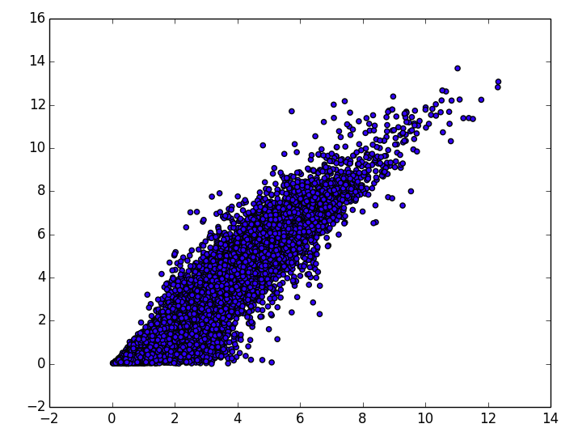
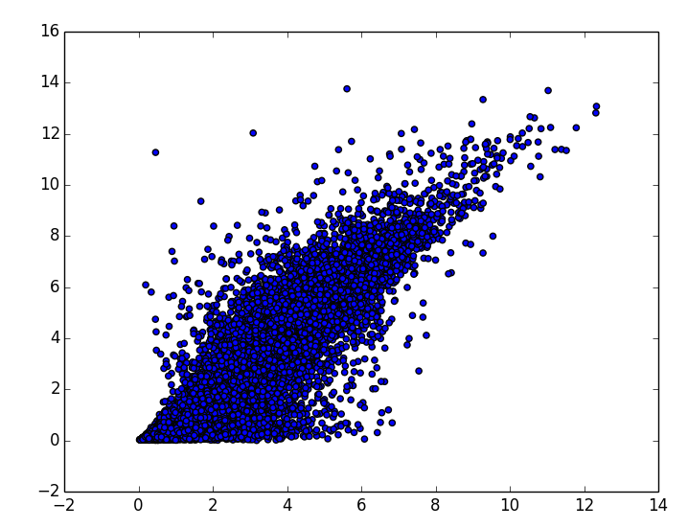
Random Forest Regression
Candy:
What’s the problem – Bias or Variance?
What should we do now?
Training: R = 0.95
Test: R = 0.52
Observed log2(RPKM+1)
Observed log2(RPKM+1)
Predicted log2(RPKM+1)
Predicted log2(RPKM+1)

Slide 28
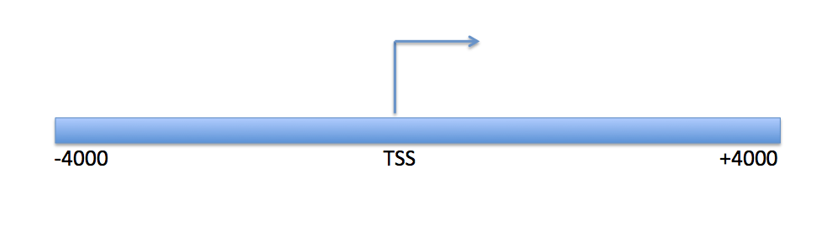
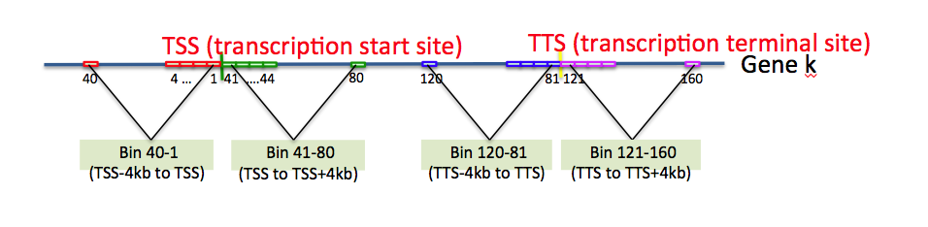
What’s the best model setup?
One bin around TSS
Candy: Which setup do we expect to perform better?
Vs.
80 bins around TSS + 80 bins around TTS
Cheng et al. Genome Biology 2011

Slide 29
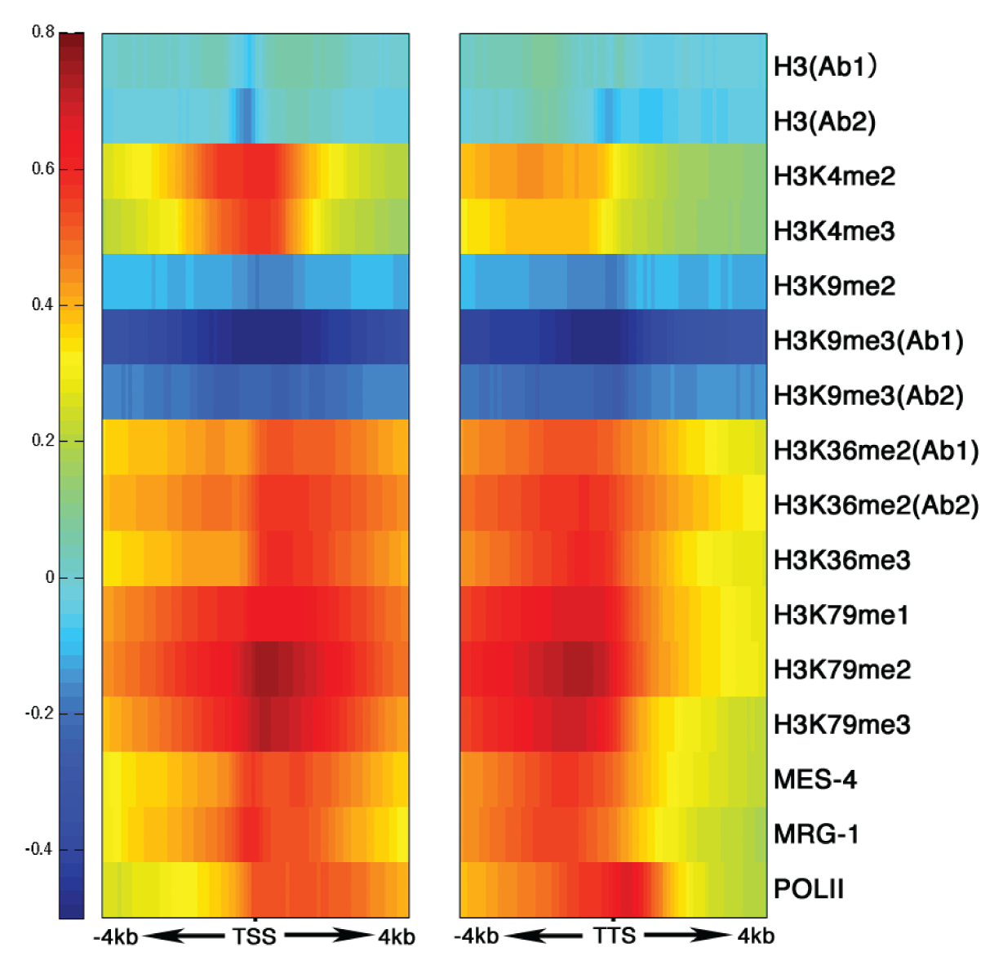
Effects of signal depend on Location!
START
STOP
TTS
Slide by Chao Cheng
Gerstein*,…, Cheng* et al. 2010, Science
Correlation between Signal and expression

Slide 30
Setting up the model
TSS (transcription start site)
TTS (transcription terminal site)
Gene k
40
1
80
120
81
4 …
41 ….44
121
160
RNA-Seq data
Bin 40-1
(TSS-4kb to TSS)
Bin 41-80
(TSS to TSS+4kb)
Bin 120-81
(TTS-4kb to TTS)
Bin 121-160
(TTS to TTS+4kb)
Prediction target:
Gene expression level
Chromatin features:
Histone modifications
Predictors
~10000 refseq genes
HM1, 2, 3, ……
Bin 1
Bin 2
……
Bin160
Slide by Chao Cheng

Slide 31
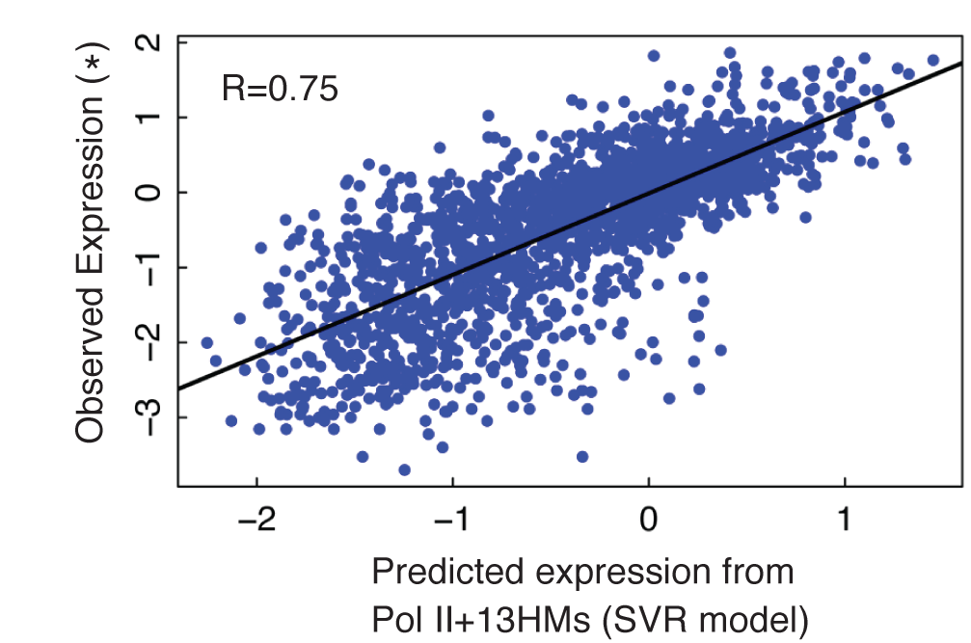
Support vector regression to predict gene expression levels
Slide by Chao Cheng
Notes:
Cite Cheng et al. Genome Research 2013

Slide 32
Context (TA bias)
My implementation:
  Train correlation = 0.95
  Test correlation = 0.58

Slide 33
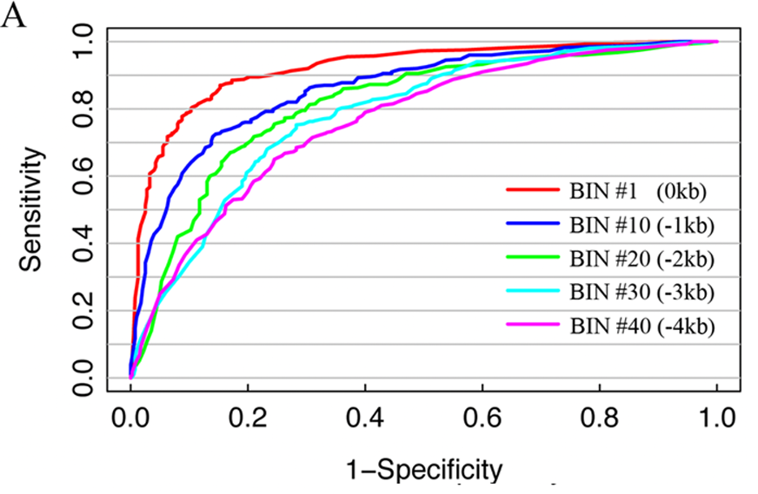
Support vector machine to classify genes with high, medium and low expression
Candy: Describe a ROC curve!
Areas close to TSS predict expression better
Adapted from Chao Cheng

Slide 34
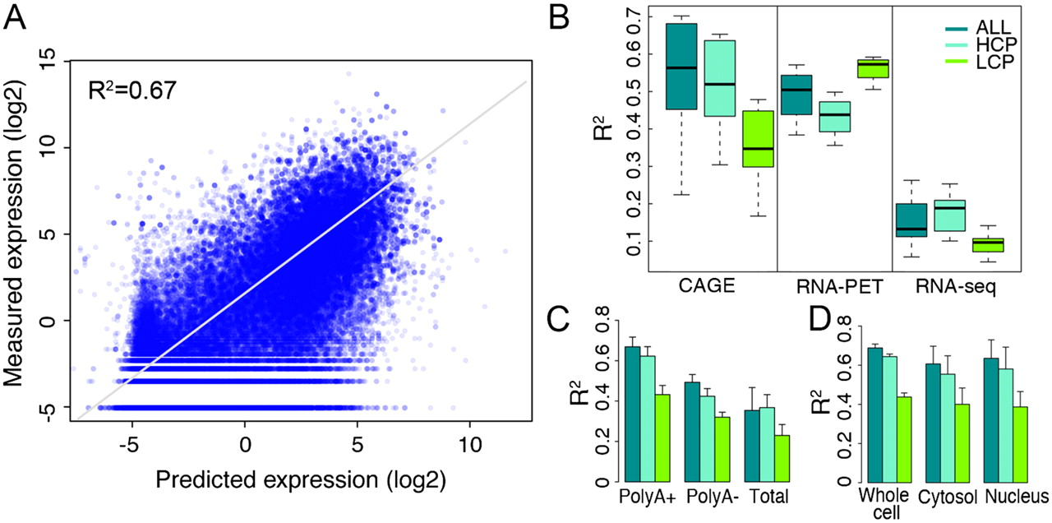
Predicting Gene Expression with Transcription Factor ChIP-Seq signals
| R = 0.81
Cheng et al. Genome Research 2012

Slide 35
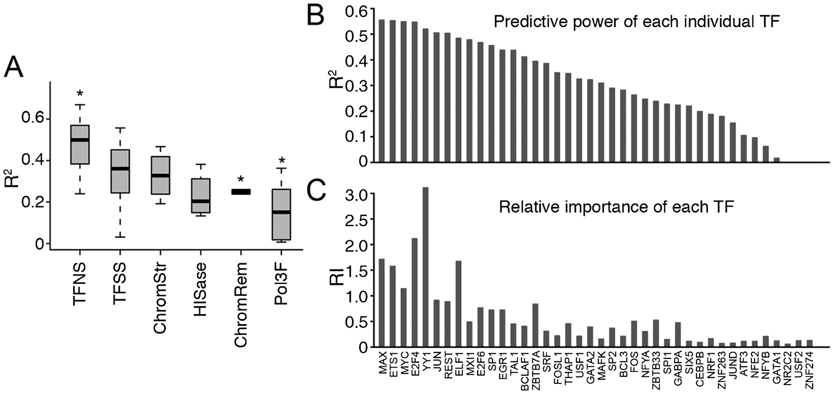
Predicting Gene Expression with Transcription Factor ChIP-Seq signals
Cheng et al. Genome Research 2012

Slide 36
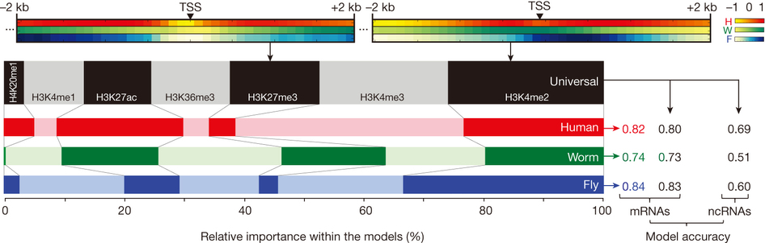
Modeling Transcription Between Organisms
Gerstein et al. Nature 2014

Slide 37
Why do we care?
What are the benefits of a quantitative model?
Does this model help us understand the mechanism of transcription?

Slide 38
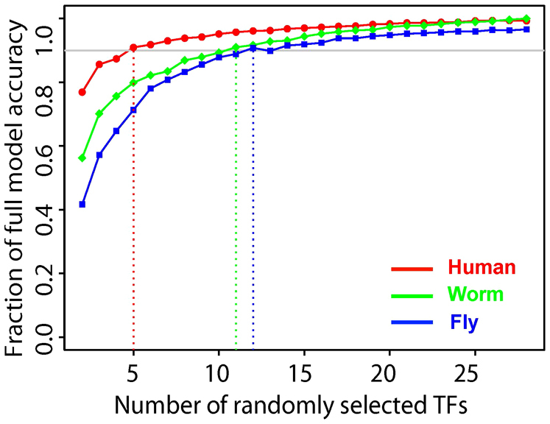
For discussion
Will the prediction model perform accurately in cells with a transcription factor knocked out?
Gerstein et al. Nature 2014

