Slide 1
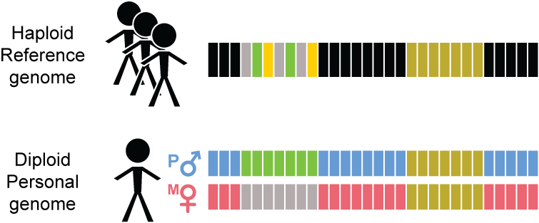
Transitioning from
Reference Genome (RG) to Personal Genome (PG)

Slide 2
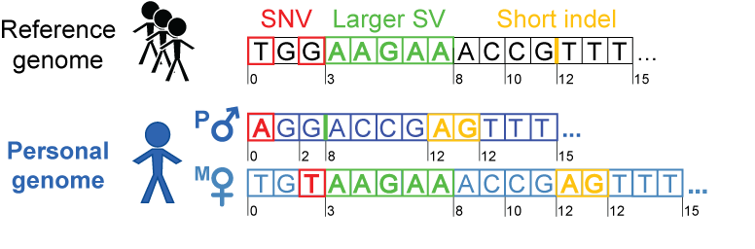
Personal genome construction using vcf2diploid
(fasta; reference)
(vcf, variants
phased or unphased)
(fasta; for each
haplotype)
Rozowsky et al. Mol Syst Biol (2011)

