Slide 1
At least one SNV from
Subj. Z Subj. S na12878 1KG HGMD
Avail PDB IDs (given ENSTs) from BioMart
PDBs are high-quality X-ray structures
PDB Chains are known/avail (UniProt)
SNVs hit within crystallized region of PDB
ResType corresponding to wt residue is consistent btwn VAT file and PDB
(remove redundant proteins)

Slide 2
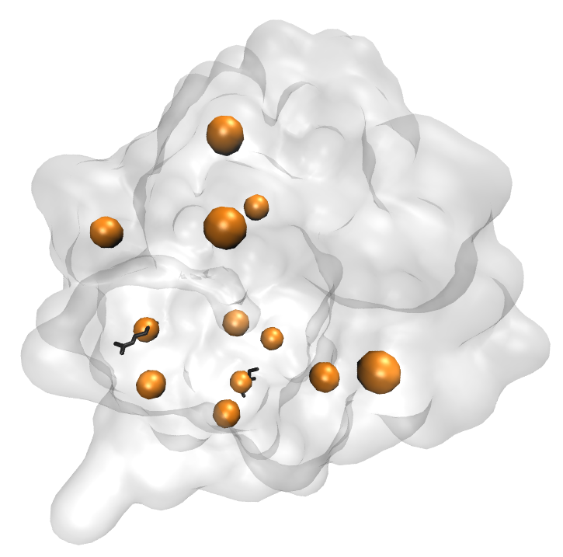
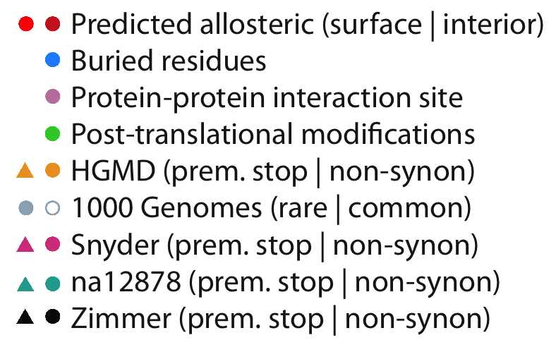
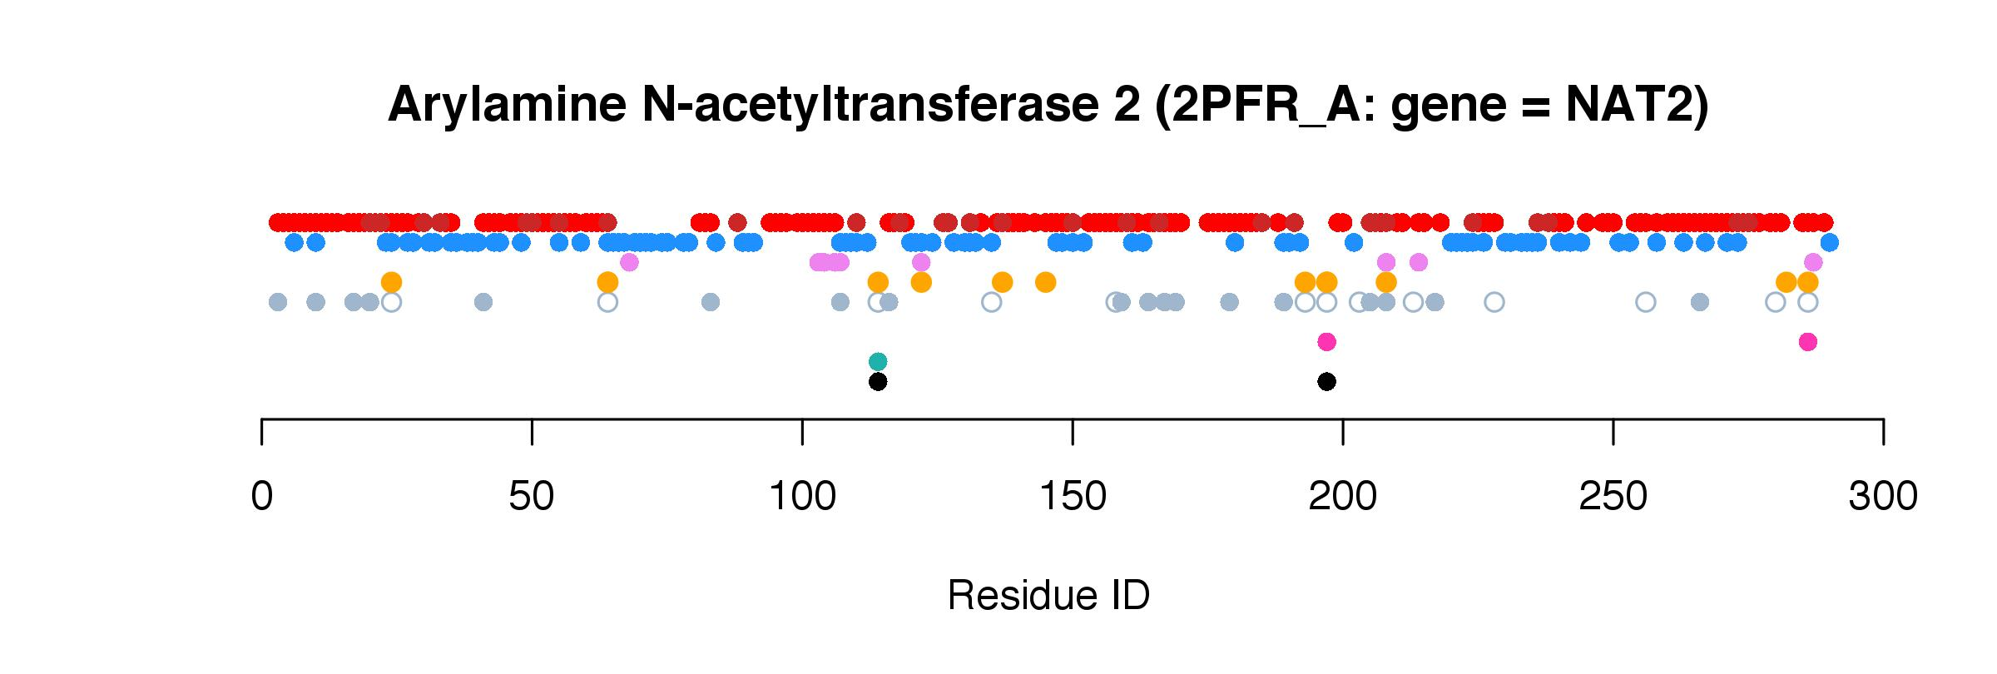
Subj. Z
Notes:
Catalyzes the N- or O-acetylation of various arylamine and heterocyclic amine substrates and is able to bioactivate several known carcinogens

Slide 3
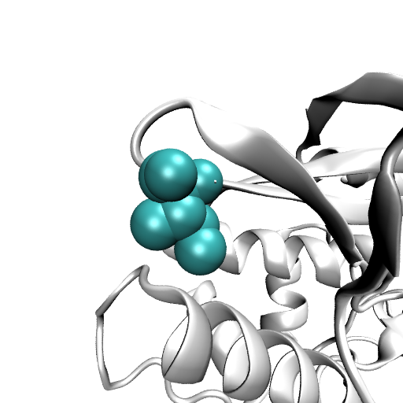
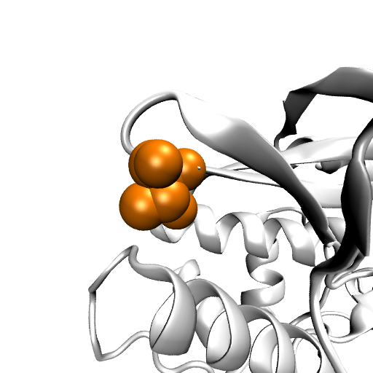
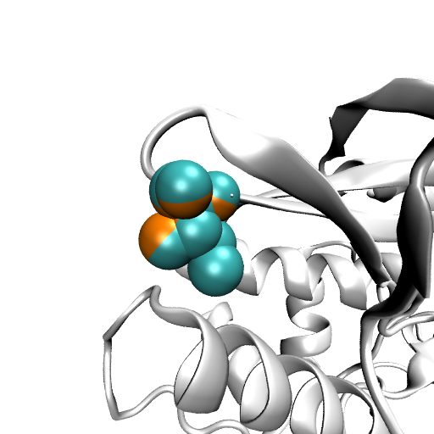
114: I->T
Wild-type Mutated (superimposed)
Notes:
Catalyzes the N- or O-acetylation of various arylamine and heterocyclic amine substrates and is able to bioactivate several known carcinogens

Slide 4
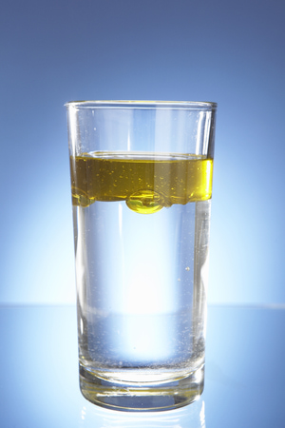
114: I->T
Vatsis (1991) Proc Natl Acad Sci U S A 88, 6333
Notes:
Catalyzes the N- or O-acetylation of various arylamine and heterocyclic amine substrates and is able to bioactivate several known carcinogens

Slide 5
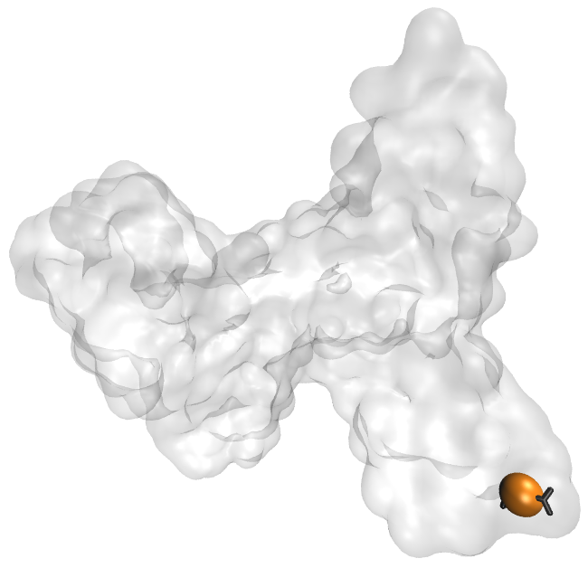
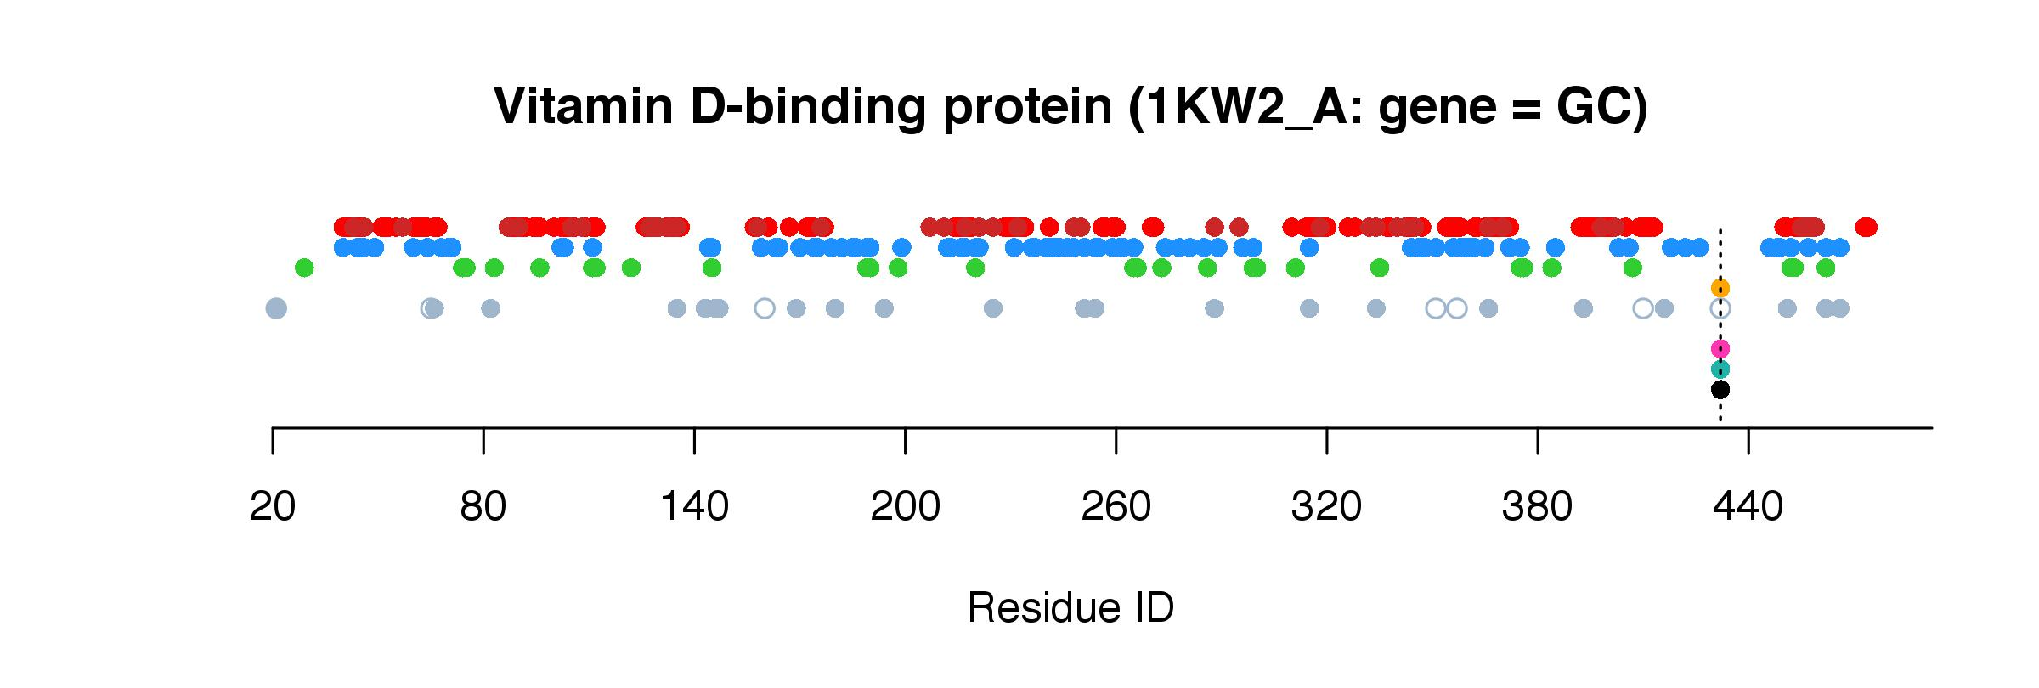
Subj. Z
Notes:
vitamin D-binding protein (DBP) traps the actin monomers, which accelerates their clearance

Slide 6
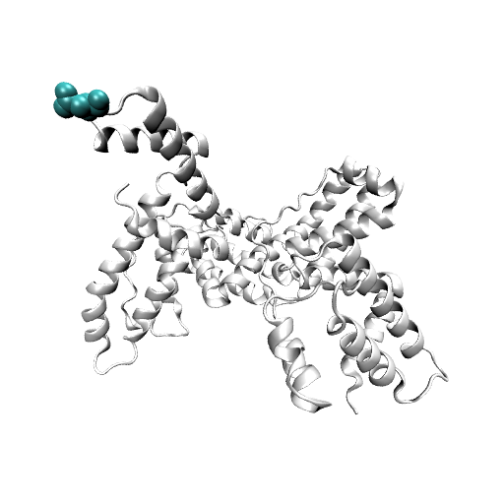
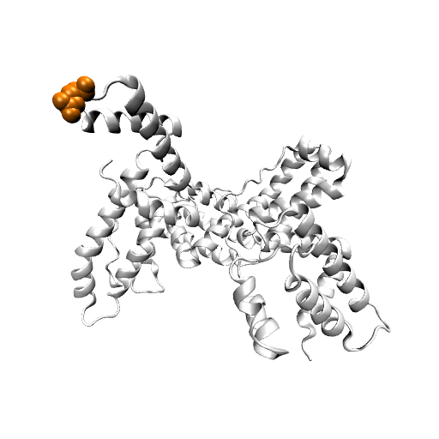
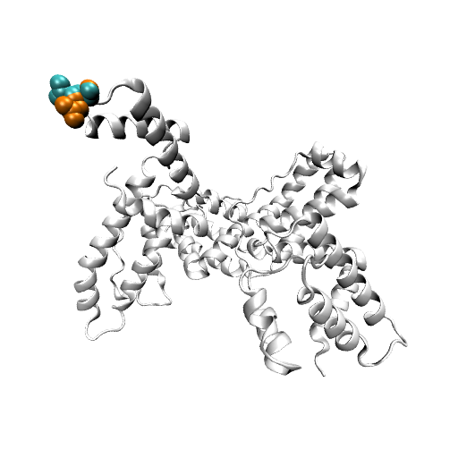
432 D->E
Wild-type Mutated (superimposed)
Notes:
vitamin D-binding protein (DBP) traps the actin monomers, which accelerates their clearance
Aspartate --> Glutamate

Slide 7
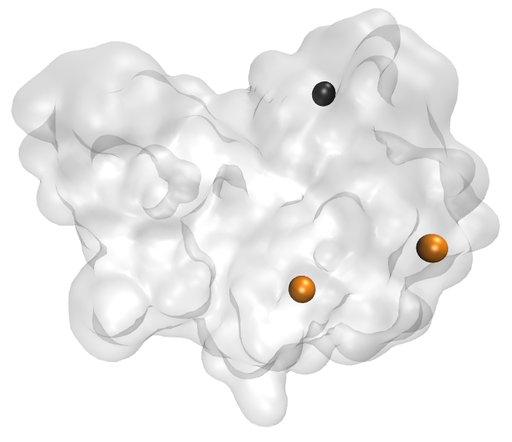
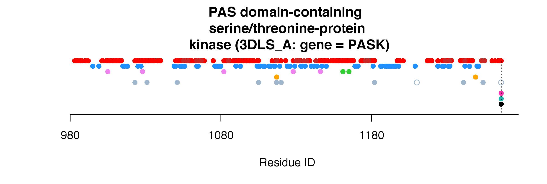
Subj. Z
Notes:
"Nutrient sensing and signaling systems play an important role in coordinating growth, development, and physiology with nutrient availability (1, 2). These systems are required to maintain a dynamic balance between energy intake and expenditure. Failure to do so lies at the heart of metabolic disorders, including diabetes and obesity"
"Mice lacking PASK were resistant to high fat diet-induced lipid accumulation and insulin resistance (14). Thus, both in yeast and mammals, PASK coordinates the utilization of nutrients and energy in response to metabolic state."

Slide 8
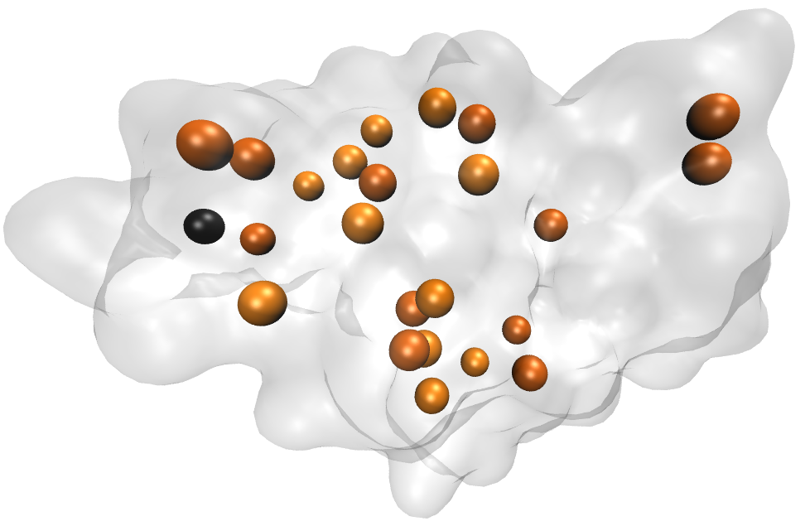
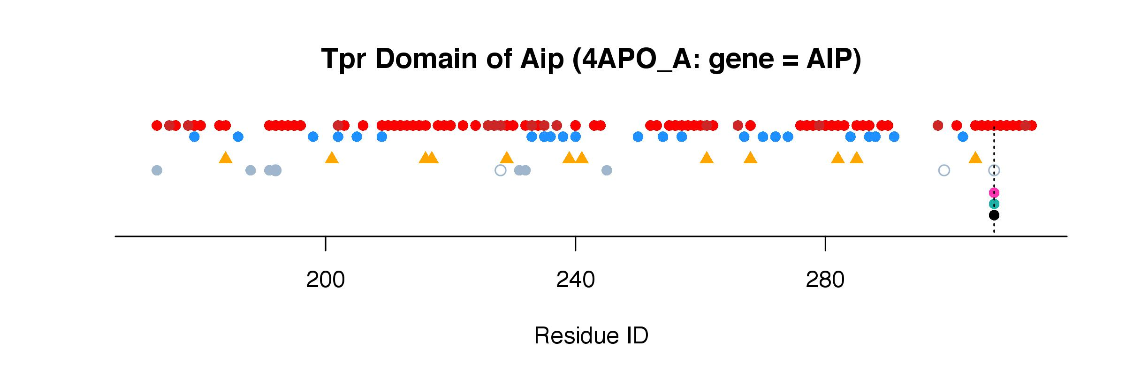
Subj. Z
Notes:
TPR domain
Mutations of the aryl hydrocarbon receptor interacting protein (AIP) have been associated with familial isolated pituitary adenomas
...The precise tumorigenic mechanism is not well understood as AIP interacts with a large number of independent proteins as well as three chaperone systems, HSP90, HSP70 and TOMM20.

