Slide 1
Individual Z Overview
3,559,137
Germline SNVs
3,239,212
Common SNVs
319,925
Rare SNVs
1,800
Coding
318,125
Non-coding
733
Synonymous
1,018
Non-synonymous
15
PreMatureStop
15,007
Enhancer
3,043
Promoter
42,389
Other annotations (TFP, DHS, ncRNA, pseudogene)
Rare variants: MAF<0.05%
Notes:
lincRNA, miRNA, misc_RNA, Pseudogene， rRNA
snoRNA，snRNA
lof on every mutation
total of coding number
check 534 number; should be more?
annotated’s category (UTR?)
rare threshould (1/100? 1/1000; 0.5%?)
enhancer and promoter number comparison; new paper figure 1

Slide 2
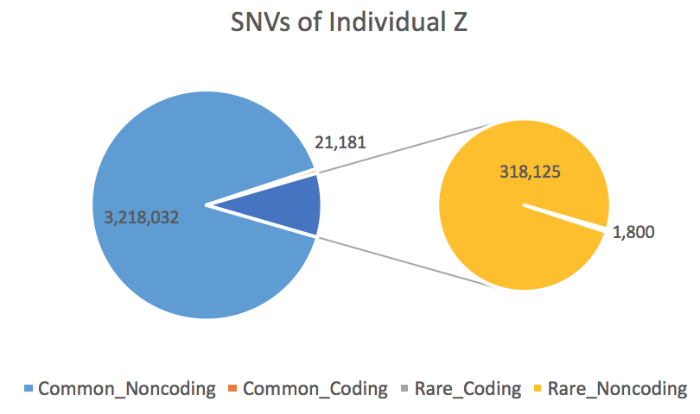
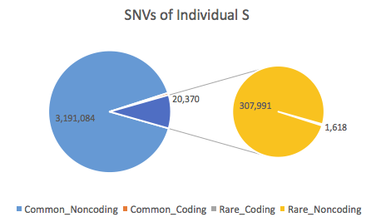
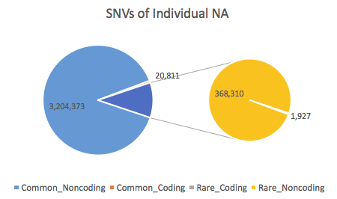
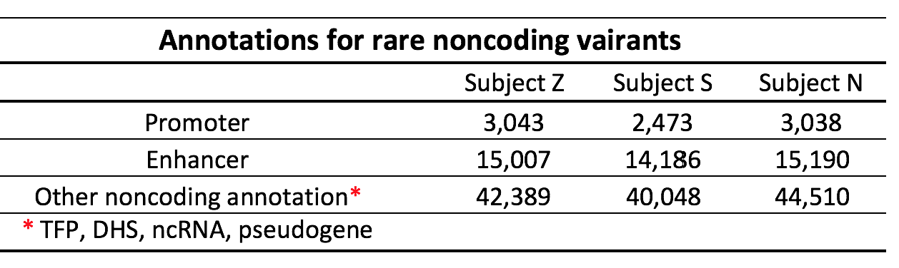
Overview

Slide 3
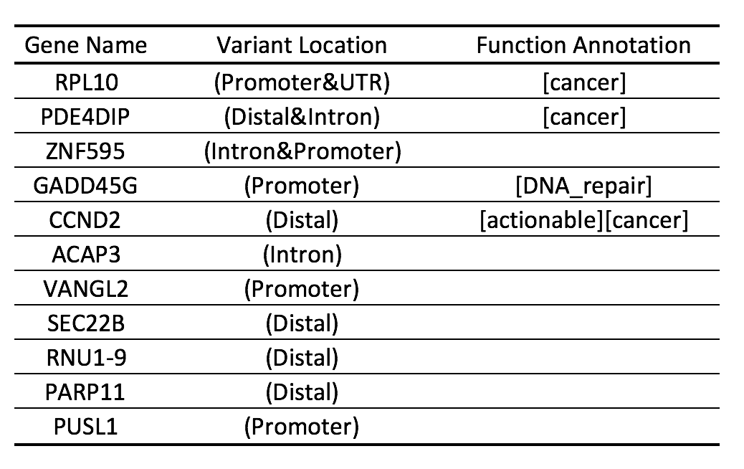
Annotation of Rare Noncoding Variants
975
863
63,753
9 variants -> 11 target genes
Motif Gain
817
14
9
374
Target gene is a hub
In sensitive regions

Slide 4
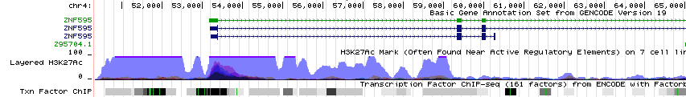
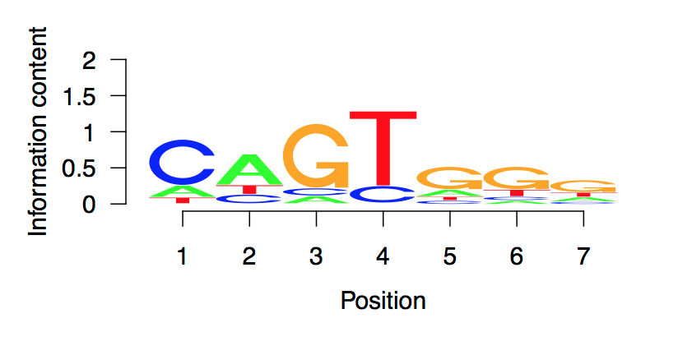
Rare noncoding SNV
  Chr4: 54475
  C => T
  Target gene: Intron of ZNF595
Motif Gain: KLF12 (AP-2)
  Chr4:54469-54476
  Minus strand
KLF12 motif Logo
A
P-value < 4e-8
5

Slide 5
Overlap with Schizophrenia SNPs

Slide 6

Subject Z’s SNVs associated with allele-specific expression (ASE) and binding (ASB)
Allele-specific expression
Allele-specific binding
maternal haplotype
paternal haplotype
Subject Z has 2,081,803 heterozygous SNVs
40,267 and 19,687 of them were found in AlleleDB, assessed for ASE and ASB, respectively
8,680 (ASE) and 734 (ASB) SNVs show some evidence for allele-specific behavior: allele-specific in at least one of the 380 AlleleDB individuals
173 of SNVs show consistent association with ASE across AlleleDB individuals: present in more than 100 individuals and found to be allele-specific in more than 95% of them
alleledb.gersteinlab.org

