Slide 1
Jitterbug uses discordant and clipped reads to predict TEIs (Transposable Element Insertions)
Hénaff et al 2015, BMC Genomics
https://github.com/elzbth/jitterbug
Notes:
So now I'd like to talk about the computational methods used to do so.
So, when you compare two genomes and describe the differences you see between them, you take one as a reference and the other as a sample, and describe as insertion or deletions elements that are present or absent in the sample with respect to the reference.
Jitterbug uses discordant and clipped reads to predict TE insertions with respect to an assembled reference

Slide 2
452 TEI in CZ's genome
These represent “normal variation, ‘ since they are also present in the PCAWG (Pan-Cancer analysis of Whole Genomes (PCAWG) normal samples, over 64 individuals, total of 5149 loci)
4 of which (all Alus) are in introns, of the following genes:
MIR7641-2
RBM6
BRWD1
ENY2
11 TEI in common with Genome in a Bottle GIAB) trio (son, father, mother):
HG002: 6
HG003: 5
HG004: 9

Slide 3
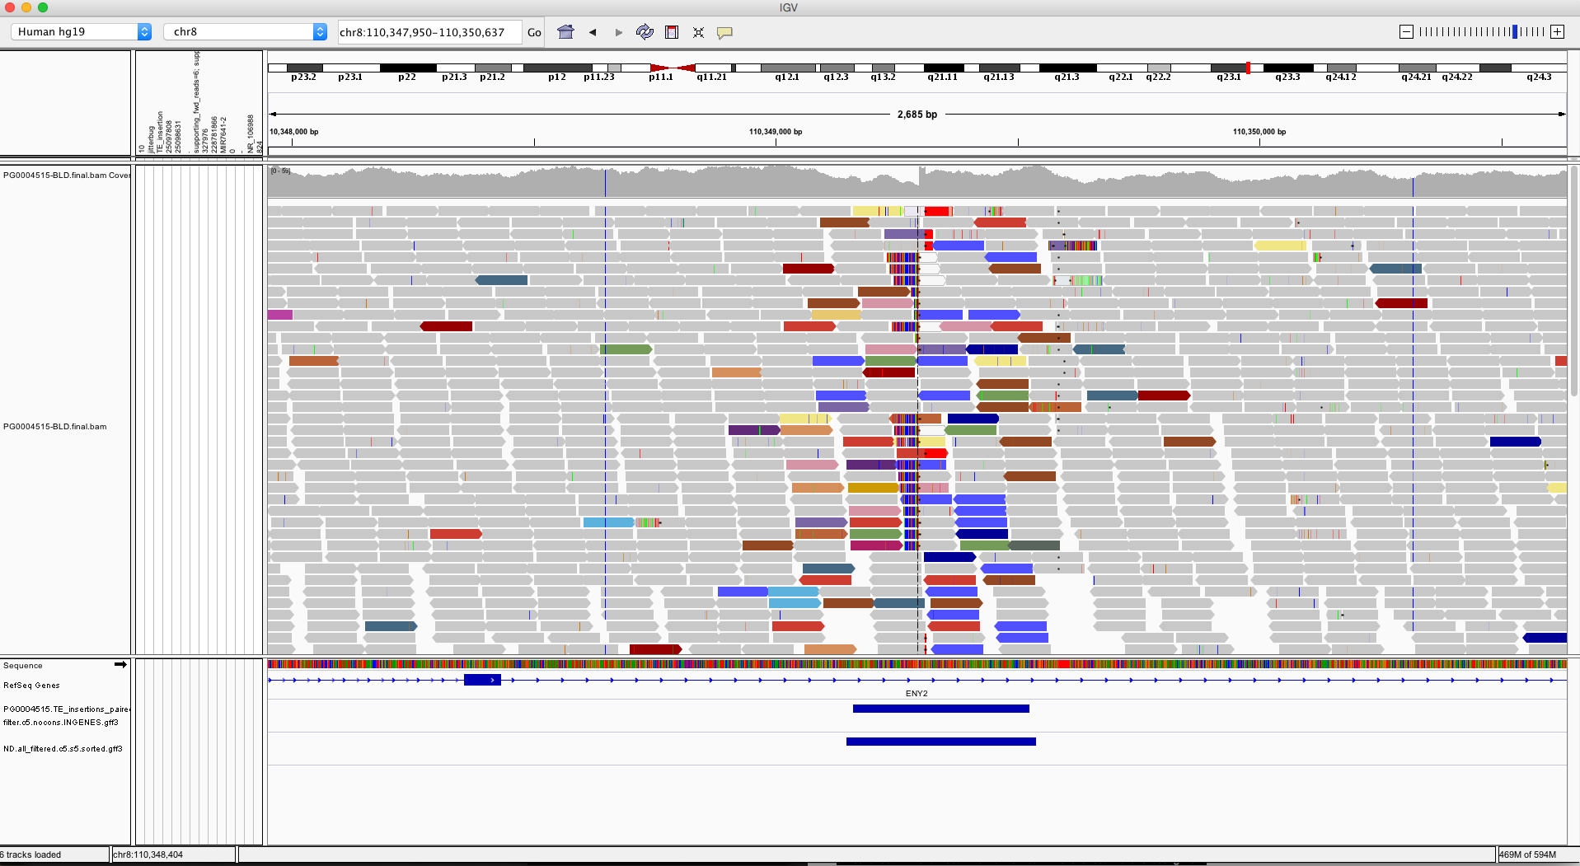
Example1
Colors show the discordant reads

Slide 4
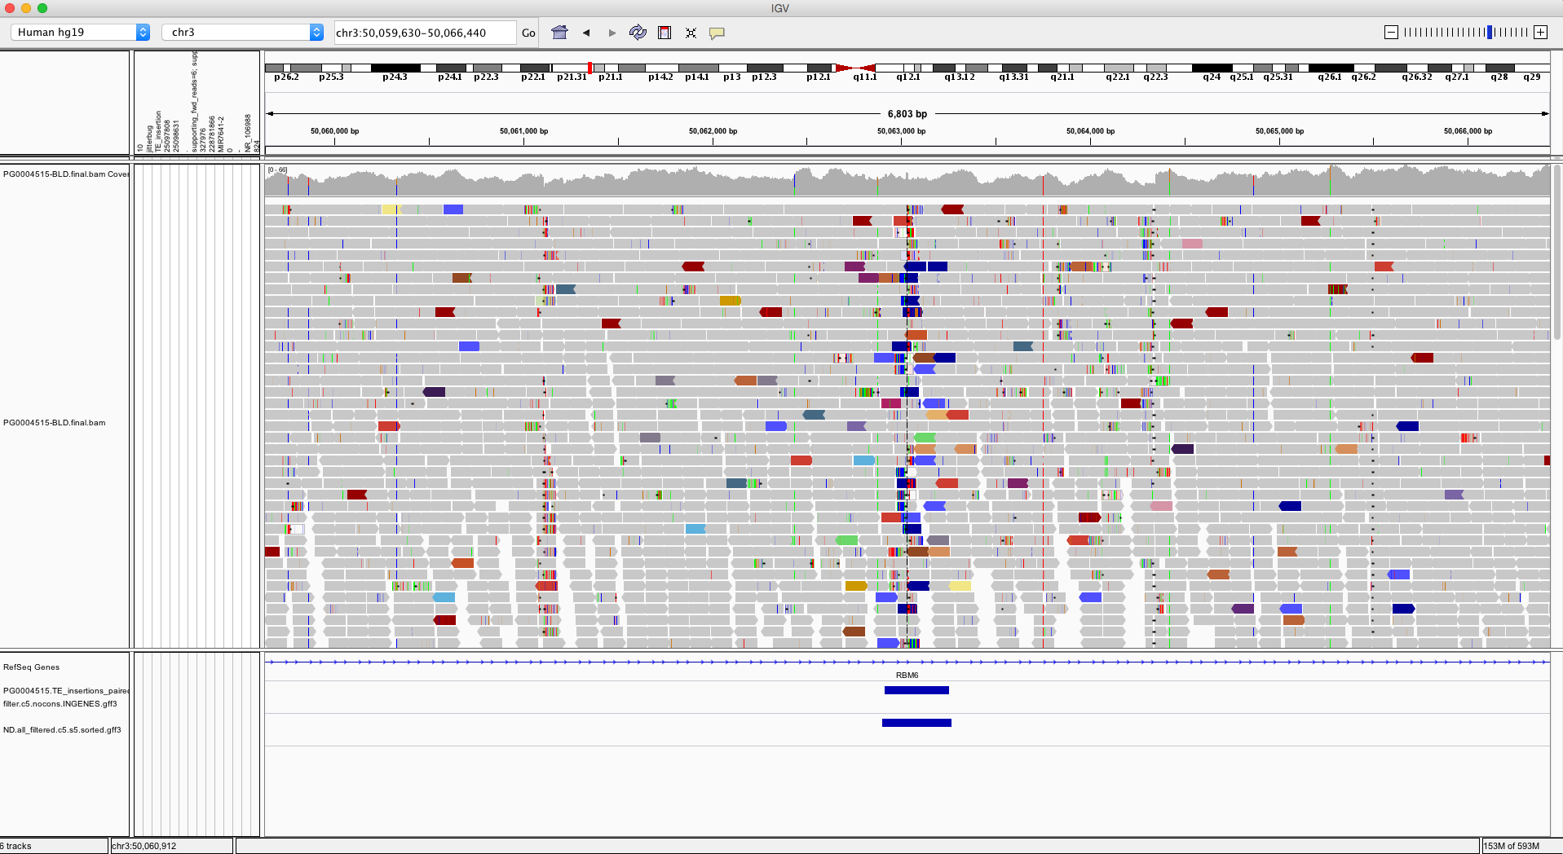
Example2
Colors show the discordant reads

