Slide 1
CWZ’s Genome
March 18, 2016

Slide 2
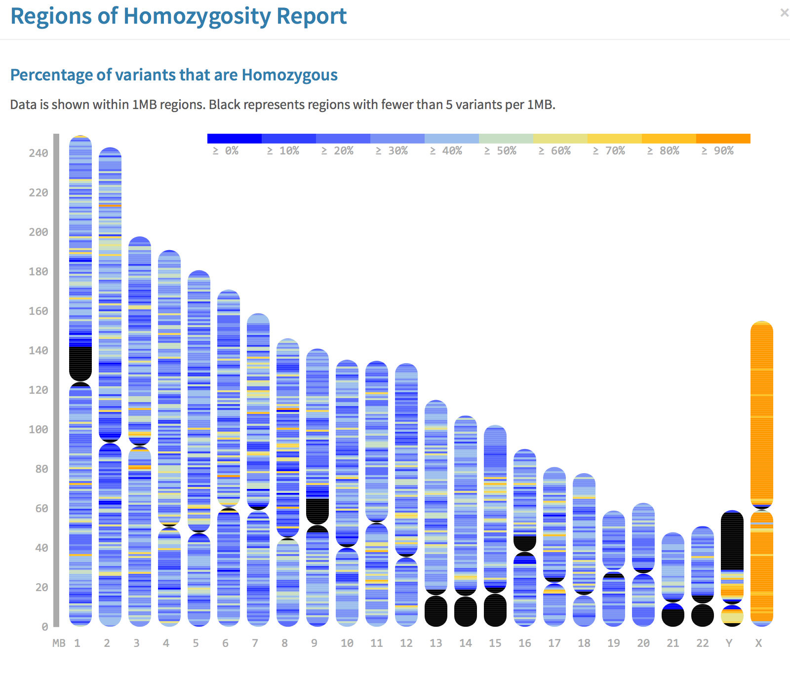
We have confirmed you are male!
chromosome

Slide 3
Global Stats
Type | Total | Homo | Hetero
Total | 4,794,784 | 37% | 63%
SNP | 3,998,314 | 37% | 63%
INS | 386,764 | 38% | 62%
DEL | 409,706 | 34% | 66%
SnpEff 3.3c

Slide 4
Variant Effects
Type | Count | Percent
NON_SYNONYMOUS_START | 5 | 0%
NONE | 13 | 0%
SYNONYMOUS_STOP | 23 | 0%
START_LOST | 24 | 0%
STOP_LOST | 48 | 0.00%
CODON_CHANGE_PLUS_CODON_INSERTION | 78 | 0.00%
CODON_CHANGE_PLUS_CODON_DELETION | 142 | 0.00%
STOP_GAINED | 157 | 0.00%
CODON_INSERTION | 166 | 0.00%
SPLICE_SITE_ACCEPTOR | 167 | 0.00%
CODON_DELETION | 173 | 0.00%
SPLICE_SITE_DONOR | 256 | 0.00%
FRAME_SHIFT | 570 | 0.01%
START_GAINED | 1,296 | 0.02%
UTR_5_PRIME | 9,031 | 0.13%
NON_SYNONYMOUS_CODING | 18,141 | 0.25%
EXON | 18,375 | 0.26%
SYNONYMOUS_CODING | 20,722 | 0.29%
UTR_3_PRIME | 58,932 | 0.82%
UPSTREAM | 313,113 | 4.34%
DOWNSTREAM | 322,452 | 4.47%
INTERGENIC | 2,958,835 | 40.99%
INTRON | 3,495,708 | 48.43%
Region | Count | Percent
NONE | 13 | 0.00%
SPLICE_SITE_ACCEPTOR | 167 | 0.00%
SPLICE_SITE_DONOR | 256 | 0.00%
UTR_5_PRIME | 10,327 | 0.14%
EXON | 58,624 | 1%
UTR_3_PRIME | 58,932 | 0.82%
UPSTREAM | 313,113 | 4.34%
DOWNSTREAM | 322,452 | 4%
INTERGENIC | 2,958,835 | 41%
INTRON | 3,495,708 | 48%

Slide 5
Protective alleles
Good news first

Slide 6
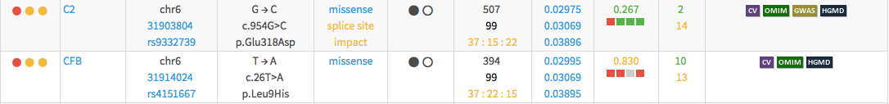
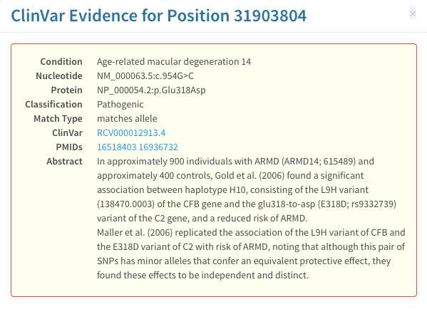
Reduced risk of age-related macular degeneration

Slide 7
Lower risk of Inflammatory Bowel Disease and Psoriasis (autoimmune)
Notes:
table shows all variants found in the gene, red highlight shows which variant is responsible for the clinical effect

Slide 8
Protection against Inflammatory Bowel Disease and Psoriasis
Notes:
table shows all variants found in the gene, red highlight shows which variant is responsible for the clinical effect

Slide 9
Protection against Type II Diabetes and Metabolic Syndromes

Slide 10
Protection against Type II Diabetes and Metabolic Syndromes

Slide 11
Protection against Myocardial Infarction and Venous Thrombosis

Slide 12
Protection against Myocardial Infarction and Venous Thrombosis

Slide 13
Protection against Coronary Heart Disease

Slide 14
Protection against Coronary Heart Disease

Slide 15
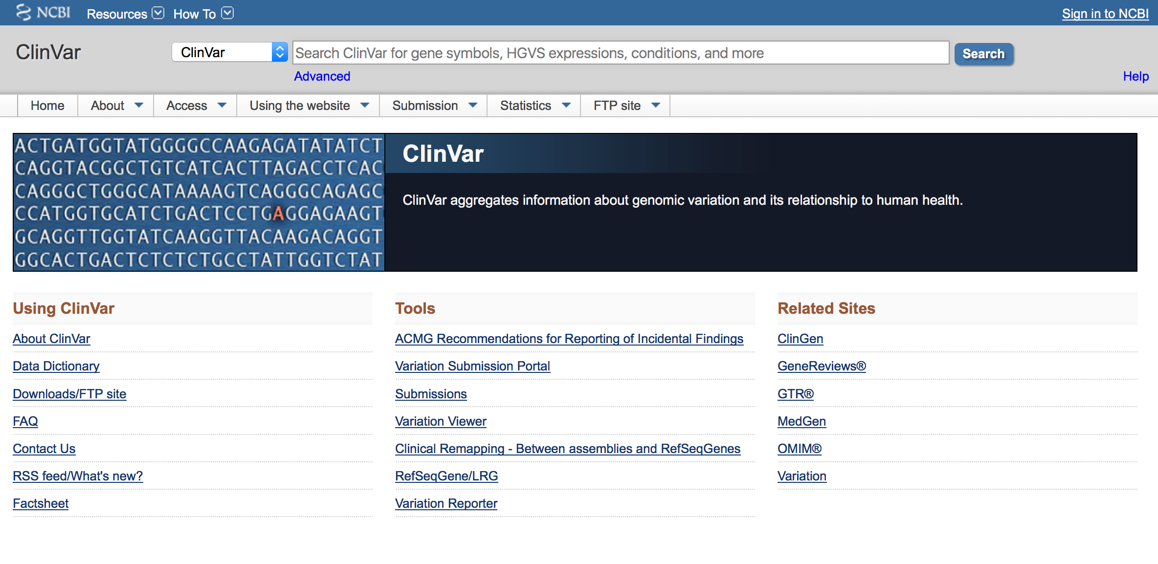
Maybe bad news: potentially pathogenic SNVs

Slide 16
Clinical data (pathogenic SNVs)
3,143 in ClinVar
  41/3,143 pathogenic (CLNSIG=5)
    5/41 not common
240/3,143 non-synonymous (moderate or high impact by snpeff) and in OMIM
TERT | H412Y | PULMONARY_FIBROSIS_AND/OR_BONE_MARROW_FAILURE\x2c_TELOMERE-RELATED\x2c_1|Aplastic_anemia|Dyskeratosis_congenita\x2c_autosomal_recessive\x2c_4
PRSS1 | N29I | Hereditary_pancreatitis,Hereditary_pancreatitis
PRSS1 | N54S | Hereditary_pancreatitis
SAA1 | A70V | Serum_amyloid_a_variant
MEFV | V726A | Familial_Mediterranean_fever

Slide 17
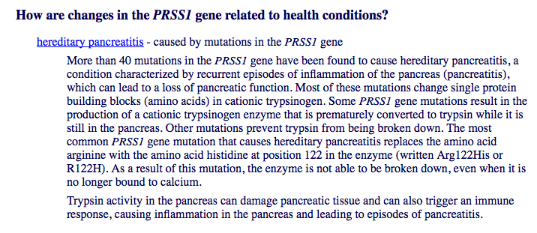
PRSS1 (protease, serine 1)
Hereditary Pancreatitis
https://ghr.nlm.nih.gov/gene/PRSS1

Slide 18
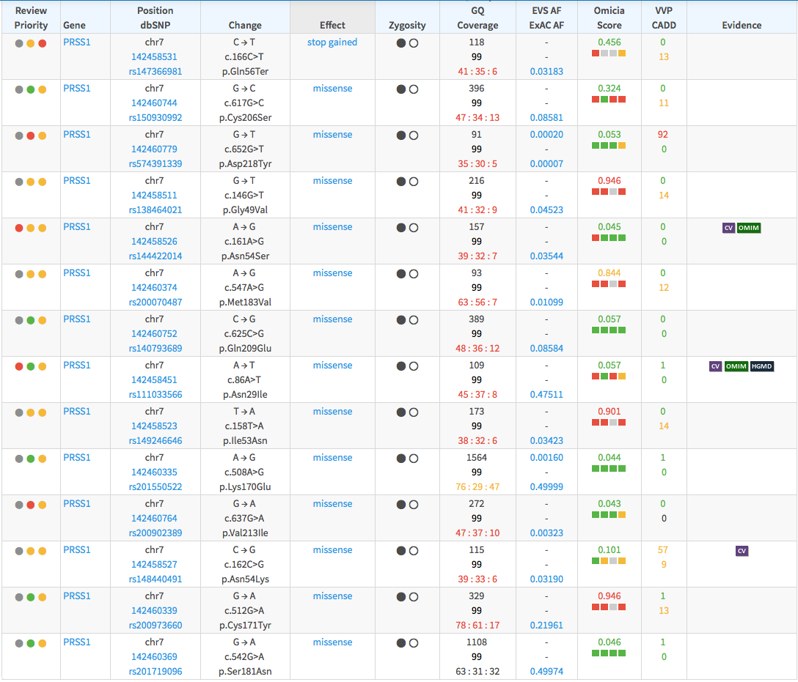
14 PRSS1 SNVs

Slide 19
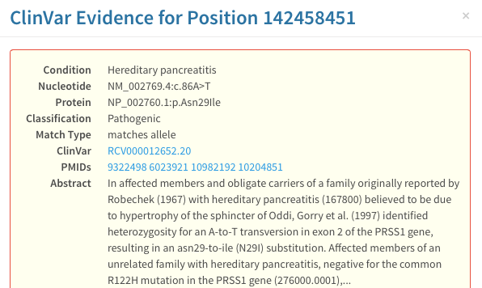
14 PRSS1 SNVs

Slide 20
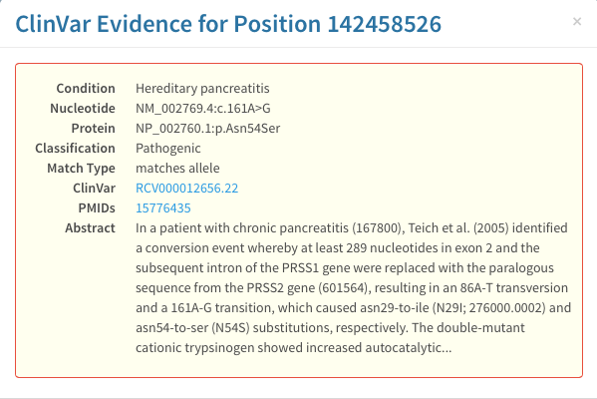
http://www.ncbi.nlm.nih.gov/pubmed/15776435
14 PRSS1 SNVs

Slide 21
Clinical data (pathogenic SNVs)
3,143 in ClinVar
  41/3,143 pathogenic (CLNSIG=5)
    5/41 not common
240/3,143 non-synonymous (moderate or high impact by snpeff) and in OMIM
TERT | H412Y | PULMONARY_FIBROSIS_AND/OR_BONE_MARROW_FAILURE\x2c_TELOMERE-RELATED\x2c_1|Aplastic_anemia|Dyskeratosis_congenita\x2c_autosomal_recessive\x2c_4
PRSS1 | N29I | Hereditary_pancreatitis,Hereditary_pancreatitis
PRSS1 | N54S | Hereditary_pancreatitis
SAA1 | A70V | Serum_amyloid_a_variant
MEFV | V726A | Familial_Mediterranean_fever

Slide 22
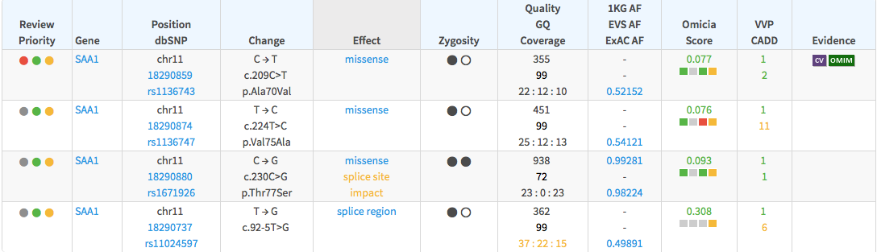
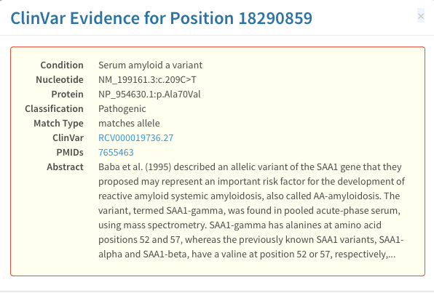
variant may increase risk of reactive systemic amyloidosis (AA-amyloidosis) which is a rare complication of common chronic inflammatory diseases such as rheumatoid arthritis
http://www.ncbi.nlm.nih.gov/pubmed/7655463

Slide 23
Clinical data (pathogenic SNVs)
3,143 in ClinVar
  41/3,143 pathogenic (CLNSIG=5)
    5/41 not common
240/3,143 non-synonymous (moderate or high impact by snpeff) and in OMIM
TERT | H412Y | PULMONARY_FIBROSIS_AND/OR_BONE_MARROW_FAILURE\x2c_TELOMERE-RELATED\x2c_1|Aplastic_anemia|Dyskeratosis_congenita\x2c_autosomal_recessive\x2c_4
PRSS1 | N29I | Hereditary_pancreatitis,Hereditary_pancreatitis
PRSS1 | N54S | Hereditary_pancreatitis
SAA1 | A70V | Serum_amyloid_a_variant
MEFV | V726A | Familial_Mediterranean_fever

Slide 24
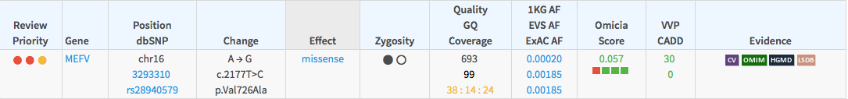
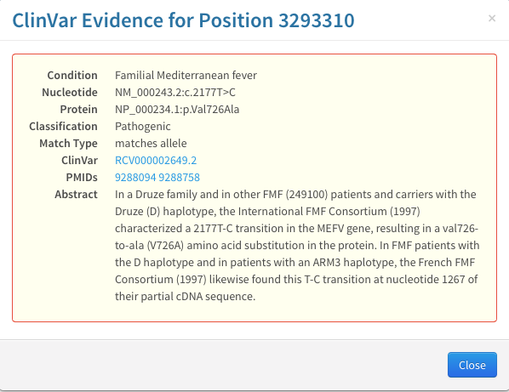
recessive inheritance

Slide 25
Reduced risk of age-related macular degeneration

Slide 26
5 Notable ClinVar genes:
1. TERT H412Y:
PULMONARY_FIBROSIS_AND/OR_BONE_MARROW_FAILURE\x2c_TELOMERE-RELATED\x2c_1|Aplastic_anemia|Dyskeratosis_congenita\x2c_autosomal_recessive\x2c_4
2. PRSS1 N29I: Hereditary_pancreatitis,Hereditary_pancreatitis
3. PRSS1 N54S:
Hereditary_pancreatitis
4. SAA1 A70V:
Serum_amyloid_a_variant
5. MEFV V726A:
Familial_Mediterranean_fever

Slide 27
Most mutated non-coding areas under TFBSs
STAT4 (Signal Transducer And Activator Of Transcription)
AP1 (Activator Protein 1)
EGR1 (nerve growth)
AP2GAMMA1 (neural crest)
GATA1 (hematopoietic TF)

Slide 28
Most mutated VISTA enhancers
1) VistaEnhancer_hg19:element 2082 | positive | dorsal root ganglion[3/7] | trigeminal V (ganglion, cranial)[3/7]
2) VistaEnhancer_hg19:element 2084 | positive | other[4/5]
3) VistaEnhancer_hg19:element 1760 | positive | heart[14/14]
4) VistaEnhancer_hg19:element 1886 | positive | heart[5/8]
5) VistaEnhancer_hg19:element 1385 | positive | hindbrain (rhombencephalon)[3/5] | midbrain (mesencephalon)[4/5]
6) VistaEnhancer_hg19:element 1391 | positive | midbrain (mesencephalon)[7/9] | forebrain[7/9]

Slide 29
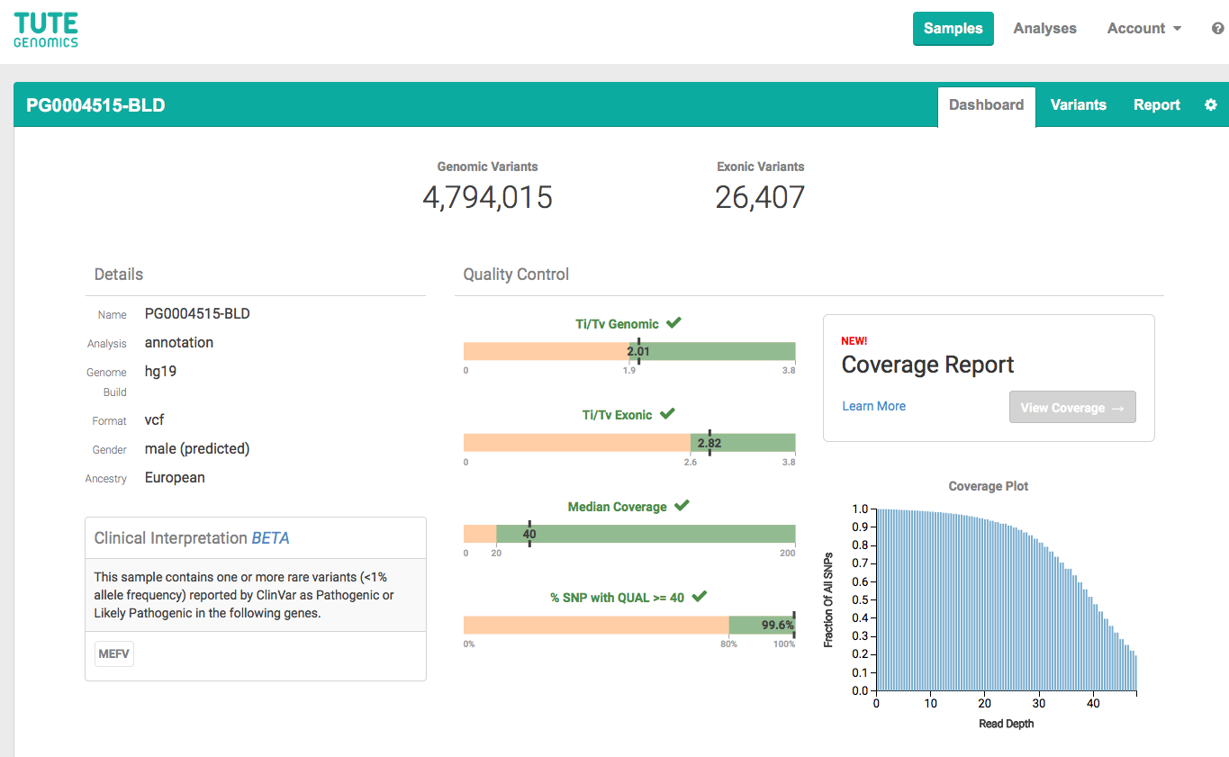
Comparison to another tool: Tute Genomics

Slide 30
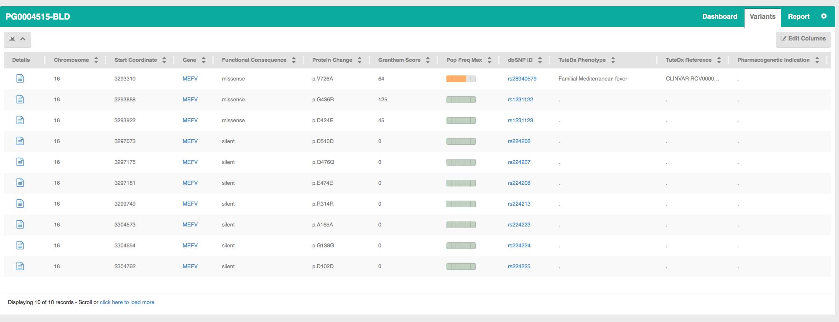
Mediterranean Fever again?

Slide 31
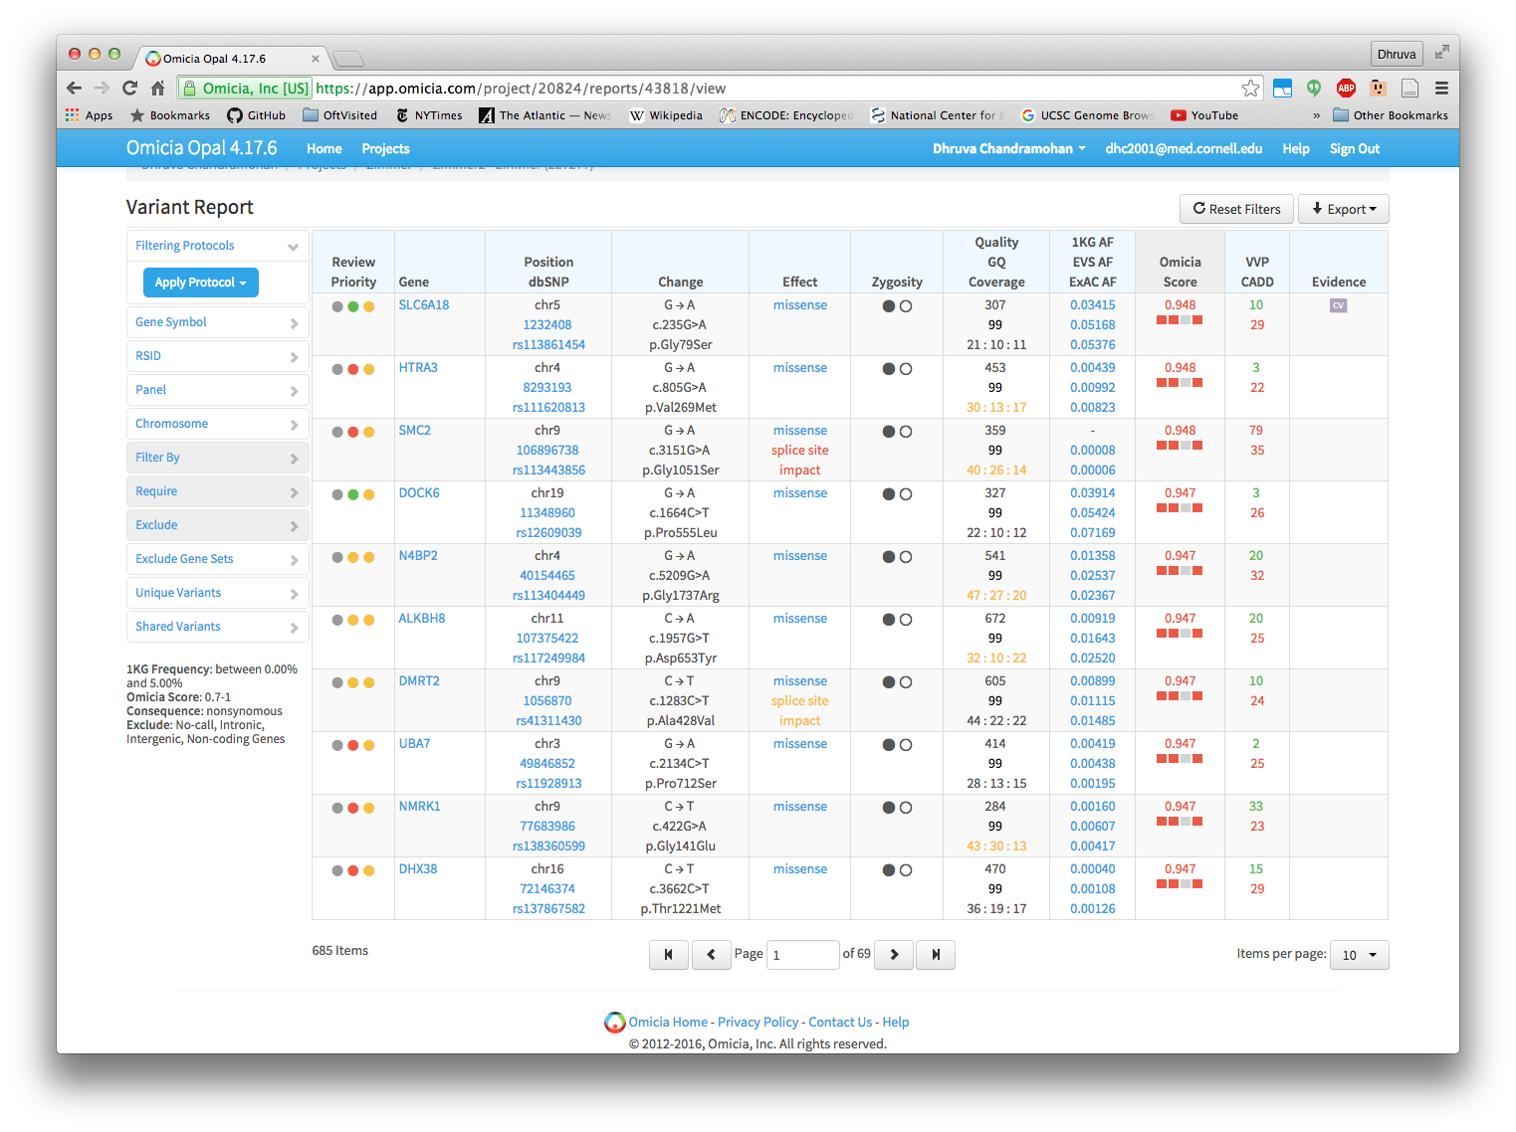
Another method: Omicia

Slide 32
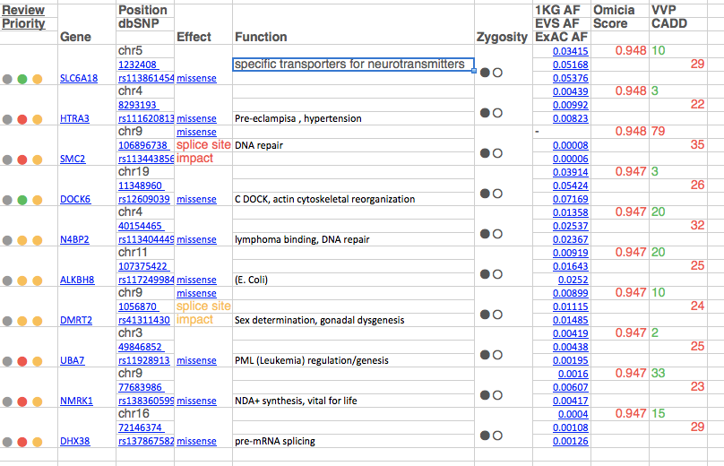
Omicia Top 10 Variants For Review, Ranked by Omicia Score
(rare, in proteins, high deleterious score)

Slide 33
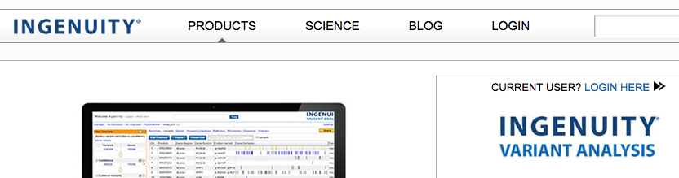
A third genome interpretation method:
Ingenuity Variant Analysis

Slide 34
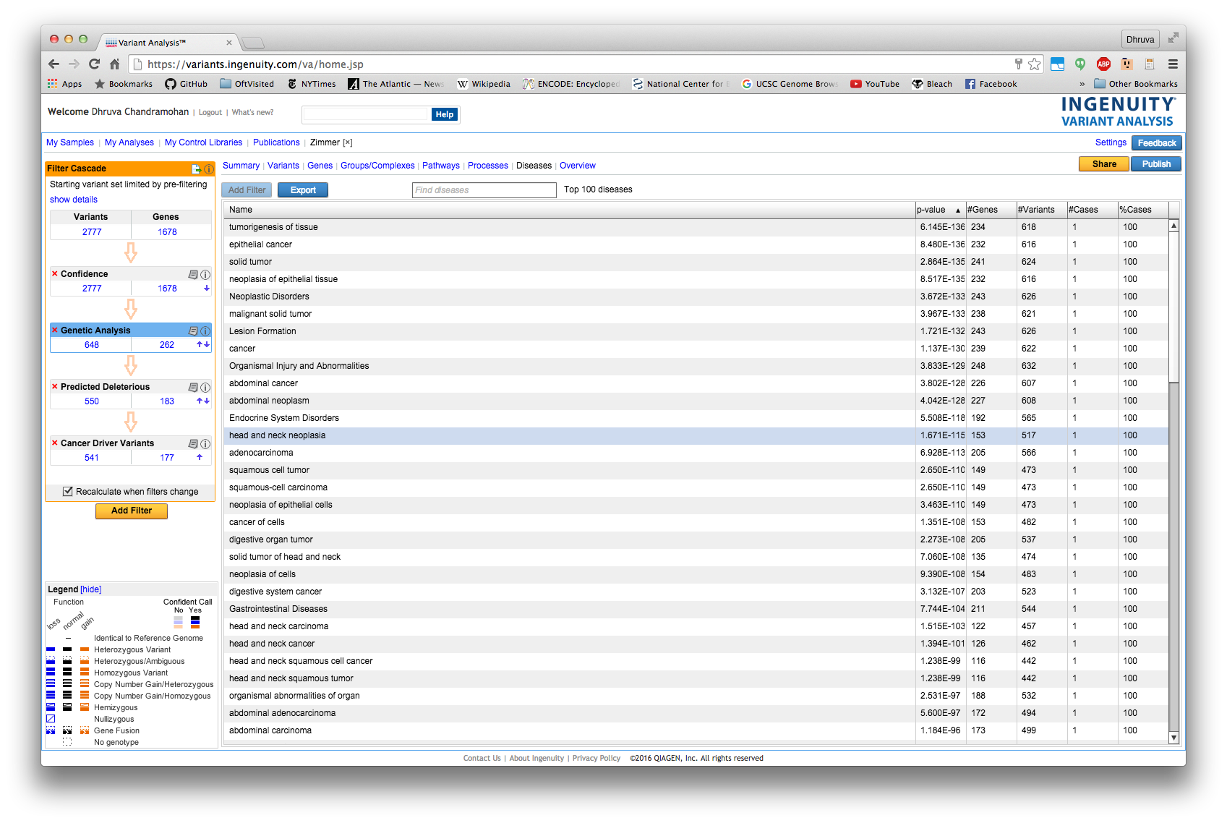
Highest risk for head and neck or epithelial cancer
Epithelial
Head and Neck

Slide 35
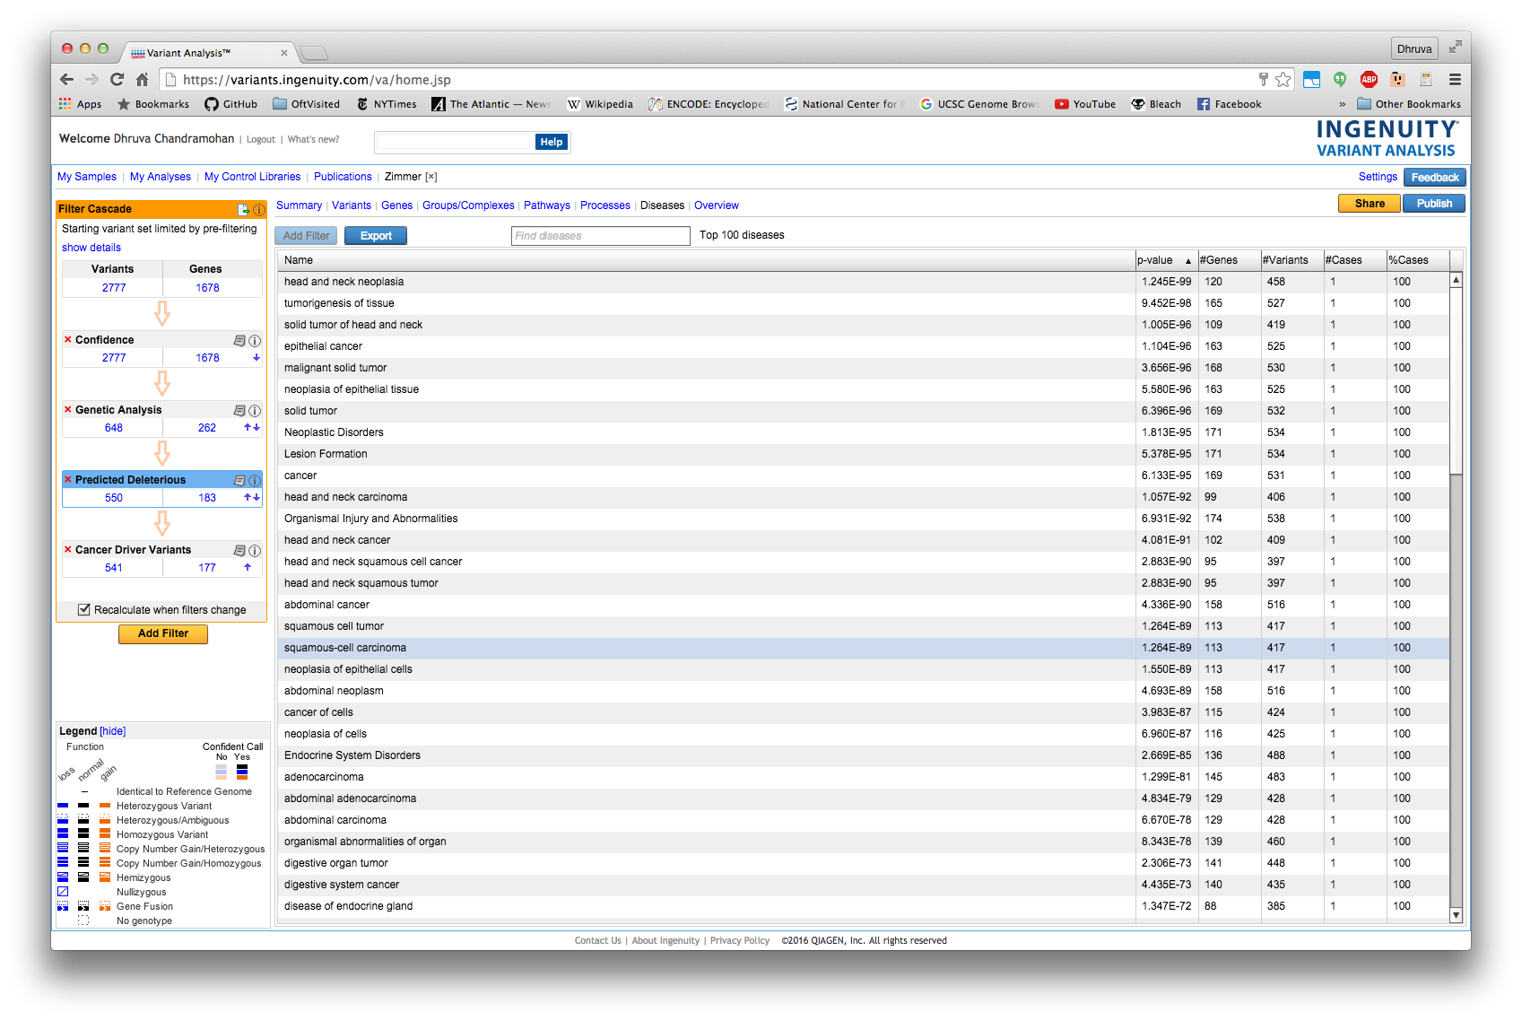
Epithelial
Head and Neck

Slide 36
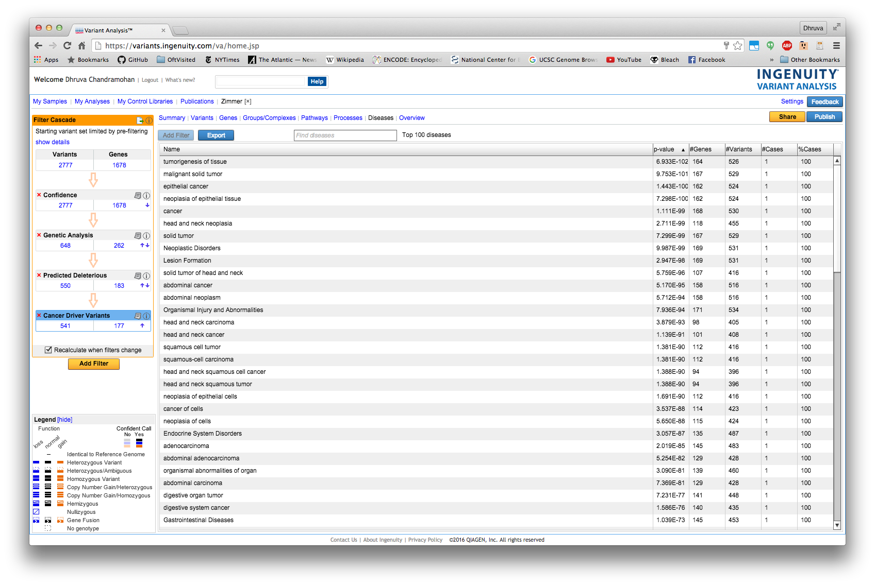
Epithelial
Head and Neck

Slide 37
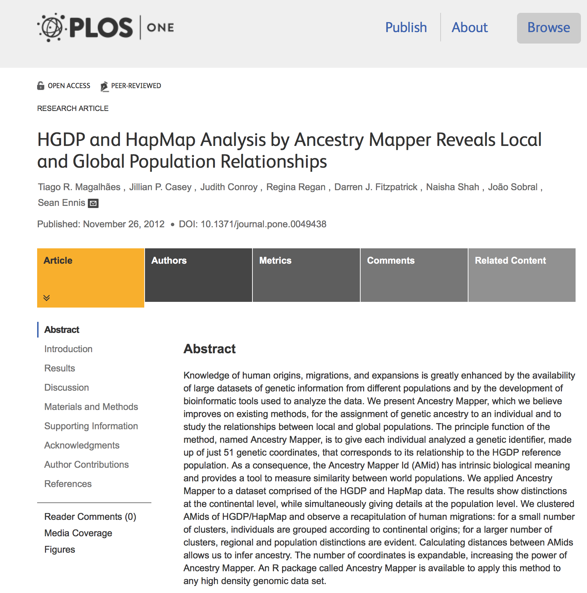
Now, for ancestry!
We used the Human Genetic Diversity Panel (HGDP)
http://journals.plos.org/plosone/article?id=10.1371/journal.pone.0049438
And AncestryMapper (R-package for ancestry analysis)

Slide 38
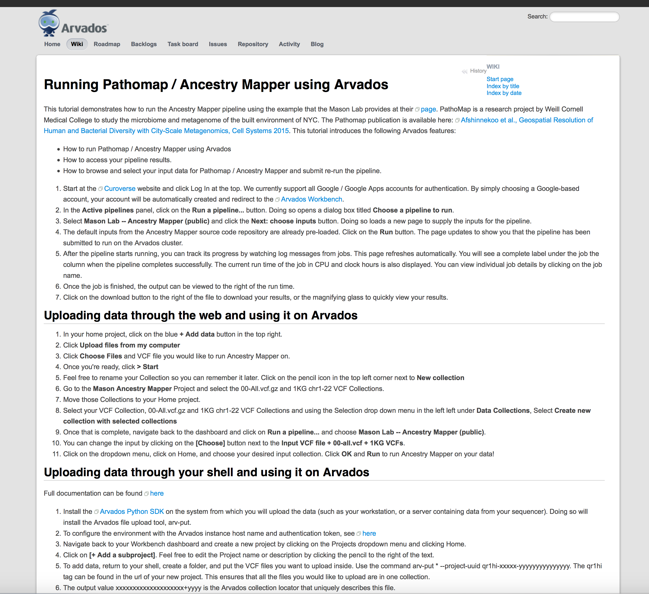
And this freely available tool
https://dev.arvados.org/projects/arvados/wiki/Pathomap_tutorial

Slide 39
You appear more Middle-Eastern and European
Ancestry Mapper Data
Darker Color=
Closer to a population
100 Individuals
CWZ Genome

Slide 40
Darker Color=
Closer to a population
Ancestry Mapper
Compare to
Random 100
Individuals
CWZ Genome

Slide 41
Top 10 Predicted Populations
Rank | Pop | Distance to CWZ
1 | French | 0.8664
2 | Italian | 0.8679
3 | Basque | 0.871
4 | Orcadian | 0.8711
5 | Tuscan | 0.8729
6 | Druze | 0.8732
7 | Sardinian | 0.8752
8 | Russian | 0.8754
9 | Palestinian | 0.876
10 | Adygei | 0.8785
50 | San | 0.9969
…

Slide 42
Methods Pipeline
#!/bin/bash
invcf=PG0004515-BLD.final.vcf
snpeff=/home/paz2005/gmake-1.0/third-party/snpEff/snpEff.jar
snpeff_config=/home/paz2005/gmake-1.0/third-party/snpEff/snpEff.config
snpsift=/home/paz2005/gmake-1.0/third-party/snpEff/SnpSift.jar
samp=${invcf%.vcf}
#1. snpeff
java -Xmx4g -jar $snpeff -c ${snpeff_config} -v -i vcf -o vcf hg19 $invcf > ${samp}.snpeff.vcf
#2. clinvar
java –Xmx4g –jar $snpsift annotate -v clinvar_20160302.vcf ${samp}.snpeff.vcf \
> ${samp}.snpeff.clinvar.vcf
#3. filter read depth 10 and quality 30
cat ${samp}.snpeff.clinvar.vcf| java -Xmx4g -jar $snpsift filter " (( QUAL >= 30 ) & ( DP >= 10 )) " > ${samp}.snpeff.clinvar.minDP10minQ30.vcf
#4. filter high priority
echo "In clinvar:"
grep -v "^#" ${samp}.snpeff.clinvar.minDP10minQ30.vcf | grep -c "CLNACC"
echo "In clinvar + snpeff MODERATE or HIGH impact:"
grep -v "^#" ${samp}.snpeff.clinvar.minDP10minQ30.vcf | grep "CLNACC" | grep -Ec "MODERATE|HIGH"
echo "In clinvar + snpeff mod or high + in OMIM"
grep -v "^#" ${samp}.snpeff.clinvar.minDP10minQ30.vcf | grep "CLNACC" | grep -E "MODERATE|HIGH" | grep -c "OMIM"
#write to file
grep "^#" ${samp}.snpeff.clinvar.minDP10minQ30.vcf > ${samp}.snpeff.clinvar.minDP10minQ30.highpriority.vcf
grep -v "^#" ${samp}.snpeff.clinvar.minDP10minQ30.vcf | grep "CLNACC" | grep -E "MODERATE|HIGH" | grep "OMIM" >> ${samp}.snpeff.clinvar.minDP10minQ30.highpriority.vcf

Slide 43
Thanks to Team Members
Mason Lab:
Dhruva Chandramohan
Cem Meydan
Priyanka Vijay
Christopher Mason
Elizabeth Hénaff
Collaborators:
Eran Elhaik
Konrad Karczewski

