Slide 1
Most mutated VISTA enhancers
1) VistaEnhancer_hg19:element 2082 | positive | dorsal root ganglion[3/7] | trigeminal V (ganglion, cranial)[3/7]
2) VistaEnhancer_hg19:element 2084 | positive | other[4/5]
3) VistaEnhancer_hg19:element 1760 | positive | heart[14/14]
4) VistaEnhancer_hg19:element 1886 | positive | heart[5/8]
5) VistaEnhancer_hg19:element 1385 | positive | hindbrain (rhombencephalon)[3/5] | midbrain (mesencephalon)[4/5]
6) VistaEnhancer_hg19:element 1391 | positive | midbrain (mesencephalon)[7/9] | forebrain[7/9]

Slide 2
Most mutated VISTA enhancers
Vista Enhancers: http://enhancer.lbl.gov
1) element 2082
dorsal root ganglion, trigeminal V (ganglion, cranial)
2) element 2084
other
3) element 1760
heart
4) element 1886
heart
5) element 1385
hindbrain (rhombencephalon), midbrain (mesencephalon)
6) element 1391
midbrain (mesencephalon), forebrain

Slide 3
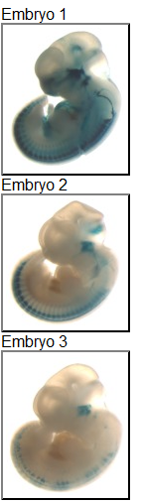
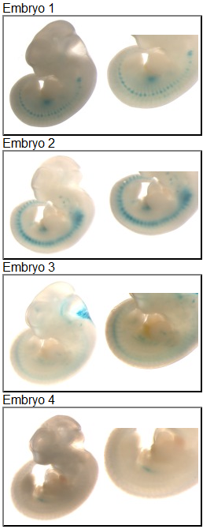
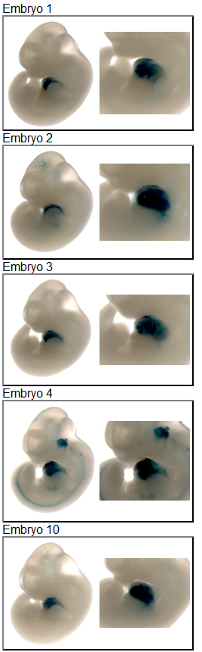
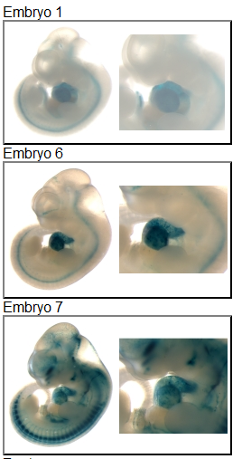
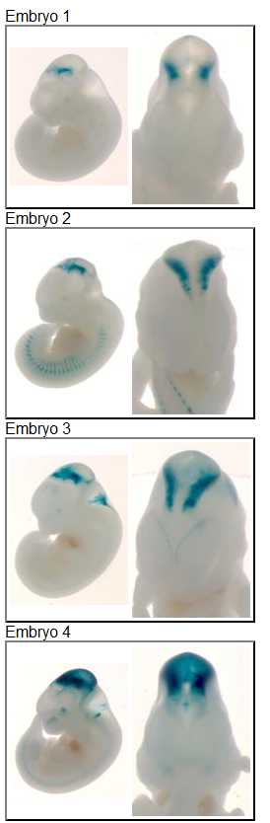
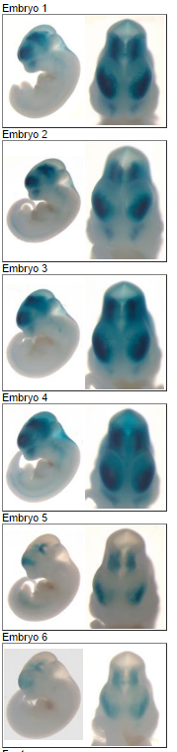
Most mutated VISTA enhancers
El.2082
El.2084
El.1760
El.1886
El.1385
El.1391

