Slide 1







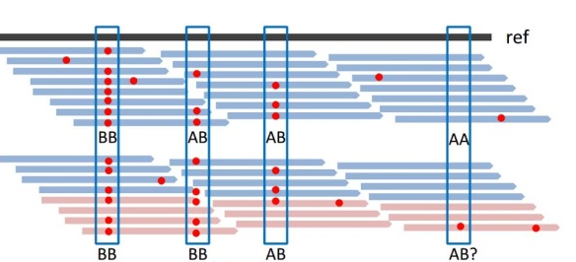

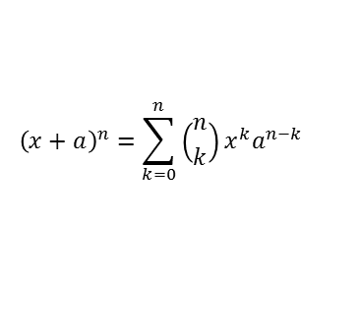
$${\left(x+a\right)}^{n}=\sum_{k=0}^{n}{\left({n \atop k}\right)x^{k}a^{n−k}}$$
Analysis Specific Filters
Databases and
Algorithms
Report
As simple as uploading a file: genomics.scripps.edu/ADVISER/

