Slide 1
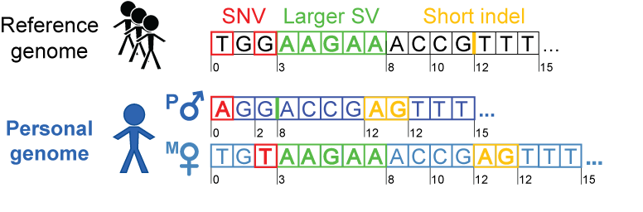
Personal genome construction
Rozowsky et al. Mol Syst Biol (2011)

Slide 2
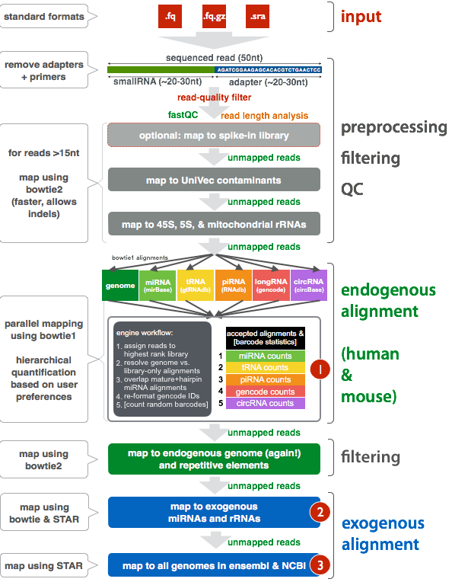
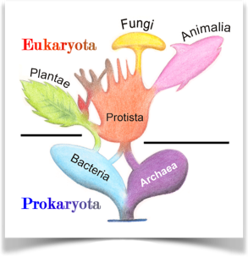
Detecting exogenous
sequences: exceRpt
Input:
sequences that can not be
explained in primary analysis
We can search for evidence of:
5,242 bacteria
52 fungi
40 plants
32 protists
12 vertebrates
5,758 viruses

Slide 3
Subject N
All bacteria
Mostly Propionibacterium
Could be skin contamination (acne)
Subject Z
All bacteria
Mostly Acinetobacter
Prob. laboratory contamination
Subject S
Mostly bacteria
Massive diversity
Likely due to saliva (rather than blood) sample

