Slide 1
Strategy to find polymorphic HERV-K copies, between SubjectZ and the reference
Case 1.
HERVK copy is absent in the reference
Human aligned reads
(BAM) of SubjectZ
List of known HERVK polymorphic loci [1][2]
“Empty site”
in the reference
LTR
HERVK genes
LTR
Case 2.
HERVK copy is present in the reference
Look for
Presence or absence of the HERVK copy
LTR
HERVK genes
LTR
“Empty site”
in SubjectZ genome
→ Homology based search (BLAST, kmer based search) of the junctions or empty sites
→ Visualization of the reads in the UCSC genome browser (thanks: Edward B. Chuong)
Long Terminal Repeats of the HERVH copy
Coding region of the HERVH copy
[1] Macfarlane et al. 2015 Retrovirology
[2] Wildschutte et al 2016, PNAS
Flanking DNA, human reference genome
Flanking DNA, SubjectZ genome
Notes:
The DNA sequence of the flanking DNA + LTR is unique in the genome.
In case 1, this means that there will be no reads with the flanking DNA + the LTR in SubjectZ for this particular location. Therefore, when reads are mapped on the human reference genome, there will be a “hole” in the coverage.
In case 2, this means that there will be no reads with the empty site in them. Therefore, when reads are mapped on the human reference genome, they will be incompletely mapping at the empty site.

Slide 2
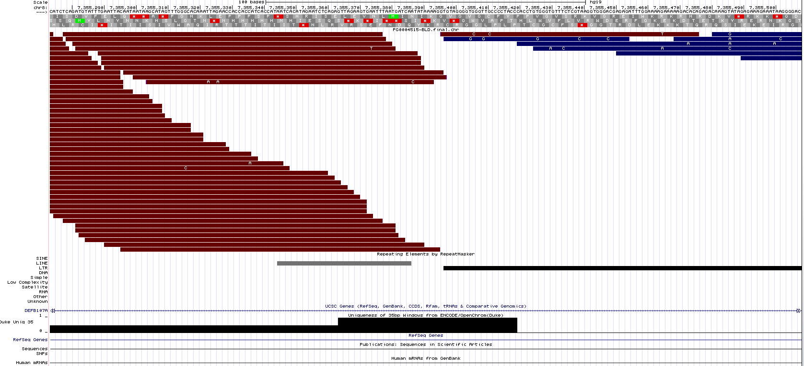
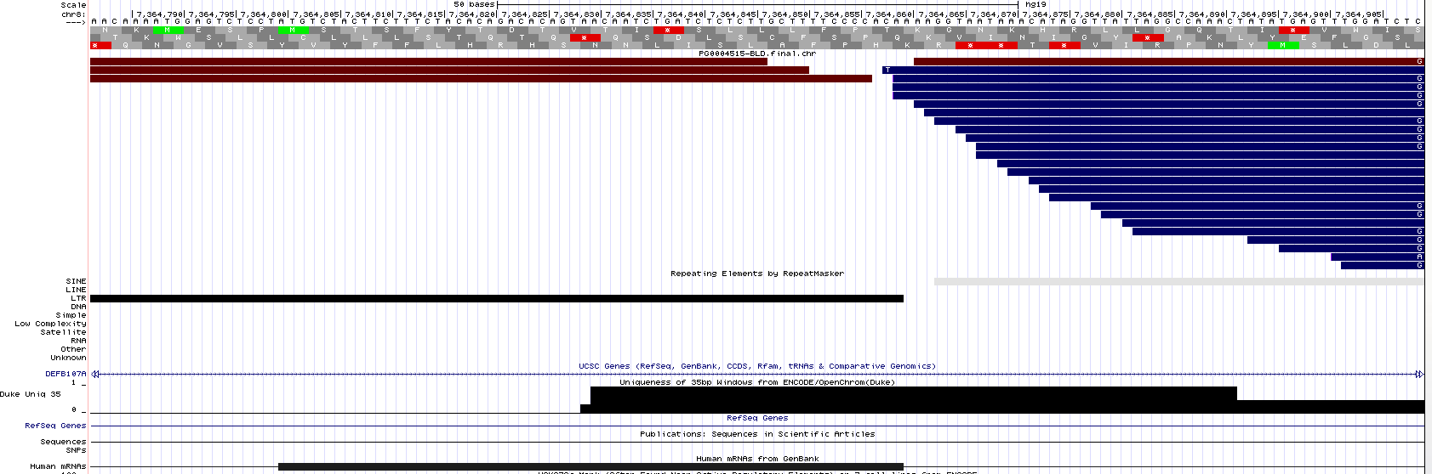
Case 1. HERVK copy is present in the reference
Screenshot of the UCSC genome browser, with reads from SubjectZ loaded as a track (in red and blue)
Ex. Locus 8p23.1a, 5’ is at chr8:7,355,392 in hg19
5’ region: some reads map to the LTR, probably spurious mapping. No read spans the flanking DNA and the LTR.
LTR
MAPPABILITY IS HIGH
MAPPABILITY IS LOW
3’ region: some reads map to the LTR, probably spurious mapping. No read spans the LTR and the flanking DNA
LTR
MAPPABILITY IS LOW
MAPPABILITY IS HIGH
Thanks: Edward B. Chuong

Slide 3
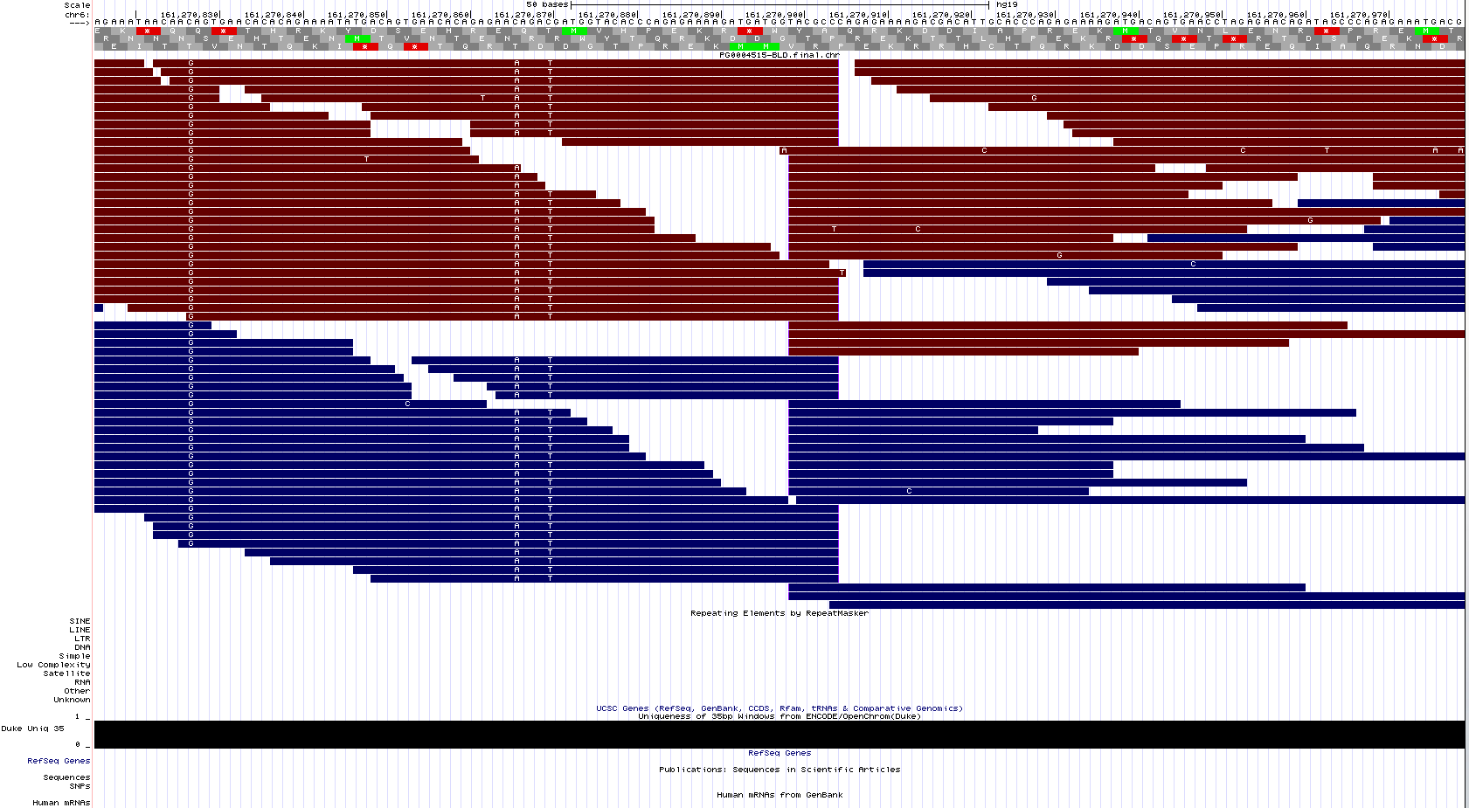
Case 2. HERVK copy is absent in the reference
Screenshot of the UCSC genome browser, with reads from SubjectZ loaded as a track (in red and blue)
Ex. Locus 6q26, at chr6:161,270,899 in hg19
MAPPABILITY IS HIGH
Thanks: Edward B. Chuong

Slide 4


ZIMMEROMME
Supplementary material for Part 12
May 2016
By:
Cédric Feschotte
Aurélie Kapusta
Thanks: Edward B. Chuong

