Slide 1
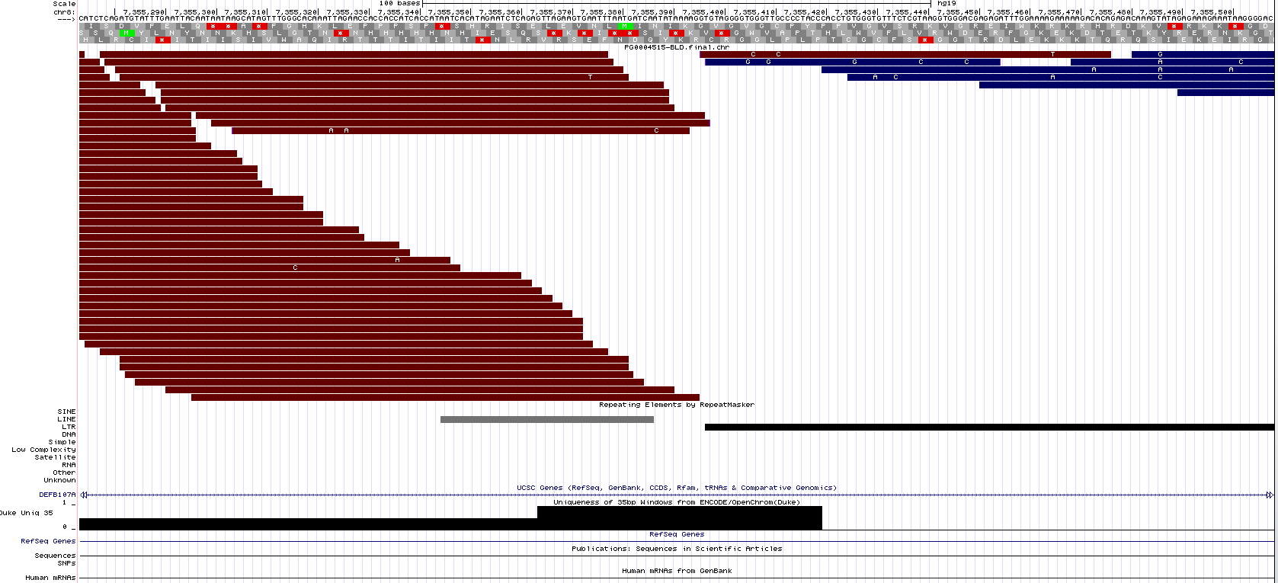
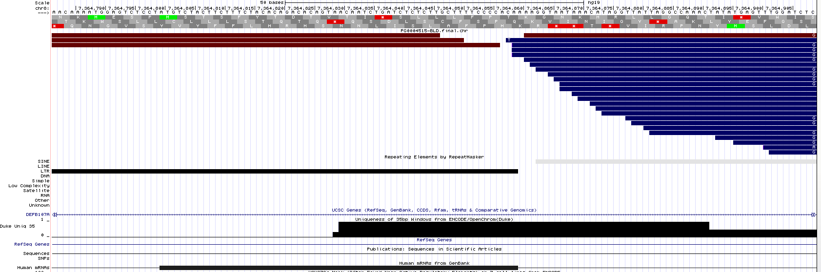
Case 1. HERVK copy is present in the reference
Screenshot of the UCSC genome browser, with reads from SubjectZ loaded as a track (in red and blue)
Ex. Locus 8p23.1a, 5’ is at chr8:7,355,392 in hg19
5’ region: some reads map to the LTR, probably spurious mapping. No read spans the flanking DNA and the LTR.
LTR
MAPPABILITY IS HIGH
MAPPABILITY IS LOW
3’ region: some reads map to the LTR, probably spurious mapping. No read spans the LTR and the flanking DNA
LTR
MAPPABILITY IS LOW
MAPPABILITY IS HIGH
Thanks: Edward B. Chuong

Slide 2
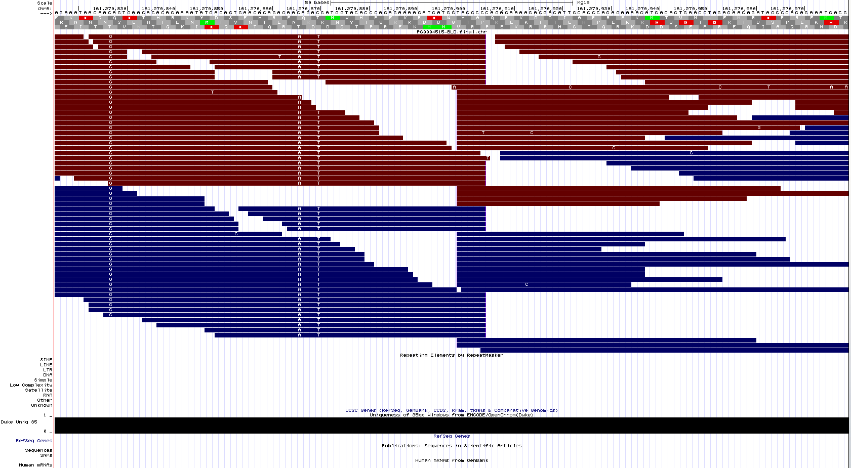
Case 2. HERVK copy is absent in the reference
Screenshot of the UCSC genome browser, with reads from SubjectZ loaded as a track (in red and blue)
Ex. Locus 6q26, at chr6:161,270,899 in hg19
MAPPABILITY IS HIGH
Thanks: Edward B. Chuong

Slide 3
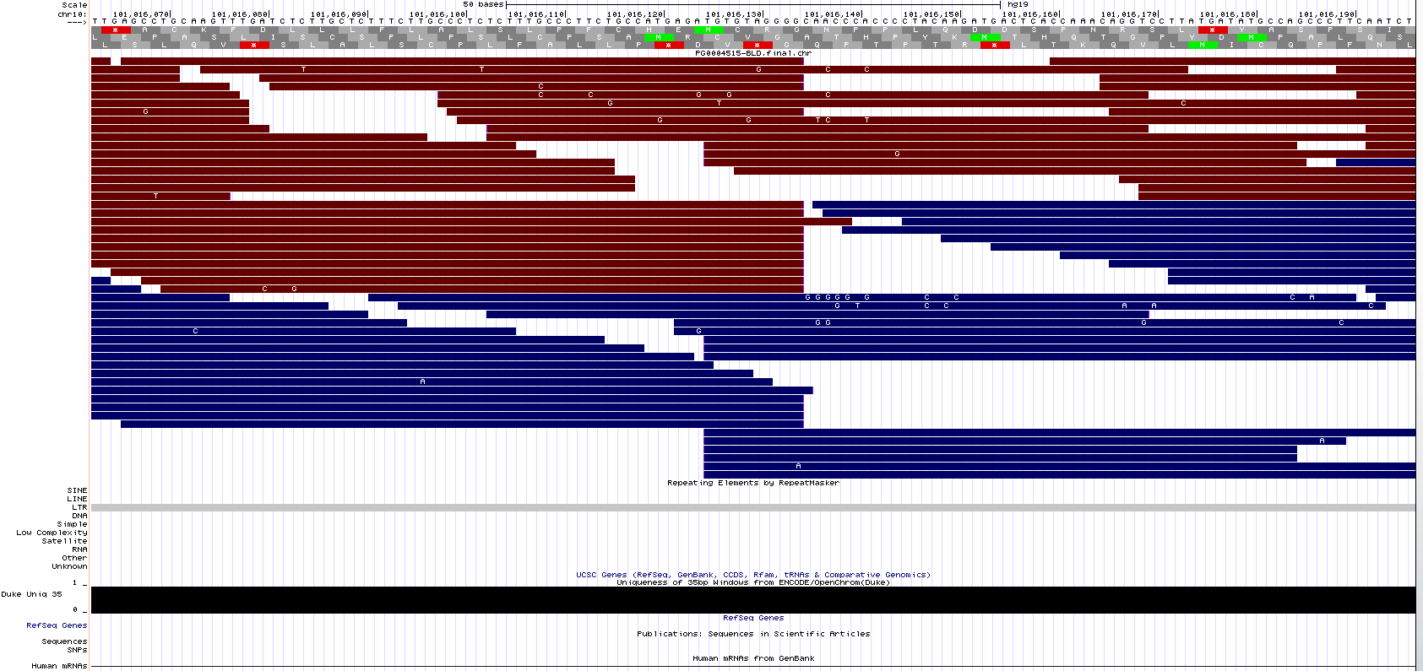
Case 2. HERVK copy is absent in the reference
Screenshot of the UCSC genome browser, with reads from SubjectZ loaded as a track (in red and blue)
Ex. Locus 10q24.2b, at chr10:101,016,122 in hg19
MAPPABILITY IS HIGH
Thanks: Edward B. Chuong

Slide 4
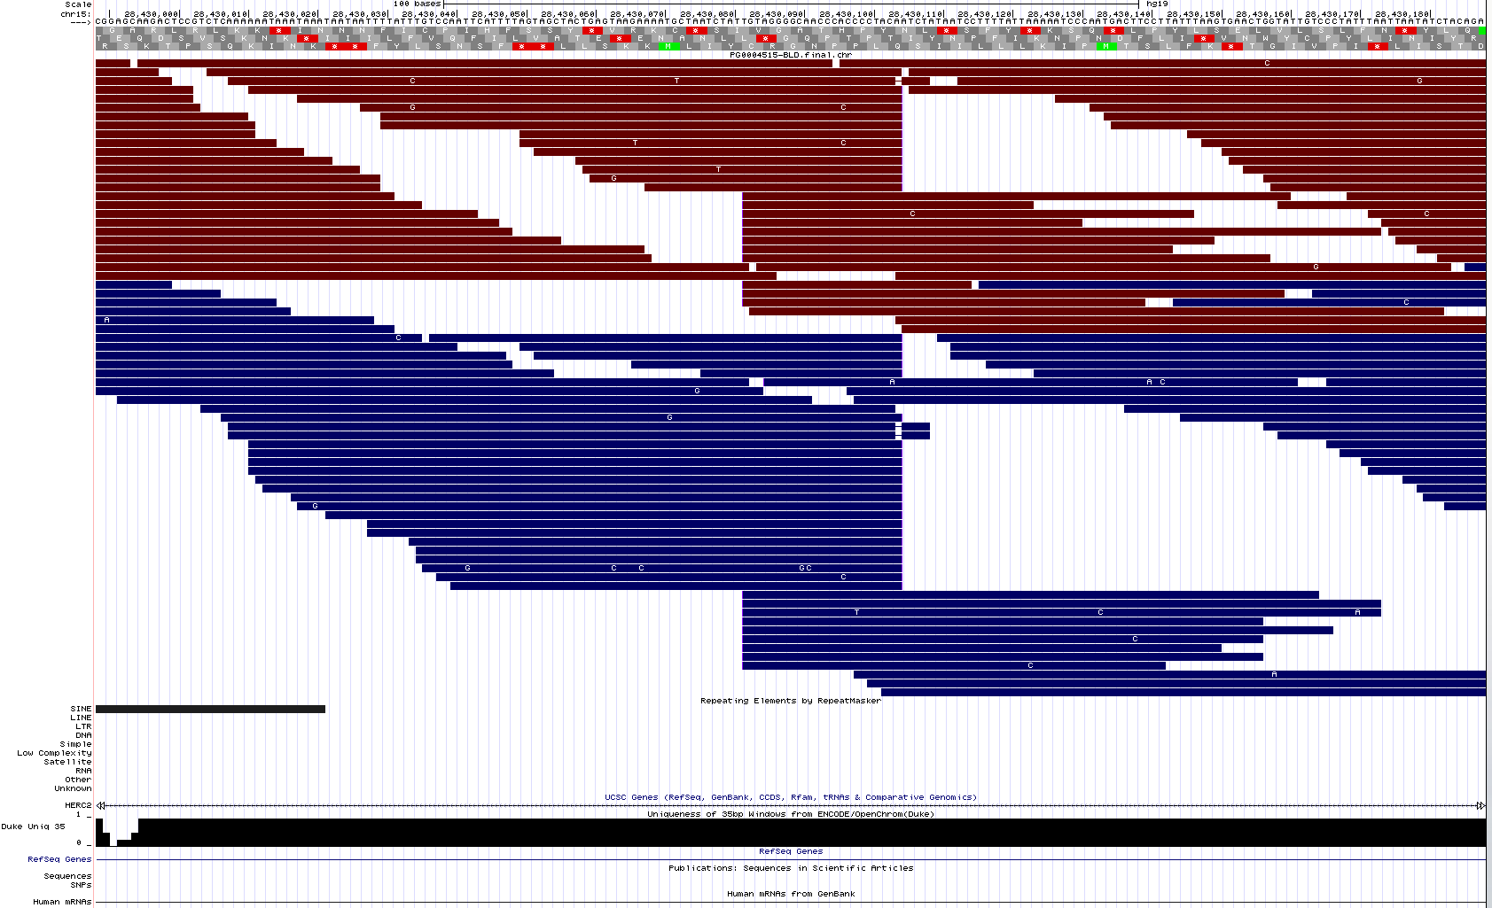
Case 2. HERVK copy is absent in the reference
Screenshot of the UCSC genome browser, with reads from SubjectZ loaded as a track (in red and blue)
Ex. Locus 15q13.1, at chr15:28,430,088 in hg19
MAPPABILITY IS HIGH
Thanks: Edward B. Chuong

Slide 5
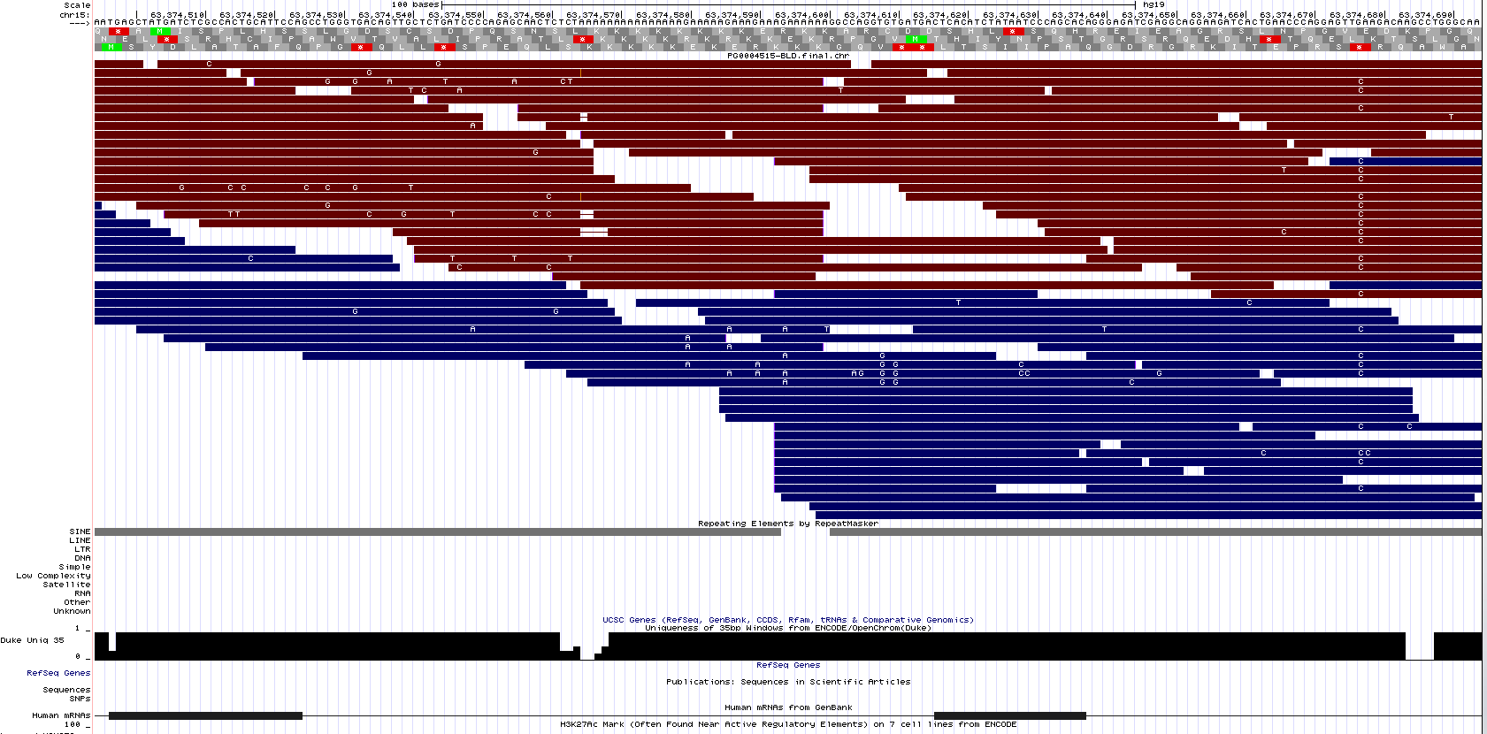
Case 2. HERVK copy is absent in the reference
Screenshot of the UCSC genome browser, with reads from SubjectZ loaded as a track (in red and blue)
Ex. Locus 15q22.2, at chr15:63,374,594 in hg19
MAPPABILITY IS HIGH
Thanks: Edward B. Chuong

Slide 6
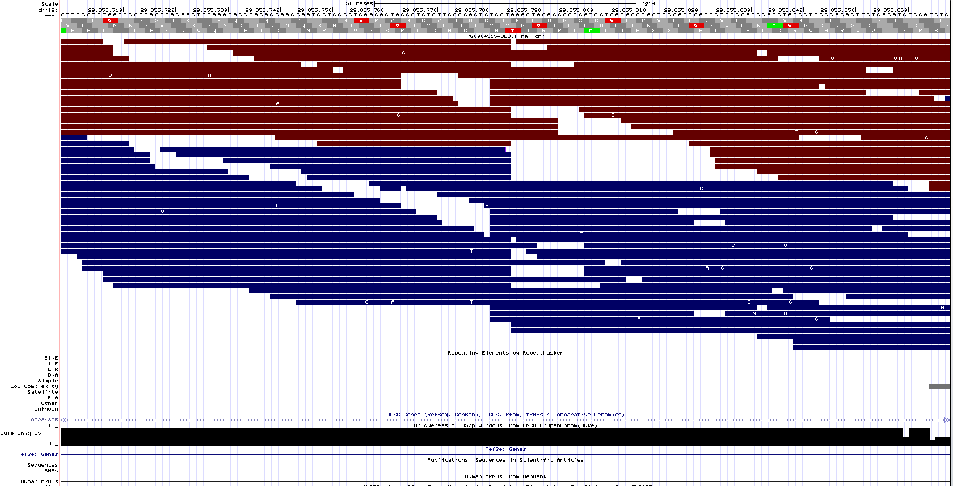
Case 2. HERVK copy is absent in the reference
Screenshot of the UCSC genome browser, with reads from SubjectZ loaded as a track (in red and blue)
Ex. Locus 19q12, at chr19:29,855,781 in hg19
MAPPABILITY IS HIGH
Thanks: Edward B. Chuong

Slide 7


ZIMMEROMME
Supplementary material for Part 12
May 2016
By:
Cédric Feschotte
Aurélie Kapusta
Thanks: Edward B. Chuong

